Slide 1
Hypertension scenario cases FM review course 2019
Dr. Dalia Alsanea
Consultant Family Medicine
Head of Surra Clinic, Capital Health District, M.O.H
Trainer & Examiner at FMRP, KIMS
Head of OSCE exam committee, FMRP

Slide 2
Case 1
Mrs. Esraa

Slide 3
Case 1
Presentation
Mrs. Esraa is a fit 41-year-old Kuwaiti, architect in private office.
Today came to the clinic for follow-up in CD clinic for hypothyroid.
Clinically she is euthyroid, Last TFT normal 3/2019.
There are no other medical illnesses.
She never smoke.

Slide 4
Case 1
Physical exam:
Height of 154 cm, weight of 67 Kg, BMI 28.3
Blood pressure of 146/88 mmHg, and a regular pulse of 76 beats/min.

Slide 5
Case 1
What is next?
Not known to have hypertension.
Last BP recorded in the file 120/70 mmHg (12/2017)
What is next?
Proper checking, how?
Notes:
Check record: Last BP recorded in the file 120/70 mmHg (12/2017)

Slide 6
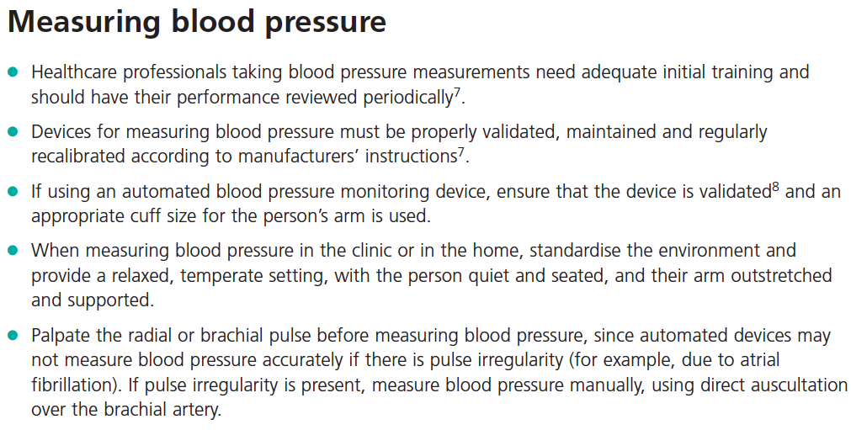
Notes:
Select a cuff size based on arm circumference
The ideal cuff bladder length is ≥80% of the patient’s arm circumference.
The ideal cuff bladder width is ≥40% of the patient’s arm circumference.

Slide 7
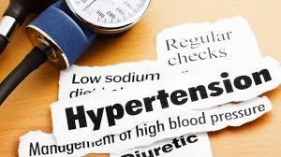
Case 1
Proper BP measuring is ensured.
The next Q is ?
Is she hypertensive?

Slide 8
Case 1
When considering a diagnosis of hypertension, measure BP in both arms.
If the difference in readings between arms is >20 mmHg, repeat the measurements.
If the difference in readings remains >20 mmHg, measure subsequent blood pressures in the arm with the higher reading.
If BP measured in the clinic ≥140/90 mmHg:
Take a second measurement during the consultation.
If the second measurement is substantially different from the first, take a third measurement.
Record the lower of the last two measurements as the clinic BP.

Slide 9
Case 1
Mrs Esraa 2nd BP reading with proper measuring method is 144/90, no difference between both arms. What to do next?
Initiate low dose anti-HTN therapy
Initiate high dose anti-HTN therapy
Reassure the patient
Arrange for further assessment
Annual follow-up for clinic BP

Slide 10
Which stage of htn
Stage 1 hypertension | Clinic BP ≥140/90 mmHg and subsequent ABPM daytime average or HBPM average ≥135/85 mmHg.
Stage 2 hypertension | Clinic BP ≥160/100 mmHg and subsequent ABPM daytime average or HBPM average ≥150/95 mmHg.
Severe hypertension | Clinic systolic BP ≥180 mmHg or clinic diastolic BP ≥110 mmHg.

Slide 11
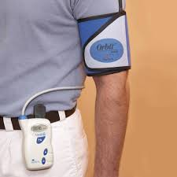
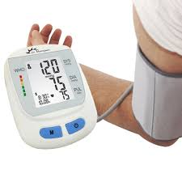
Diagnosing hypertension
If the clinic BP ≥140/90 mmHg, offer ambulatory blood pressure monitoring (ABPM) to confirm the diagnosis of hypertension.
If a person is unable to tolerate ABPM, home blood pressure monitoring (HBPM) is a suitable alternative.
If the person has severe hypertension, consider starting antihypertensive drug treatment immediately, without waiting for the results of ABPM or HBPM.

Slide 12
Case 1
You were unable to confirm the diagnosis with ABPM because she refused it because as it would interfere with her daily activities. What alternative test could you have used to diagnose hypertension?
Home blood pressure monitoring (HBPM).
Daily BP checking in the clinic.
No need to confirm at the mean time.
Insist to do ABPM.
A or B
Notes:
If a person is unable to tolerate ABPM, home blood pressure
monitoring (HBPM) is a suitable alternative to confirm the diagnosis of
hypertension.

Slide 13
Case 1
Question 2:
When instructing Mrs. Esraa in how to use HBPM, what instructions did you have to give her and what measurements would you base your diagnosis on?
Notes:
When using HBPM to confirm a diagnosis of hypertension, ensure
that:
for each blood pressure recording, two consecutive
measurements are taken, at least 1 minute apart and with the
person seated and
blood pressure is recorded twice daily, ideally in the morning and
evening and
blood pressure recording continues for at least 4 days, ideally for
7 days.
Discard the measurements taken on the first day and use the average
value of all the remaining measurements to confirm a diagnosis of
hypertension.

Slide 14
HBPM
When using HBPM:
2 measurements are taken at least 1 minute apart and
BP is recorded twice daily, morning and evening and
BP recording continues for at least 4 days, ideally for 7 days.
Discard the measurements taken on the first day and use the average value of all the remaining measurements.

Slide 15
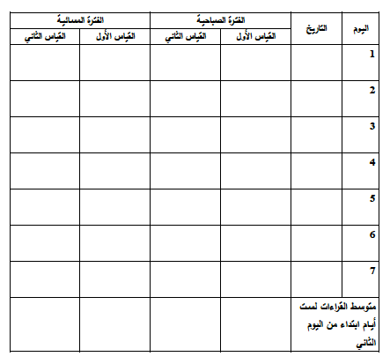

Slide 16
Mrs. Hadeel agreed for 1 week HBPM.
While waiting to confirm the diagnosis, carry out investigations for target organ damage and a formal assessment of cardiovascular risk.
What?

Slide 17
investigations

Slide 18
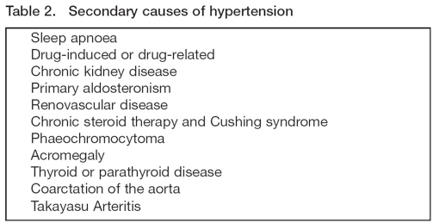
Types of thn
Primary HTN:
also known as essential HTN.
accounts for 95% cases of HTN.
no universally established cause known.
Secondary HTN:
less common cause of HTN ( 5%).
secondary to other potentially rectifiable causes (Renal, Endocrine, Vascular, Pregnancy related & Drug induced).

Slide 19
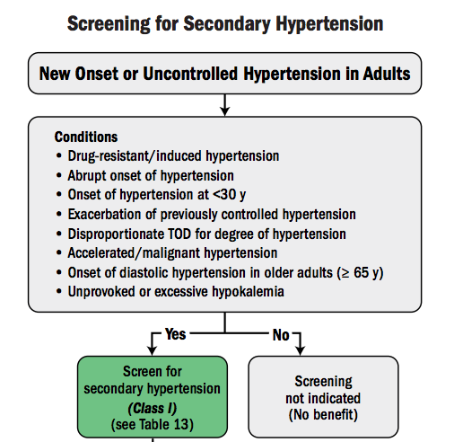
Case 1
What type of hypertension the patient may have, most likely?

Slide 20
Secondary causes of hypertension?
For patients <40 years with stage 1 hypertension and no evidence of target organ damage, cardiovascular disease, renal disease or diabetes, consider specialist referral to exclude secondary causes.
Specific investigations for a suspected secondary cause:
24-hour urinary metanephrines.
Urinary free cortisol and/or dexamethasone suppression test.
Renin/aldosterone levels.
Plasma calcium.
Magnetic resonance imaging of the renal arteries.

Slide 21
Initial visit
Confirm the diagnosis of HTN
Stage the hypertension
Role out 2ry causes
Assess end organ damage
Assess other CV risk factors
Assess CVD 10-year risk
Management plan

Slide 22
End organ damage
Brain : TIA, stroke, vascular demntia
Heart :
1- symptoms of failure or ECG strain
2- angina, MI or other coronary disease
Eye : fundal hemorrahge or papilloedema
Kidney : protienuria, renal failure
Peripheral vascular disease : claudication

Slide 23
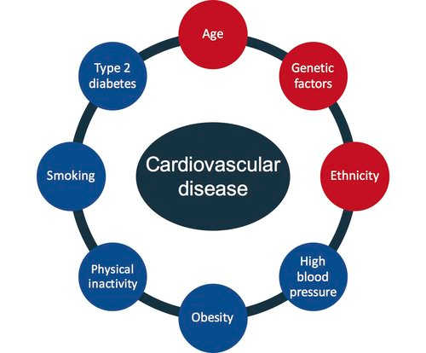
Assess CVD risk

Slide 24
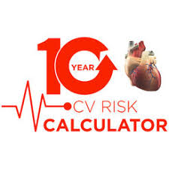
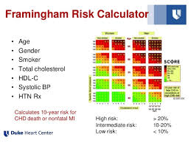
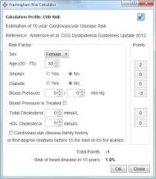
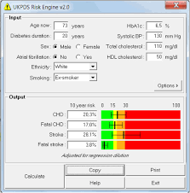
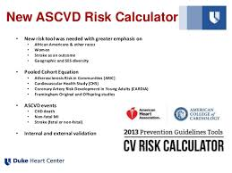
Assess 10-yr cv risk
Use any validated CV risk assessment tool:
ASCVD, Framingham risk assessment, Q risk, UKPDS, …. Etc..

Slide 25
10-yr cvd risk
Notes:
What do we mean by very high risk ?
Established CV disease (cardiac, stroke), stage 4 Renal disease, diabetic with organ damage.

Slide 26
Q risk
Notes:
What is the difference between QRISK®2 and the traditional Framingham score?
The QRISK®2 score contains many of the traditional risk factors included in Framingham (such as age, sex, cholesterol/HDL ratio blood pressure, diabetes and smoking status) but also contains important additional risk factors:
Self-assigned ethnicity
Family History of premature coronary heart disease in a first degree relative under the age of 60
Deprivation (measured using the Townsend deprivation score)
Blood Pressure Treatment
Body Mass Index
Rheumatoid Arthritis
Chronic Kidney Disease
Atrial Fibrillation

Slide 27
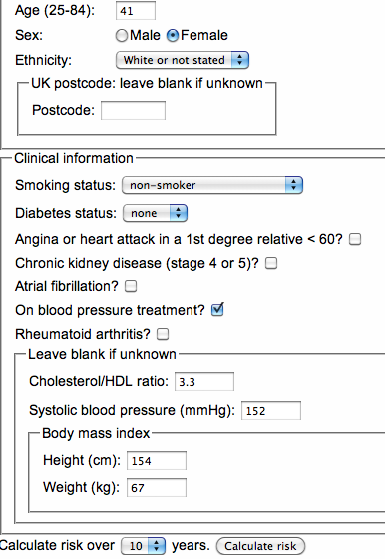
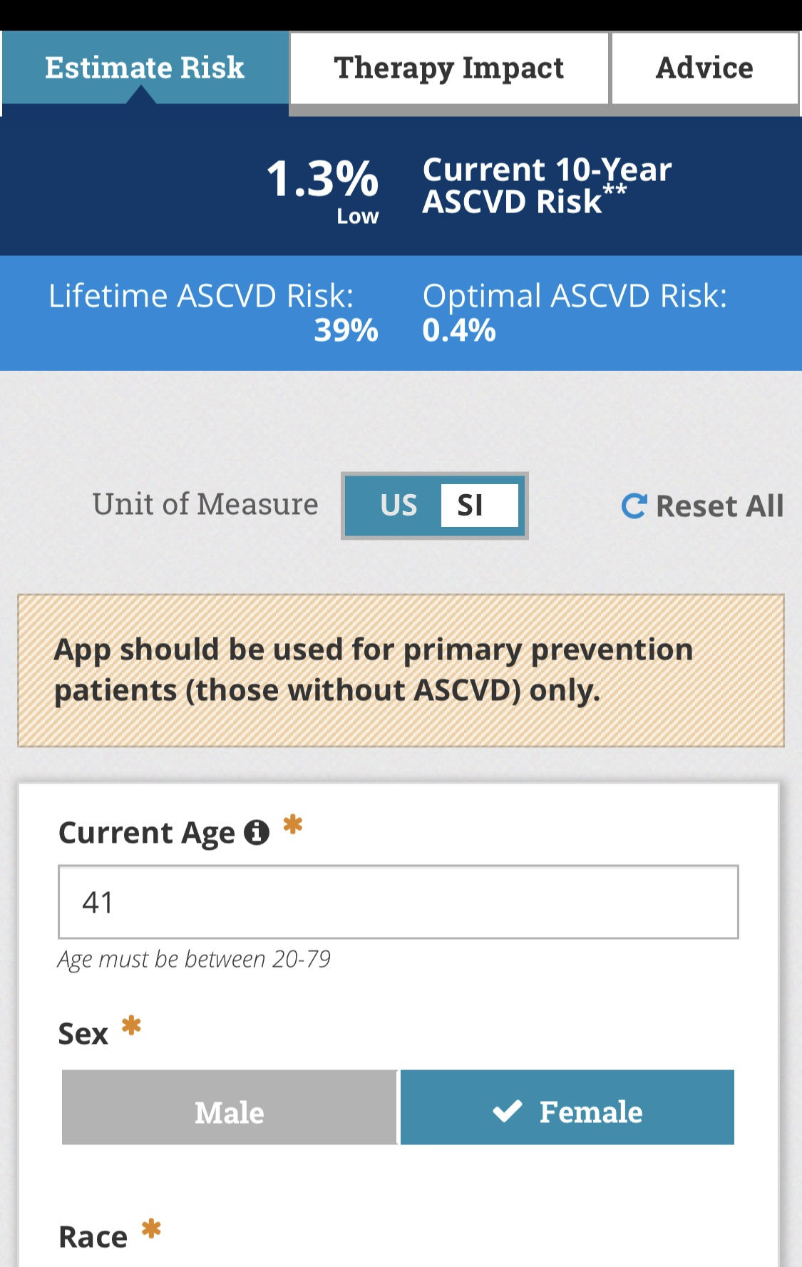
Notes:
Since Lifetime Risk it is a new measure, there are no established thresholds for defining high risk and by implication, people who might be suitable for risk reducing interventions like blood pressure treatment or statins. Therefore, we have selected the cut off which identifies the top 10% highest risk patients. This threshold is a lifetime risk of 50% which means that 10% of the population will have a Lifetime Risk greater than 50%
Current guidelines tend to define high risk as a 10 year CVD risk of greater than 20%.
The threshold is fixed regardless of the patient's age.

Slide 28
Case 1
Question 1:
How would you grade her cardiovascular risk level?
Low risk (<10%)
Moderate risk (10-20 %)
High risk (>20%)
Very high risk
Not enough given data to calculate it
Notes:
What is the difference between QRISK®2 and the traditional Framingham score?
The QRISK®2 score contains many of the traditional risk factors included in Framingham (such as age, sex, cholesterol/HDL ratio blood pressure, diabetes and smoking status) but also contains important additional risk factors:
Self-assigned ethnicity
Family History of premature coronary heart disease in a first degree relative under the age of 60
Deprivation (measured using the Townsend deprivation score)
Blood Pressure Treatment
Body Mass Index
Rheumatoid Arthritis
Chronic Kidney Disease
Atrial Fibrillation

Slide 29
Case 1
Mrs. Esraa came back in 2 weeks follow-up visit.
Her BP today is 148/90, pulse 80.
Her recent lab tests: Electrolytes, FBC, lipids, glucose and uric acid tests are normal.
Recent ECG was normal too.
What do you want to ask for?
Average HBPM 144/88

Slide 30
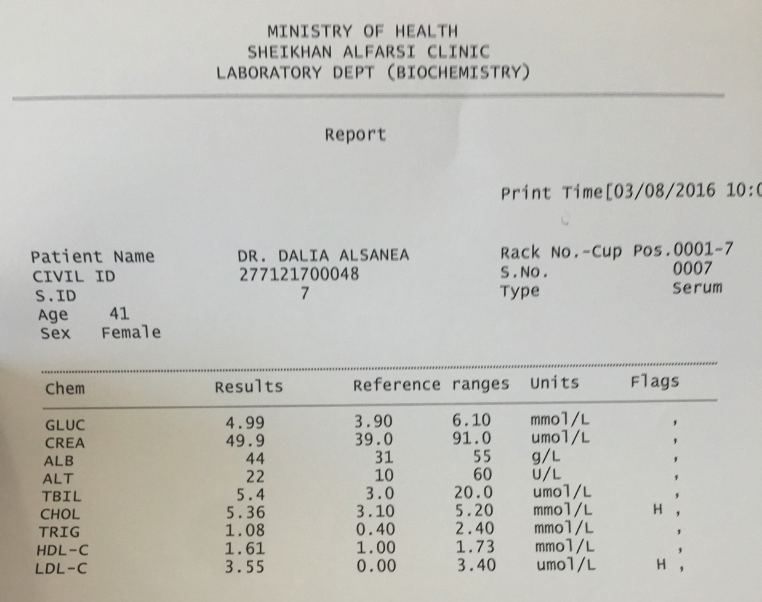
Case 1
Laboratory:

Slide 31
Case 1
What is the best next action?
Start anti-HTN therapy
Repeat HBPM for 1 week
Start lifestyle measures
Refer to hospital
Annual follow-up

Slide 32
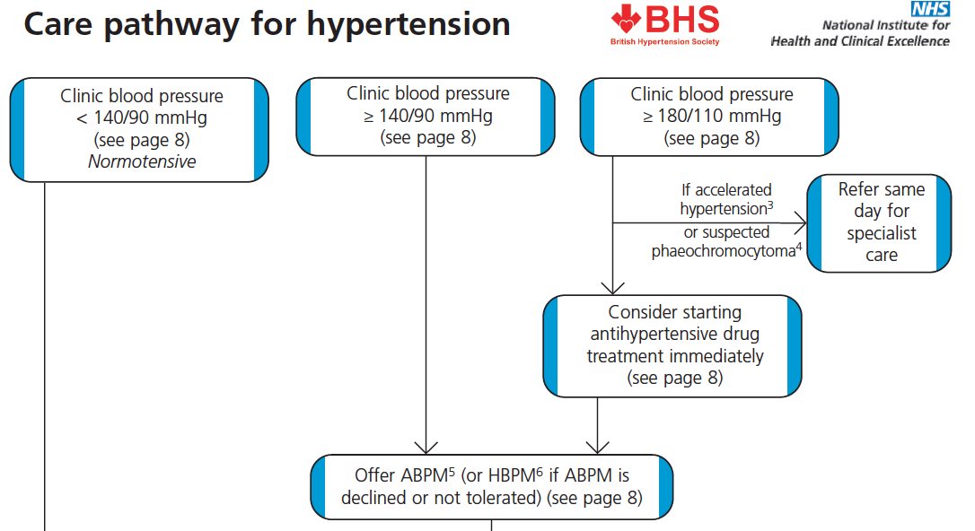

Slide 33
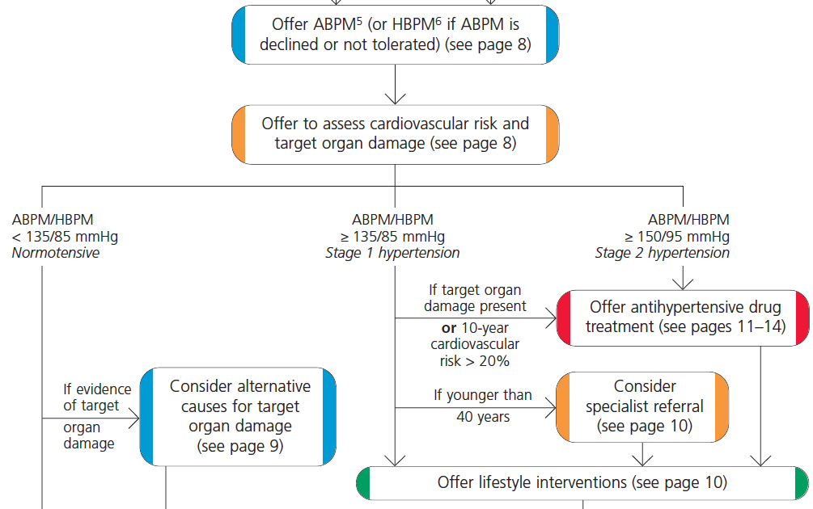

Slide 34
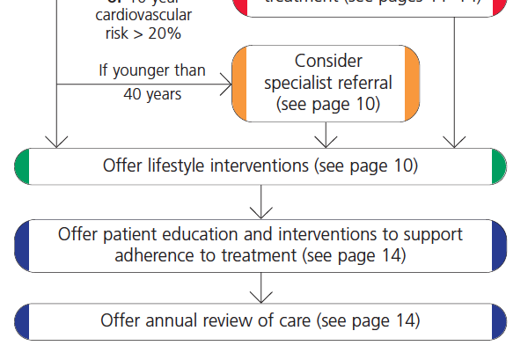

Slide 35
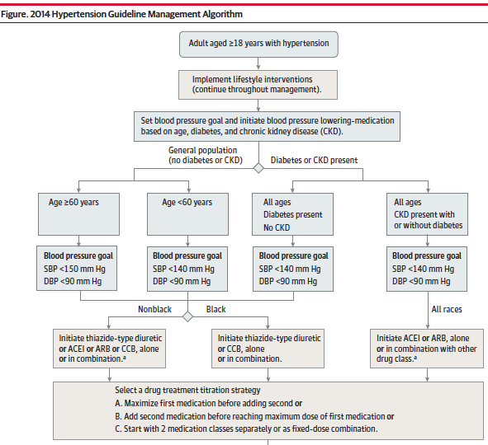

Slide 36
Case 1
What is the best next action?
Start anti-HTN therapy
Repeat HBPM for 1 week
Start lifestyle measures
Refer to hospital
Annual follow-up

Slide 38
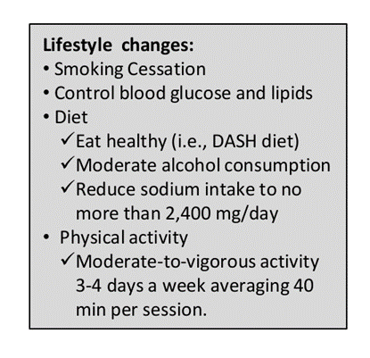
Life style:
Patient education and adherence
information about benefits of drugs and side effects
an annual review of care.

Slide 39
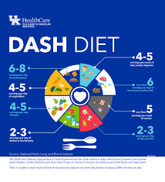

Slide 40
Life style:

Slide 41
Case 1
After 1 year, the patient came for a visit and she was compliant to lifestyle. Her average HBPM 160/92. BP in clinic is 165/92. You choose to write a prescription, which agent would be your add on choice?
ACE inhibitor
Beta blocker
Calcium channel blocker
Thiazide diuretic
Angiotensin II receptor antagonist

Slide 42
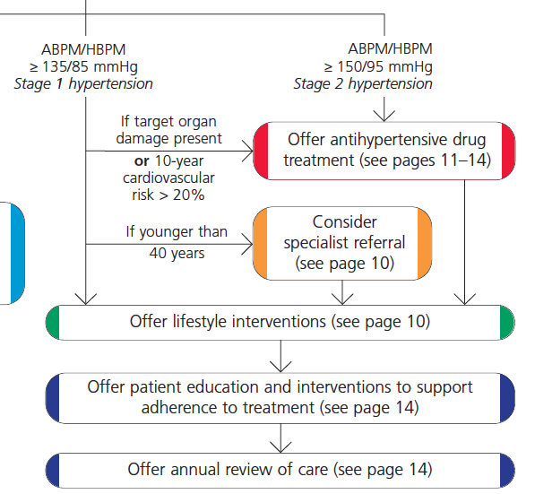

Slide 43
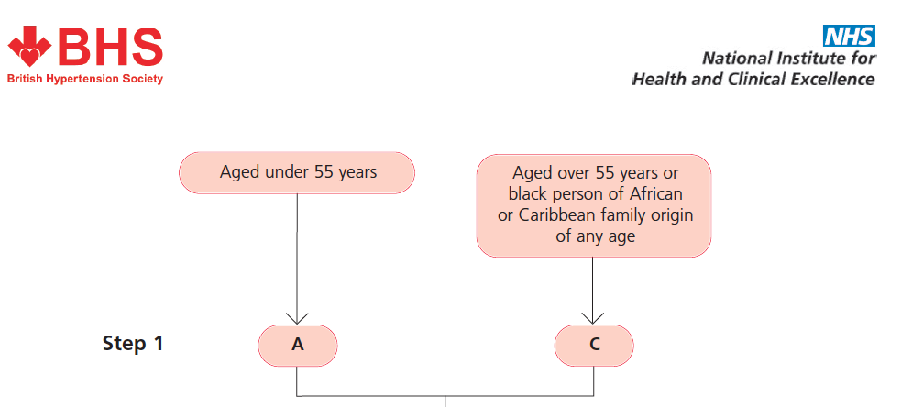

Slide 46
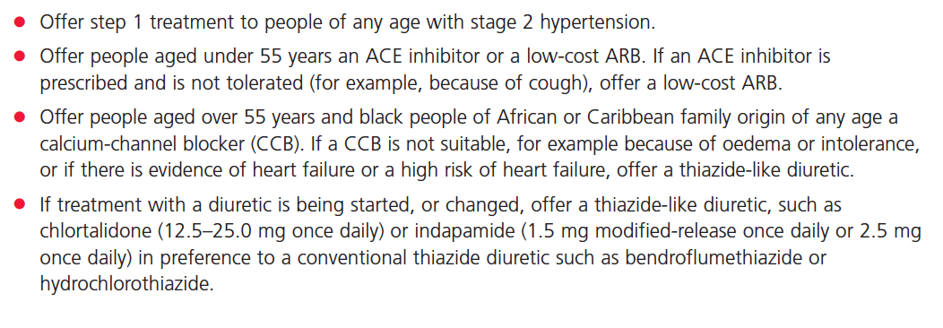

Slide 48
Case 1
What would you regard as an appropriate blood pressure response for clinic BP measures?
< 130/80 mmHg
< 140/90 mmHg
130/80 mmHg to 140/90 mmHg
140/80 mmHg to 140/90 mmHg
> 140/85 mmHg

Slide 49
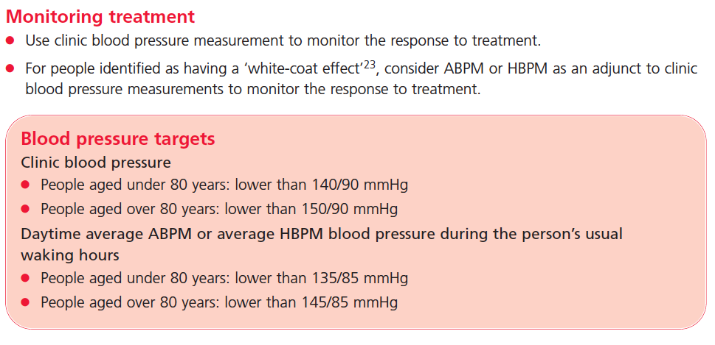

Slide 51
Case 1
Mrs. Esraa agreed to start Lisinopril (zestril) 10mg OD in the morning, along side with lifestyle modifications.
Follow-up visit (2 weeks):
HBPM average 158/90 mmHg
Clinic BP 162/90 mmHg
What to do next?
Notes:
Request RFT (K and creatinin)
Check adherence
Add another or increase the dose

Slide 52
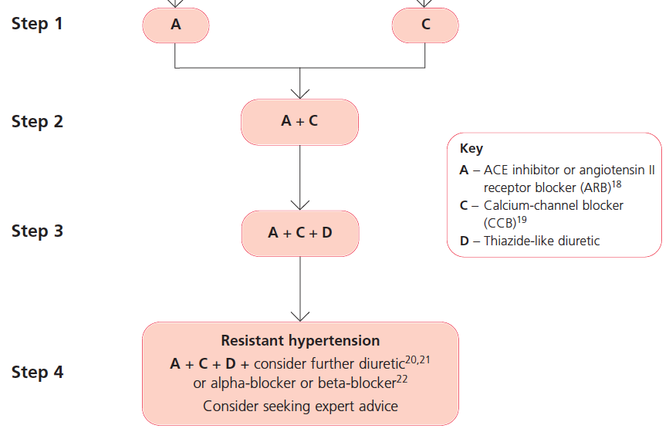

Slide 53
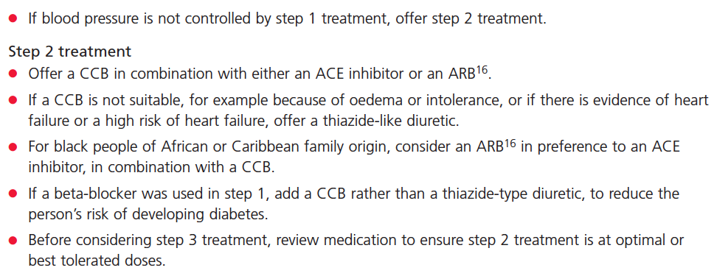

Slide 55
Case 1
If you choose to write a prescription, which agent would you choose as add-on therapy?
ACE inhibitor
Beta blocker
Calcium channel blocker
Thiazide diuretic
Angiotensin II receptor antagonist

Slide 56
Case 1
The patient agreed to add amlodipine (norvasc) 5mg OD night time to her current medication.
Mrs. Esraa came back in 2 months follow-up visit, she HBPM average is about 150/88. Her BP today is 154/90, pulse 76.
Her recent lab tests: Electrolytes, FBC, lipids, glucose and uric acid tests are normal.
What to do next?

Slide 57
Case 1
What is the main cause of her uncontrolled hypertension?
Non compliance to medication
Non compliance to lifestyle measures
Denial of the disease
Depression
White-coat hypertension

Slide 58
Case 1
The screening of depression showed mild score in PHQ-9 testing.
The white coat hypertension is ruled out by comparing the home readings to clinic measures.
Mrs. Esraa admitted poor compliant to night dose Rx.

Slide 59
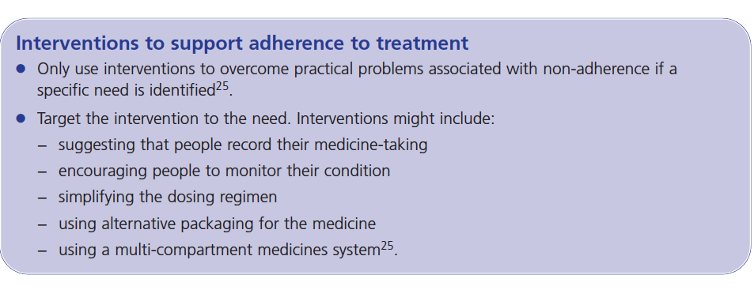

Slide 60
Case 1
What is your next
measure to overcome
this obstacle?

Slide 61
Case 1
The patient was asked to take both tablets together in the morning.
Mrs. Esraa came back in 2 months follow-up visit, she looked unhappy with her hypertension. Her BP today is 144/90, pulse 78.
What to do next?

Slide 63
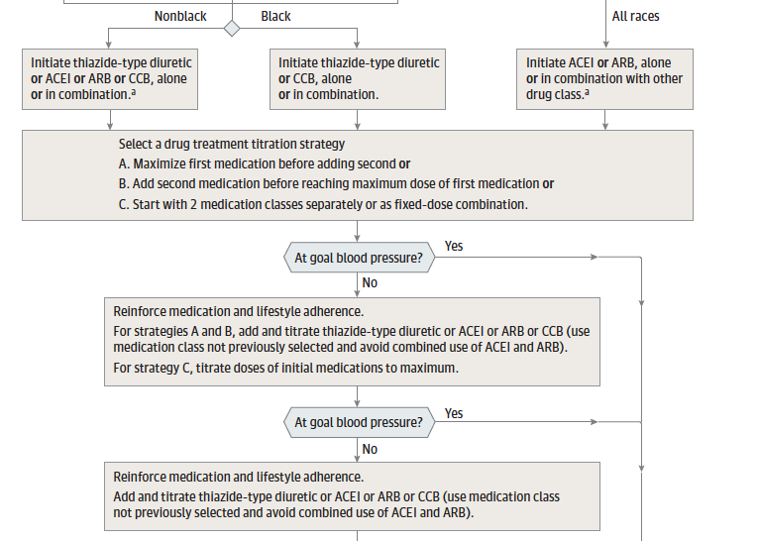

Slide 64
CASE 1
Ms Esraa was very happy of reaching average HBPM of 132/76 and clinic BP of 134/76 after adding natrilix SR (indapamide) for 2 months.
What is her F/U plan?

Slide 65
Case 2
Mr. Mahmoud

Slide 66
Case 2
Mr. Mahmoud is a 53-year-old Kuwaiti retired teacher, who has been diagnosed with stage 2 hypertension. You confirmed diagnosis one month ago.
At diagnosis and assessment his clinic blood pressures was 176/108 mmHg.
No other CV risks or medical H of significant.
Additionally, you identified the following changes in the ECG.

Slide 67
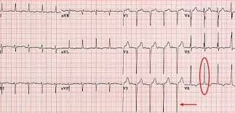
The diagnosis is?
Notes:
Lt axis deviation, QRS complex wide slightly, ST depression, inverted T waves, R waves summation is about

Slide 68
Case 2
Mr. Mahmoud clinic blood pressures is 176/108 mmHg with left ventricular hypertrophy changes on ECG.
Which stage of hypertension?
Stage 2
What medication was started on?
How to confirm the diagnosis?
HBPM or ABPM

Slide 69
Case 2
Mr. Mahmoud agreed on using ABPM. When instructing Mr. Mahmoud in how to use ABPM, what instructions did you have give him and what measurements would you base your diagnosis on?

Slide 70
Mr. Mahmoud is a 53-year-old Kuwaiti retired teacher, who has been diagnosed with stage 2 hypertension. You confirmed diagnosis one month ago.
At diagnosis and assessment his clinic blood pressures was 176/108 mmHg.
Additionally, you identified left ventricular hypertrophy on ECG.

Slide 71
Case 2
After 1 week:
The average ambulatory blood pressure results was 155/97 mmHg. With this result you noted that Mahmoud had a (white-coat effect). However despite this, his ABPM measurements indicated a diagnosis of stage 2 hypertension and he had target organ damage.

Slide 72
Which stage of htn
Stage 1 hypertension | Clinic BP ≥140/90 mmHg and subsequent ABPM daytime average or HBPM average ≥135/85 mmHg.
Stage 2 hypertension | Clinic BP ≥160/100 mmHg and subsequent ABPM daytime average or HBPM average ≥150/95 mmHg.
Severe hypertension | Clinic systolic BP ≥180 mmHg or clinic diastolic BP ≥110 mmHg.

Slide 73
Case 2
What drug regimen would you have offered Mr. Mahmoud?
ACE inhibitor
Beta blocker
Calcium channel blocker
Thiazide diuretic
Angiotensin II receptor antagonist

Slide 74
Case 2
Mr. Mahmoud has returned to you with the results of his monitoring HBPM. During the past week, his average blood pressure was 150/94 mmHg.
What is the target blood pressure for him?
When monitoring response to treatment, which method is preferred ?
His blood pressure is not controlled so you would offer him step 2 treatment with a calcium-channel blocker in addition to his current ACE inhibitor.

Slide 75
Case 2
When he returns to you 1 month later, Mr. Mahmoud HBPM result is still above 140/90 mmHg. What would you do next?
Double the dose of ACE-I
Double the dose of CCB
Add B blocker
Add thiazide diuretic
Refer to specialist

Slide 76
Case 2
Adherence to medication regimen is ensured.
You would offer the patient a thiazide-like diuretic in addition to his ACE inhibitor and calcium-channel blocker.
Mr Mahmoud returns to your clinic and his blood pressure is still not controlled.
You conclude that he is adherent to his medication regime and that he is on the optimal doses of the ACE inhibitor, calcium channel blocker and thiazidelike diuretic. What would you do next?

Slide 77
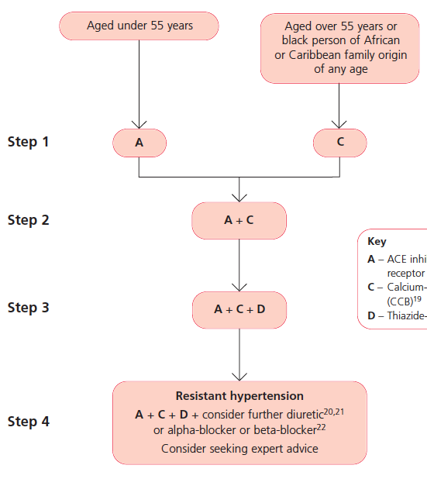

Slide 78
Case 2
Refer to specialist.

Slide 79
Case 3
Mr. Jamal

Slide 80
Case 3
Mr. Jamal is a 57-year-old Kuwaiti man with type 2 diabetes first diagnosed 2 years ago.
Other medical problems include obesity and hypercholestrlemia. He has a history of heavy alcohol use but quit drinking alcohol 2 years ago. He presents now for routine follow-up and is noted to have a blood pressure of 168/100 mmHg. He is asymptomatic.
Drug H: metformin 2 gm/day, saxagliptin (onglyza) 5mg, atorvastatin (lipitor) 20mg, aspirin 81mg, insulin glargine (lantus) 20 U.

Slide 81
Case 3
Physical exam:
Height of176 cm, weight of 110 Kg, BMI 36%, blood pressure of 168/100 mmHg, and a regular pulse of 84 beats/min.
There is no clinical evidence of congestive heart failure or peripheral vascular disease.

Slide 82
Case 3
Laboratory:
Evaluation reveals blood urea nitrogen of 14 mg/dl, serum creatinine of 120 mmol/L, HbA1c 7.8, normal electrolytes, and normal thyroid-stimulating hormone levels.
Urine microalbumin 88/96 (4 months apart)
Urine/Creatinin ration (ACR) 106

Slide 83
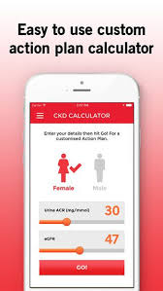
Case 3
What is the calculated eGFR depends on?
What is the calculated eGFR?
57.5
Notes:
Depends on gender, age, body surfeace area (Ht, wt), creatinin

Slide 84
Case 3
What stage of renal disease DKD does the patient have?
Stage I
Stage II
Stage III
Stage IV
Stage V

Slide 86
Case 3
What is the option of treatment you want to add, if you choose to do so?
ACE inhibitor
Beta blocker
Calcium channel blocker
Thiazide diuretic
Angiotensin II receptor antagonist

Slide 88
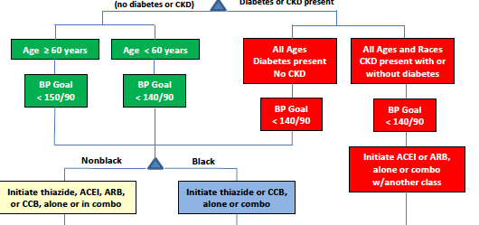

Slide 89
RECOMENDATIONS

Slide 90
Case 3
Mr. Jamal came back for follow-up in 2 months, being regular on ARB daily.
He has not experienced any S/E of the medication. His clinic BP today is 148/96, pulse 80.
His recent lab tests: Electrolytes, FBC, lipids, glucose and uric acid tests are all normal.
A recent test reveals an ACR 102.

Slide 91
Case 3
If you choose to write a prescription, which agent would be your add on choice?
ACE inhibitor
Beta blocker
Calcium channel blocker
Thiazide diuretic
Increase dose of Angiotensin II receptor antagonist

Slide 92
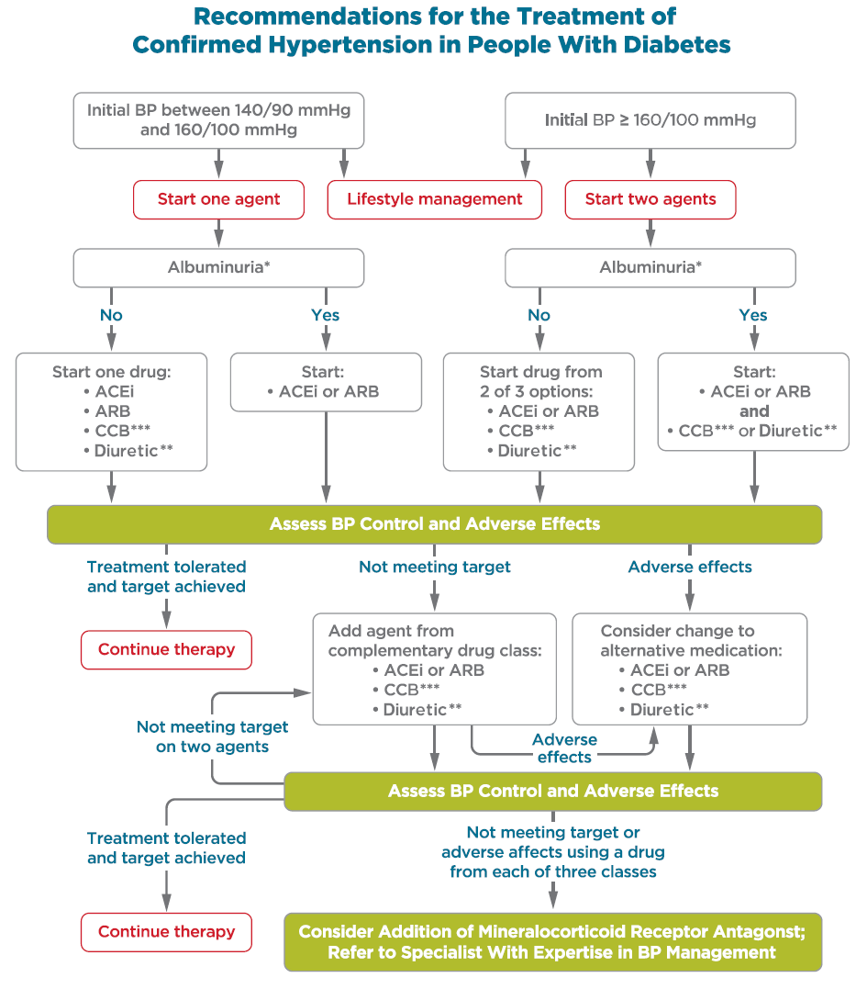
Notes:
New to the standards in 2018, an algorithm summarizing recommendations for the treatment of confirmed hypertension in people with diabetes has been added to Section 9.
A few key points about this algorithm is that it has different pathways depending on blood pressure at hypertension diagnosis as well as the presence or absence of albuminuria. It also emphasizes that ACE inhibitors and ARBs should not be combined.
Treatment for hypertension should include drug classes demonstrated to reduce CV events in patients with diabetes: A
ACE Inhibitors
Angiotensin receptor blockers (ARBs)
Thiazide-like diuretics
Dihydropyridine calcium channel blockers
Multiple-drug therapy is generally required to achieve BP targets. However, combinations of ACE inhibitors and ARBs and combinations of ACE inhibitors or ARBs with direct renin inhibitors should not be used.
An ACE inhibitor or ARB, at the maximumly tolerated dose indicated for BP treatment, is the recommended first-line treatment for hypertension in patients with diabetes and urinary albumin-to-creatinine ratio ≥300 mg/g creatinine A or 30-299 mg/g creatinine B. If one class is not tolerated, the other should be substituted. B
For patients treated with an ACE inhibitor, ARB, or diuretic, serum creatinine/estimated glomerular filtrated rate and serum potassium levels should be monitored at least annually
92

Slide 93
Case 3
According to the ADA recommendation for managing hypertension in non-pregnant diabetic patient, which statement is the most correct?
BP should be measured annually.
Treatment goal to BP <140/80 mmHg.
DASH diet is recommended for BP > 120/80
For BP >140/90 start with dual Anti-HTN Rx
ACE-I or ARB are the best Anti-HTN Rx in the absence of proteinuria
Notes:
Answer: C

Slide 94
Case 4
Mrs. Shrifa

Slide 95
Case 4
You are visited by Mrs. Shrifa in CDC for her appointment visit. This is the first time you meet her.
Her electronic records shows the following:
Age: 57 Gender: F Nationality: Kuwaiti
CD: Hypertention (2010), Hyperlipidemia (2009)
Rx: Valsartan (diovan) 160mg, Verapamil (isoptin SR) 240mg, Rosuvastatin (crestor) 10 mg.

Slide 96
Case 4
Electronic file
Visits every 2 months
Last lab results recorded

Slide 97
Case 3
At nurse station
Ht 162 cm, Wt 65
BMI 24.8
Waist C. 84 cm
B.P: 138/84 mmHg

Slide 98
Case 4
CD booklet
Check other CD
Check last visit reading, medications, last date Rx issued, notes, lab tests requests or registered, fundus, …ect
What to ask for in each follow-up visit?

Slide 99
4Cs ?
Compliance
-ARE YOU FOLLOWING OUR DISCUSSED ADVICES ( EXRCISE, DIET, WEIGHT LOSS… OTHERS ) ?
-ARE YOU TAKING YOUR MEDICATIONS
Complains
IF ANY NEW COMPLAINS ?
Control
CLINIC BLOOD PRESSURE MEASURMENT OR HOME MEASURMENTS ?
SIGNS OR SYMPTOMS OF OVER TREATING OR UNDER TREATING ?
Complications
THERE ANY SIGNS OR SYMPTOMPS OF ANY END ORGAN DAMGE ?
ARE THERE ANY ISSUE WITH THE MEDICATIONS ( side effects ) ?

Slide 100
Control ?
OVER-TREATING :
UNDERTREATING:
→ LOW BP → HYPOTENSION →
-DIZZNIESS, FAINTING, NUSEA, PALPTATION, SWEATING, FEVER,FATIGUE, LACK OF CONCENTRATION, BLURRED VISSION, DEPRESSION.
-SHOCK( CONFUSION, COLD PALE SKIN, RAPID AND SHALLOW BREATHING, WEAK AND RAPID PULSE ),
-POSTURAL HYPOTENSION SPECIALY IN ELDERLY.
→ HIGH BP → HYPERTENSION →
-DIZZNIESS, HEADACHE, PALPTATION, NOSE BLEED,FLUSHING, FATIGUE, CONFUSION, BLURRED VISSION, CHEST PAIN, SHORTNESS OF BREATH, ARYTHMIA, HEMATURIA.
-COULD RESULT IN → HYPERTENSION URGENCY OR EMERGENCY.

Slide 101
Complications

Slide 102
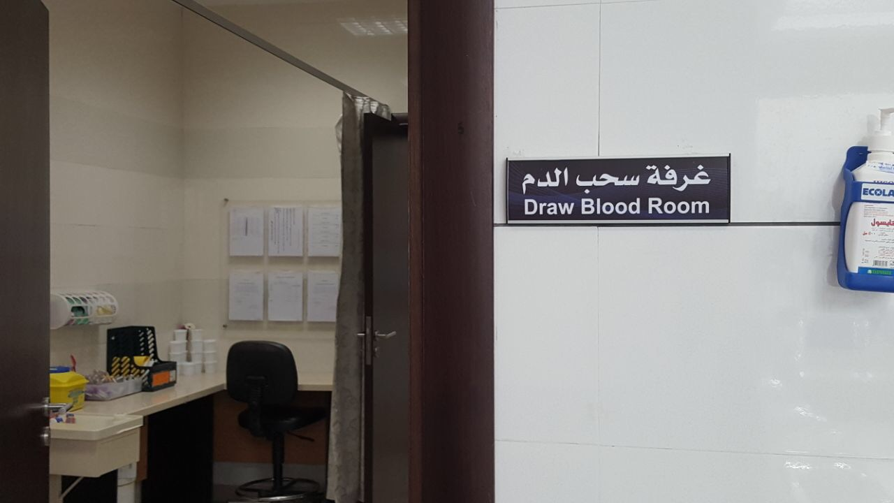
Lab tests
Full profile: FBS, RFT, electrolyes.
Lipid profile: TC, LDL, HDL, Tg.
HbA1c
Urine albumin test: UMA, ACR, …
How often?

Slide 103
Fundus role

Slide 104
FOLLOW UP TARGET
Use clinic blood pressure measurements to monitor response to treatment. Aim for target blood pressure below:
140/90 mmHg in people aged under 80
150/90 mmHg in people aged 80 and over
If white coat effect→ use Home measurement and the target:
135/ 85 mmHg in people aged under 80
145/85 mmHg in people aged 80 and over
In diabetics, aim for target BP:
With no organ damage: < 140/80
With organ damage: < 130/80

Slide 105
Case 4

Slide 106
Case 5
Mrs. Lisa

Slide 107
Case 5
Mrs. Lisa 44 years Philippine house-maid referred from the general clinic to the chronic disease in the same center for hypertension.
She had hypertension for 1 year.
Previous clinic BP readings: average (SBP 150-160), DBP (100-110)
Current medication: moduretic, capoten 50 Tid and adalat LA 30. Moduretic added 4 months back.
She is asymptomatic today and her BP 188/112.

Slide 108
Case 5
How would you manage her?

Slide 109
Hypertensive Crisis
Hypertensive crises encompass a spectrum of clinical situations that have in common severely elevated blood pressure (BP), usually higher than 180/110 mm Hg, together with progressive or impending target organ damage.
Commonest cause is non compliance.
Most crisis are preventable.

Slide 110
Hypertensive Crisis
Pts can be classified into 3 categories ;
Hypertensive emergency : BP > 220/120, with involvement of end-organ involvement.
Hypertensive urgency: BP > 180/110, but has not yet caused acute end-organ damage.
Accelerated hypertension: recent significant increase over baseline blood pressure that is associated with target organ damage.

Slide 111
Hypertension Urgency
Symptoms may include headache, shortness of breath, and pedal edema.
Management in the clinic with oral agents is suitable, depending on the individual's presentation, and follow-up within 24 to 72 hours is recommended.
In many cases, with blood pressure higher than 180/110 mm Hg, patients present without clinical symptoms and have no clinical evidence of target organ damage.

Slide 112
Hypertension Urgency
If untreated, they may be initiated on a drug regimen or an existing treatment regimen may be modified.
Emotional distress or non-adherence with prior treatment are often at fault.
These patients do not require BP reduction to normal.
follow-up scheduled within 3 to 7 days.

Slide 113
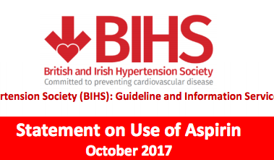
Other medications for hypertensive patients
Primary prevention
(1) Aspirin: use 75mg daily if patient is aged ≥50 years with blood pressure controlled to <150/90 mm Hg and either; target organ damage, diabetes mellitus, or 10 year risk of cardiovascular disease of ≥20% (measured by using the new Joint British Societies’ cardiovascular disease risk chart)
(2) Statin: use sufficient doses to reach targets if patient is aged up to at least 80 years, with a 10 year risk of cardiovascular disease of ≥20% (measured by using the new Joint British Societies’ cardiovascular disease risk chart) and with total cholesterol concentration ≥3.5mmol/l

Slide 114
Thank you

