Slide 1
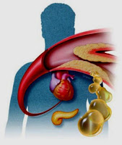
Management of dyslipidemia
Dr.Alia Sadik

Slide 2
Prevention
Primary
Normal population age 40-75
Diabetic
Secondary
ASCVD
Very High risk SCVD
LDL >/= 4.9
age <40

Slide 3
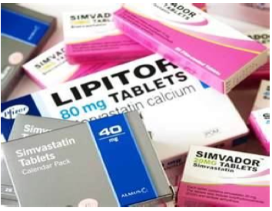
Intensities of Statin Therapy
High-Intensity Statin
Daily dose lowers LDL on average by approximately ≥50%
Atorvastatin 40-80 mg
Rosuvastatin 20-40 mg
Moderate-Intensity Statin
Daily dose lowers LDL on average by approximately 30-<50%
Atorvastatin 10-20 mg
Rosuvastatin 5-10 mg
Simvastatin 20-40 mg

Slide 4
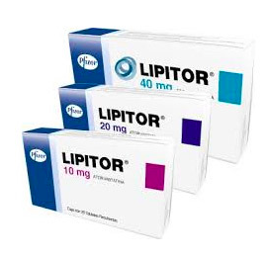
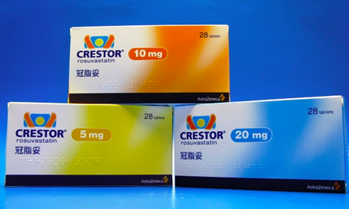
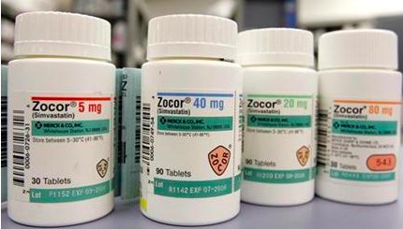
Statin | High intensity | Moderate intensity | Low intensity
Atorvastatin (Lipitor) | 40-80 | 10-20
Rosuvastatin (Crestor) | 20-40 | 5-10
Simvastatin (Zocor) | - | 20-40 | 10

Slide 5
Statin risk/ benefit ratio
Notes:
40 mg/dl = mmol/l

Slide 7
Top 10 Take Home Messages (1)
In all individuals, emphasize a heart- healthy lifestyle across the life course.
A healthy lifestyle reduces (ASCVD) risk at all ages. In younger individuals, healthy lifestyle can reduce development of risk factors and is the foundation of ASCVD risk reduction.
In young adults 20 to 39 years of age, an assessment of lifetime risk facilitates the clinician–patient risk discussion and emphasizes intensive lifestyle efforts.
In all age groups, lifestyle therapy is the primary intervention for metabolic syndrome.

Slide 8
Case 1
Sara 36 years old female smoker presented with her annual check up
BP =110/68
BMI = 28
FBS | 5.2
Chol | 5.7
TG | 1.7
LDL | 2.5
HDL | 1.3
HbA1C | 5

Slide 9
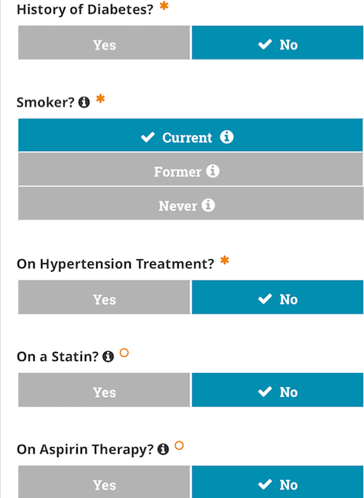
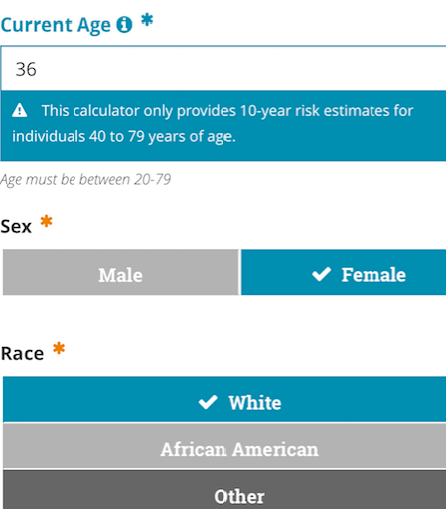
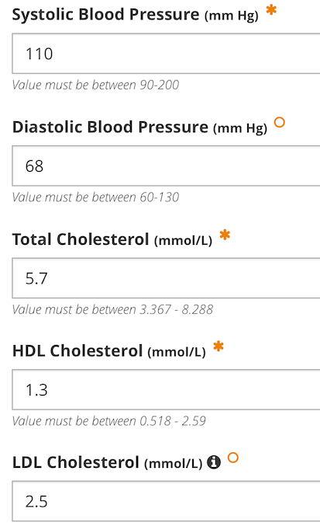

Slide 10
Secondary prevention

Slide 11
Top 10 Take Home Messages (2)
Patients who ≤ 75 years with clinical ASCVD, high-intensity statin therapy should be initiated or continued with the aim of achieving ≥50% reduction in LDL-C levels.
The more LDL-C is reduced >>>the greater will be subsequent risk reduction.
In patients with clinical ASCVD in whom high-intensity statin therapy is contraindicated or who experience statin- associated side effects, moderate-intensity statin therapy should be initiated or continued with the aim of achieving a 30% - 49% reduction in LDL-C levels.

Slide 12
Top 10 Take Home Messages (3)
In very high-risk ASCVD, use a LDL-C threshold of 70 mg/dL (1.8 mmol/L) to consider addition of non-statins to statin therapy.
Very high-risk includes a history of multiple major ASCVD events or 1 major ASCVD event and multiple high-risk conditions.
In very high-risk ASCVD patients, add ezetimibe to maximally tolerated statin therapy when the LDL-C level remains ≥1.8 mmol/L.
Iif patients LDL-C level remains ≥1.8 mmol/L on maximally tolerated statin and ezetimibe therapy, addinga PCSK9 inhibitor is reasonable,

Slide 13
Very High-Risk of Future ASCVD Events
Major ASCVD Events :
Recent ACS (within the past 12 mo)
History of MI (other than recent ACS event listed above)
History of ischemic stroke
Symptomatic peripheral arterial disease (history of claudication with ABI <0.85, or previous revascularization or amputation)

Slide 14
High-Risk Conditions
Age ≥65 y
familial hypercholesterolemia
History of prior coronary artery bypass surgery or percutaneous coronary intervention outside of the major ASCVD event(s)
Diabetes mellitus
Hypertension
CKD (eGFR 15-59 mL/min/1.73 m2)
Current smoking
Persistently elevated LDL-C ( [≥2.6 mmol/L]) despite maximally tolerated statin therapy and ezetimibe
History of congestive HF

Slide 15
CASE 2
Mr. Husain 74 years old gentleman
Known:
HTN since 1990
DM since 1990
IHD(MI did CABAG 1 year back
Presented with blood test
BP 100/60
On Zestril 5mg OD
Diabetic on diet + Glucophage 500 mg BD

Slide 16
Full bio. Profile
FBS | 5.4
ALT | 14
S.creat | 64
Chol | 5.2
TG | 0.74
HDL | 1.04
LDL | 3.8
HBA1C | 6
Urine albumin | <19
Notes:
What will do?
Are you going to use pooled cohort equation? No
Why? Already a case of CVD + age
What the plan?

Slide 17
How to manage?
Are we going to use ASCVR calculator?
Which Intensity of statin are we going to use?
What other risk you want to control?
Notes:
Lifestyle
High intensity statin
Control Bp+DM= stop smoking if

Slide 18
Case 3
Mr. Hasan 55 years old
Known Case :
Diabetic on Glucophage XR 1g 2*1
Hypertensive on Zestril 20 mg
Dyslipidemia on Crestor 10 mg
Bp 120/65
BMI 41
Recently diagnose 1 week back TIA
How to manage?
FBS | 8
HBA1C | 6.2
Chol | 4.2
LDL | 2.3
TG | 1.3
HDL | 1

Slide 19
Plan:
Lifestyle style
Modify his medication
Notes:
Increase dose of Crestor to high intensity
AnTIplATeleT AgenTs
Add aspirin , Clopidogrel was more effective than aspirin alone in reducing the combined end point of ischaemic stroke, myocardial infarction (MI) or vascular death
All patients with a previous stroke or TIA should be considered for treatment with an Ace inhibitor (for example, perindopril) and thiazide (for example, indapamide) regardless of blood pressure, unless contraindicated.
d patients with hypertension should be treated to <140/85 mm hg (<130/80 mm Hg for patients with diabetes).

Slide 20
Age specific
Patients >75 years of age with clinical ASCVD (after evaluation of the potential for ASCVD risk reduction, adverse effects, and drug–drug interactions, as well as patient frailty and patient preferences):
Initiate moderate- or high-intensity statin therapy
In patients >75 years of age who are tolerating high-intensity statin therapy>>>continue
Consider initiation of moderate-intensity statin In patients with:
heart failure & reduced ejection fraction
life expectancy 3 to 5 years

Slide 21
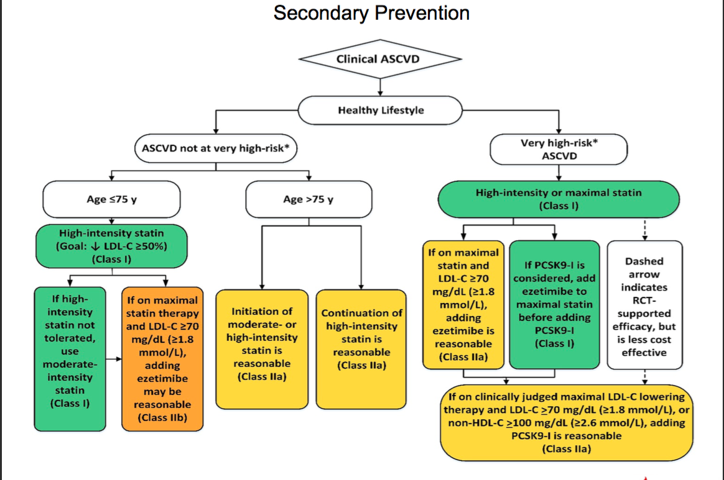

Slide 22
Primary prevention

Slide 23
Top 10 Take Home Messages (4)
In patients 40 to 75 years of age with diabetes mellitus and LDL-C ≥1.8 mmol/L, start moderate-intensity statin therapy without calculating 10-year ASCVD risk.
In adults 40 to 75 years of age with diabetes mellitus and an LDL-C level 1.8 to 4.8 mmol/L, it is reasonable to assess the 10-year risk of a first ASCVD event to stratify ASCVD risk.
In patients with diabetes mellitus at higher risk, especially those with multiple risk factors or those 50 to 75 years of age, it is reasonable to use a high-intensity statin to reduce the LDL-C level by ≥50%. with the aim to reduce LDL-C levels by 50% or more.

Slide 24
If patient > 75 years of age with DM and already on statin>>continue.
In adults with diabetes mellitus and 10-year ASCVD risk ≥ 20% , it may be reasonable to add Ezetimibe to maximally tolerated statin therapy to reduce LDL-C levels by 50% or more.
In adults older than 75 years with diabetes mellitus, it may be reasonable to initiate statin therapy after a clinician–patient discussion of potential benefits and risks.

Slide 25
In adults 20 to 39 years of age with diabetes mellitus consider risk enhancer for diabetes
Diabetes-Specific Risk Enhancers That Are Independent of Other Risk Factors in Diabetes Mellitus :
Long duration ≥10 years for type 2 diabetes mellitus ,or ≥20 years for type 1 diabetes mellitus
Albuminuria ≥30 mcg of albumin/mg creatinine
eGFR <60 mL/min/1.73 m2
Retinopathy
Neuropathy
ABI <0.9

Slide 26
CASE 4
Khalid 43 years old, smoker present with his lap test for check up
BP 130/80
FBS | 7
HBA1C | 6.6
T.Chol | 4
LDL | 1.5
TG | 2
HDL | 1.2
Notes:
LDL <1.8 so not to measure

Slide 27
Case 5
Ms. Komary 55 years-old Indian lady
Diabetic 2005 on Glucophage 850 TDS
Dyslipidemia 2008 on Zocor 20mg
Hypertensive 2008 on Zestril 20 mg
FBS 8.3
BP 120/75
BMI 30

Slide 30
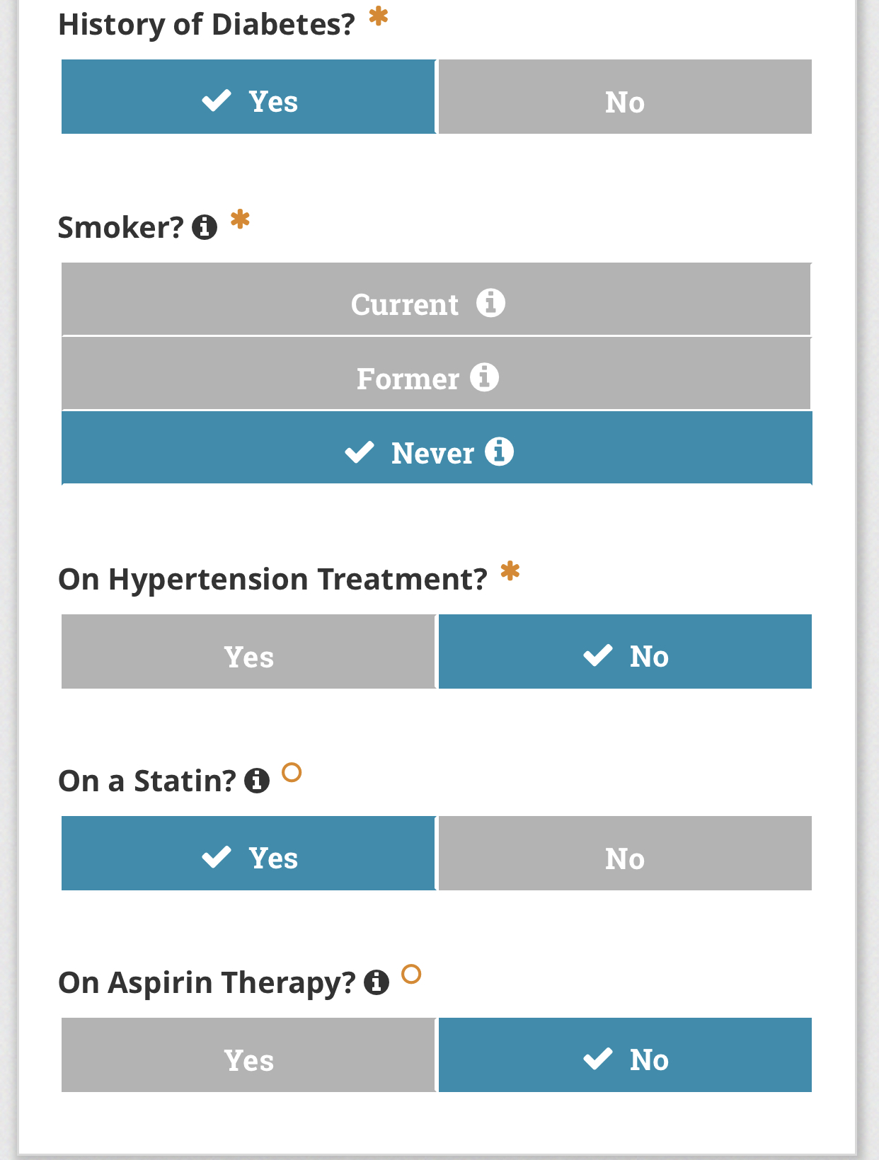
Notes:
She need moderate intensity
Zocor 40 or lipitor 20 or crestor 10

Slide 31
Top 10 Take Home Messages (5)
In patients 20_ 75 years of age with an LDL-C level of ≥4.9 mmol/L, without calculating 10-year ASCVD risk, begin high-intensity statin therapy
maximally tolerated statin therapy is recommended.
If the LDL-C level remains ≥2.6 mmol/L >>add ezetimibe
If the LDL-C level on statin plus ezetimibe remains ≥2.6 mmol/L & the patient has multiple factors that increase subsequent risk of ASCVD events, a PCSK9 inhibitor may be considered

Slide 32
Case 6
Mr. Ali 25 years old healthy gentleman presented with lab test requested from his GYM
Blood test
FBS | 4.3
Chol | 5.3
TG | 2
LDL | 4.9
HDL | 1.5

Slide 33
Primary Prevention in Adult ≥21 Years With LDL–C ≥4.9 mmol/l
PLAN:
Role out secondary causes
Familial screening ?
1/500
AD
A 5,000 pt practice will have
10 patients with FH
50% cardiac event by age 55
12% all MI’s under 60 yr have FH
75% remain undiagnosed
Life expectancy normal with TT
Secondary Cause | Elevated LDL–C
Diet | Saturated fats weight gain anorexia
Drugs | Diuretics glucocorticoids
Diseases | Biliary obstruction nephrotic syndrome
Disorders | Hypothyroidism obesity pregnancy

Slide 34
Case 7
FBS 6.1
HbA1C 6.5
BP 130/80
Ms. Samira 50 year old Diabetic on
Lantus 12 IU
Glucophage 850 mg TDS
Januvia 100 mg OD
HTN on Micardis 40 mg
Lipid profile
Chol | 5.1
Tg | 2.4
LDL | 5.1
HDL | 0.8
Notes:
How to manage?
No need for pooled cohort
Ldld>4.9
Plan : High intensity statin

Slide 35
Case 8
Laila 40 years old kuwaity female with history of gestation diabetes
Present after 1 year of delivery for check up
Non smoker
BP= 120/60
BMI 23

Slide 37
Top 10 Take Home Messages (6)
In adults 40 to 75 years of age evaluated for primary ASCVD prevention, have a clinician–patient risk discussion before starting statin therapy.
Risk discussion should include a review of :
major risk factors (e.g., cigarette smoking, elevated blood pressure, (LDL-C), hemoglobin A1C, and calculated 10-year risk of ASCVD);
the presence of risk-enhancing factors
the potential benefits of lifestyle and statin therapies
the potential for adverse effects and drug–drug interactions
the patient preferences & values in shared decision-making.

Slide 38
Risk-Enhancing Factors for Clinician–Patient Risk Discussion
Family history of premature ASCVD
Primary hypercholesterolemia Metabolic syndrome
Chronic kidney disease
Chronic inflammatory conditions such as psoriasis, RA, or HIV/AIDS
History of premature menopause (before age 40 y) and history of pregnancy- associated conditions that increase later ASCVD risk such as preeclampsia
High-risk race/ethnicities (e.g., South Asian ancestry)
Notes:
Primary hypercholesterolemia (LDL-C 4.1–4.8 mmol/L); non–HDL- 4.9–5.6 mmol/L]
Metabolic syndrome
Chronic kidney disease (eGFR 15–59 mL/min/1.73 m2 with or without albuminuria; not treated with dialysis or kidney transplantation)
Chronic inflammatory conditions such as psoriasis, RA, or HIV/AIDS

Slide 39
Top 10 Take Home Messages (7)
For the primary prevention in adults 40 to 75 years of age without diabetes mellitus and with an LDL-C level 1.8 to 4.8 mmol/L), the 10-year ASCVD risk categorized as being at :
low risk (<5%),
borderline risk (5% to <7.5%)
intermediate-risk (≥7.5% to <20%)
high- risk (≥20%).
Clinicians and patients should engage in a risk discussion that considers risk factors, adherence to healthy lifestyle, the potential for ASCVD risk- reduction benefits, and the potential for adverse effects and drug–drug interactions, as well as patient preferences, for an individualized treatment decision.
at a 10-year ASCVD risk of ≥7.5%, start a moderate-intensity statin if a discussion of treatment options favors statin therapy.
In adults 40 to 75 years of age without diabetes mellitus and 10-year risk of 7.5% - 19.9% (intermediate risk), risk- enhancing factors favor initiation of statin therapy

Slide 40
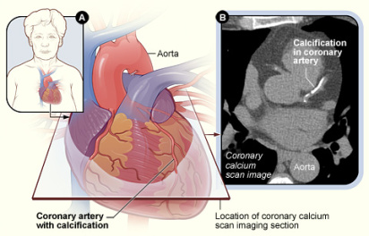
Top 10 Take Home Messages (8)
In adults 40 to 75 years of age without diabetes mellitus and with LDL-C levels ≥1.8-4.9 mmol/L, at a 10-year ASCVD risk of ≥7.5% to 19.9%, if a decision about statin therapy is uncertain, consider measuring CAC.
If CAC is zero, statin therapy may be withheld or delayed, except in cigarette smokers, those with diabetes mellitus, and those with a strong family history of premature ASCVD.
therapy and reassess in 5 to 10 years, as long as higher risk conditions are absent (diabetes mellitus, family history of premature CHD, cigarette smoking)
A CAC score of 1 to 99 favors statin therapy, especially in those ≥55 years of age.
For any patient, if the CAC score is ≥100 ,statin therapy is indicated

Slide 41
In patients at borderline risk, in risk discussion, the presence of risk-enhancing factors may justify initiation of moderate- intensity statin therapy.

Slide 42
CASE 9
Mr. Hashem
41 years old
Presented with lab test for annual check up
BMI 23
BP 122/75
Past medical history:
Obese BMI 40 did SLEEVE in 2012

Slide 44
Notes:
Role out 2 causes of hyperlipidemia:

Slide 45
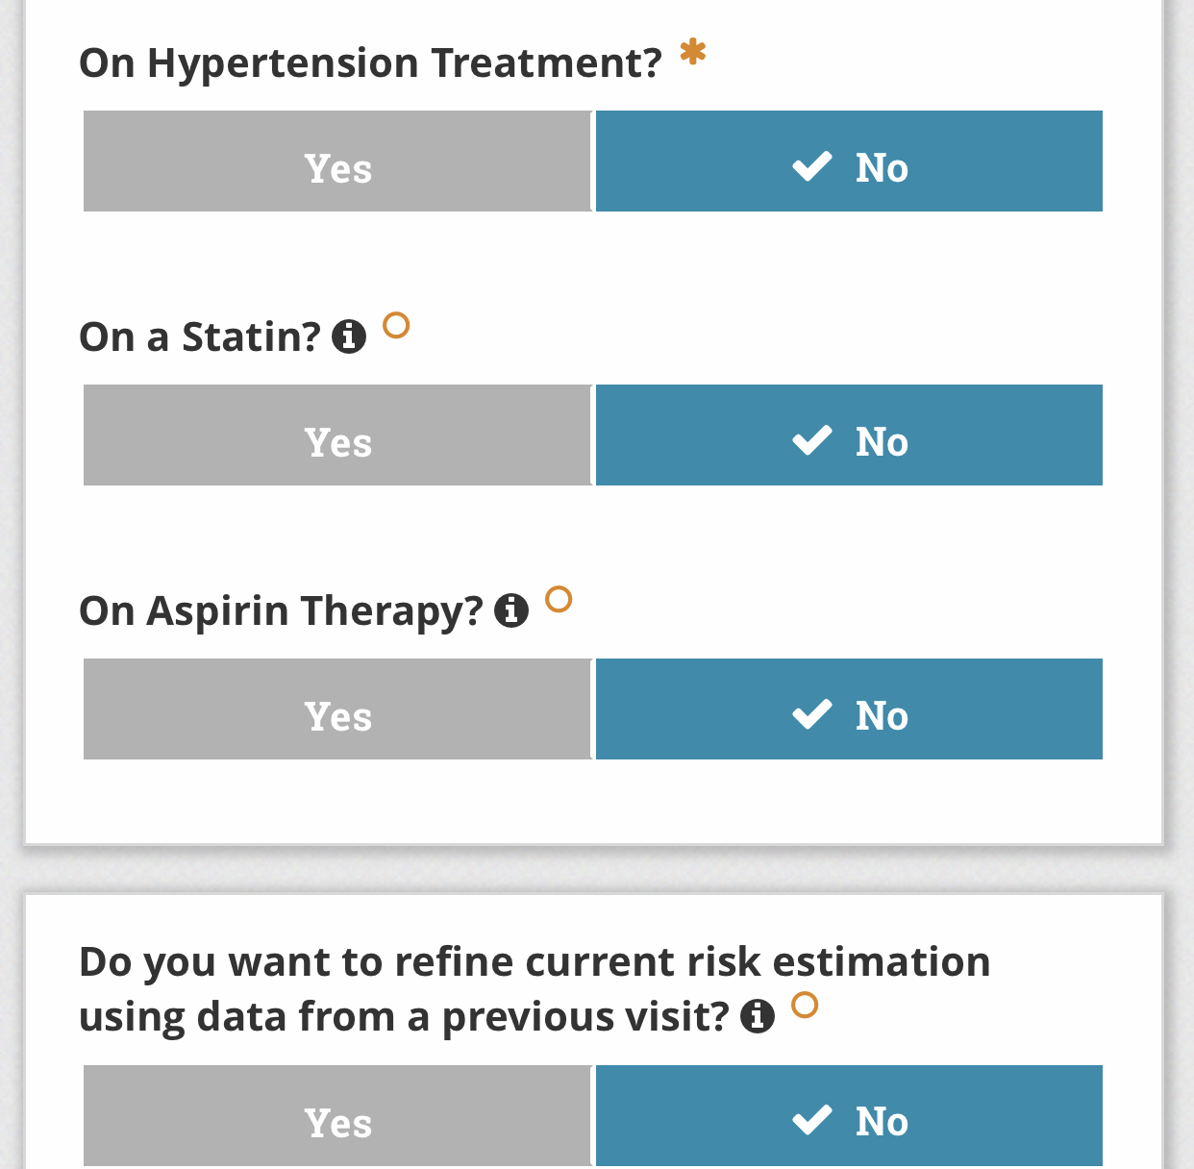

Slide 46
Case 10
Mr. Jasem
66 years-old gentleman
Previously healthy presented with blood investigation as annual check up

Slide 47
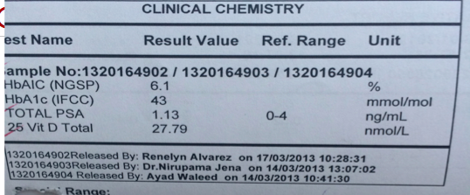

Slide 48
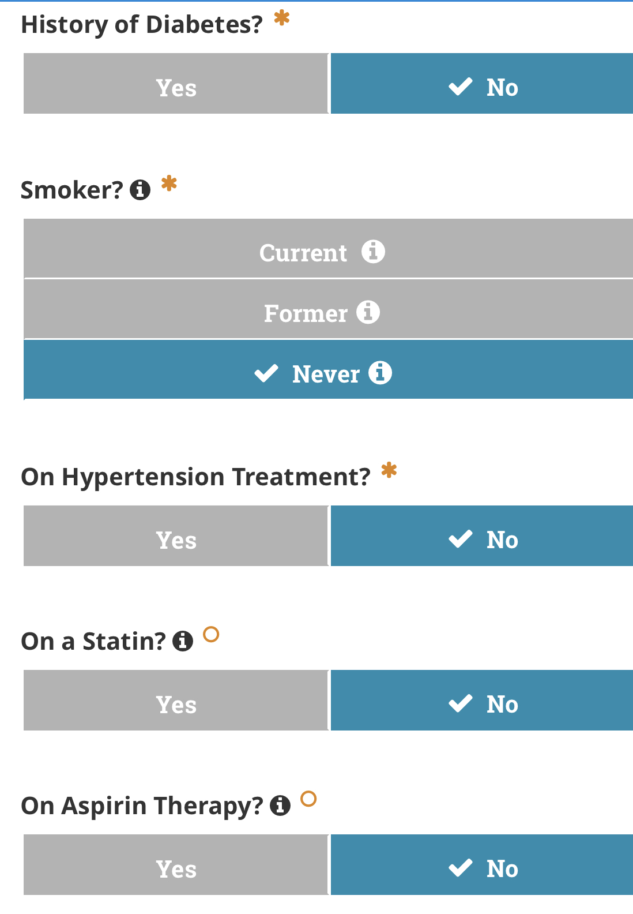

Slide 49
Primary Prevention in Other Age Groups (Older Adults)
In adults ≥75 years & LDL-C level 1.8 to 4.8 mmol/L, initiating a moderate-intensity statin may be reasonable.
it may be reasonable to stop statin therapy in:
functional decline (physical or cognitive)
multimorbidity
frailty
or reduced life-expectancy

Slide 50
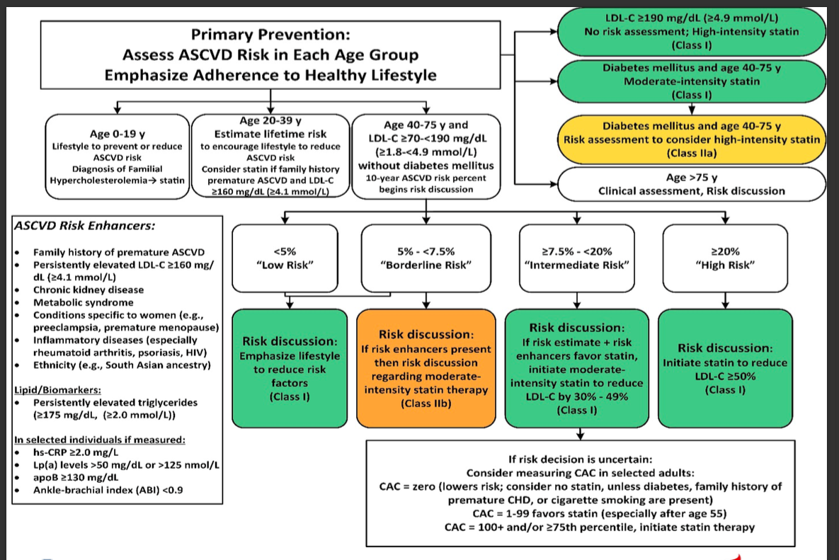

Slide 51
Lifestyle modifications
Review lifestyle habits
Diet
Physical activity
Weight
Body mass index
Tobacco

Slide 52
Assess adherence and percentage response to LDL- C–lowering medications and lifestyle changes with repeat lipid measurement 4 to 12 weeks after statin initiation or dose adjustment, repeated every 3 to 12 months as needed.
Define responses to lifestyle and statin therapy by percentage reductions in LDL-C levels compared with baseline.

Slide 53
Hypertriglyceridemia
In adults ≥20 years & moderate high Tg [1.9 to 5.6 mmol/L]:
treat lifestyle factors (obesity and metabolic syndrome),
secondary factors
(diabetes mellitus, chronic liver or kidney disease and/or nephrotic syndrome, hypothyroidism),
medications that increase triglycerides.
In adults 40 to 75 years of age with:
moderate or severe hypertriglyceridemia &ASCVD risk of 7.5% or higher, it is reasonable to reevaluate ASCVD risk after lifestyle and secondary factors are addressed and to consider a persistently elevated triglyceride level as a factor favoring initiation or intensification of statin therapy
severe hypertriglyceridemia (fasting Tg ≥5.6 mmol/L & and ASCVD risk of 7.5% or higher, it is reasonable to address reversible causes of high triglyceride and to initiate statin therapy
If Tg very high ≥11.3 mmol/L) :
identify and address other causes of hypertriglyceridemia
and to further reduce triglycerides implement a very low-fat diet, avoidance of refined carbohydrates and alcohol, consumption of omega-3 fatty acids, and,
if necessary to prevent acute pancreatitis, fibrate therapy.

Slide 54
Statin Side effect

Slide 55
statin-Associated Side Effects | Frequency |  | Predisposing Factors |  | Quality of Evidence
Statin-associated muscle symptoms (SAMS)
Myalgias (CK Normal) |  | Infrequent (1% to 5%) in RCTs |  | Age female low body mass index high-risk medications comorbidities (HIV, renal, liver, thyroid, preexisting myopathy) Asian excess alcohol high levels of P/E trauma |  | RCTs cohorts/observational
Myositis/myopathy (CK > ULN) with concerning symptoms or objective weakness |  | Rare |  |  |  | RCTs cohorts/observational
Rhabdomyolysis (CK >10× ULN + renal injury) |  | Rare |  |  |  | RCTs cohorts/observational

Slide 56
Statin-Associated Side Effects | Frequency | Predisposing Factors | Quality of Evidence
Liver
Transaminase elevation 3× ULN | Infrequent |  | RCTs/ cohorts/observational Case reports
Hepatic failure | Rare
Central nervous system
Memory/cognition | Rare/unclear |  | Case reports; no increase in memory/cognition problems in 3 large-scale RCTs
Cancer | No definite association |  | RCTs/meta-analyses

Slide 57
Statin-Associated Side Effects | Frequency | Predisposing Factors | Quality of Evidence
Other
Renal function | Unclear/unfounded
Cataracts | Unclear
Tendon rupture | Unclear/unfounded
Hemorrhagic stroke | Unclear
Interstitial lung disease | Unclear/unfounded
Low testosterone | Unclear/unfounded

Slide 58
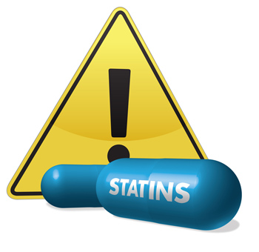
STATIN Safety
Conditions that could predispose to statin side effect:
Impaired renal or hepatic function
History of previous statin intolerance or muscle disorders
Unexplained ALT elevations ≥3 times ULN
Patient uses drugs affecting statin metabolism
Age >75 years
Additional characteristics that could modify the decision to use higher statin intensities might include, but are not limited to:
History of hemorrhagic stroke
Notes:
Symptoms of hepatic dysfunction: unusual fatigue or weakness, loss of appetite, abdominal pain, dark colored urine, Jaundice
Those who develop diabetes during statin therapy encouraged heart healthy dietary pattern
engage in physical activity
achieve and maintain a healthy body weight
cease tobacco use
continue statin therapy to reduce their risk of ASCVD events.

Slide 59
Check baseline ALT prior initiating the statin
Check LFTs if patient develops Symptoms of hepatic dysfunction
If 2 consecutive LDL <1.04, Consider decreasing the statin dose
It may be harmful to initiate simvastatin 80mg, or increase the dose of simvastatin to 80mg
After start statin evaluated for new-onset diabetes.

Slide 60
CK should not be routinely measured
Baseline measurement of CK for individuals believed to be at increased risk for adverse muscle events based on:
personal /family history of statin intolerance
personal / family history of muscle disease
drug therapy that might increase the risk for myopathy
During statin therapy, measure CK in patient with muscle pain, tenderness, stiffness, cramping, weakness, or generalized fatigue.

Slide 61
Management of Muscle Symptoms on Statin Therapy
To avoid unnecessary discontinuation of statins? obtain a history of prior or current muscle symptoms to establish a baseline before initiating statin therapy
If severe muscle symptoms or fatigue :
Stop statin
Possibility of rhabdomyolysis ??
CK
Creatinine
Urinalysis for myoglobinuria
If mild-to-moderate muscle symptoms :
Stop statin
Evaluate the patient for other conditions
If after 2 months without statin Rx, muscle symptoms or elevated CK levels do not resolve completely, consider other causes of muscle symptoms & resume original dose
Notes:
All in this slide are expert opinion
*Hypothyroidism, reduced renal or hepatic function, rheumatologic disorders such as polymyalgia rheumatica, steroid myopathy, vitamin D deficiency or primary muscle diseases

Slide 62
Statin myopathy ➔stop statin and follow
Not resolve 2 months➔ resume to original dose
Resolve not related ➔resume with low dose
Resolve, related ➔change to different statin + low dose
Notes:
then

Slide 63
Thank you

