Slide 1

Diabetes Mellitus: All what you need to know.
Dr Dalal Alhajeri
Consultant Family physician
MRCGP, Diabetes PgDip

Slide 2
Outline
Classification and diagnosis of diabetes.
Prevention or Delay of type 2 diabetes.
Medical evaluation and assessment (initial, follow up and annual visits).
Glycemic targets.
Pharmacologic approaches.
Cardiovascular disease and risk management.
Microvascular complications.

Slide 3

Diagnosis

Slide 4
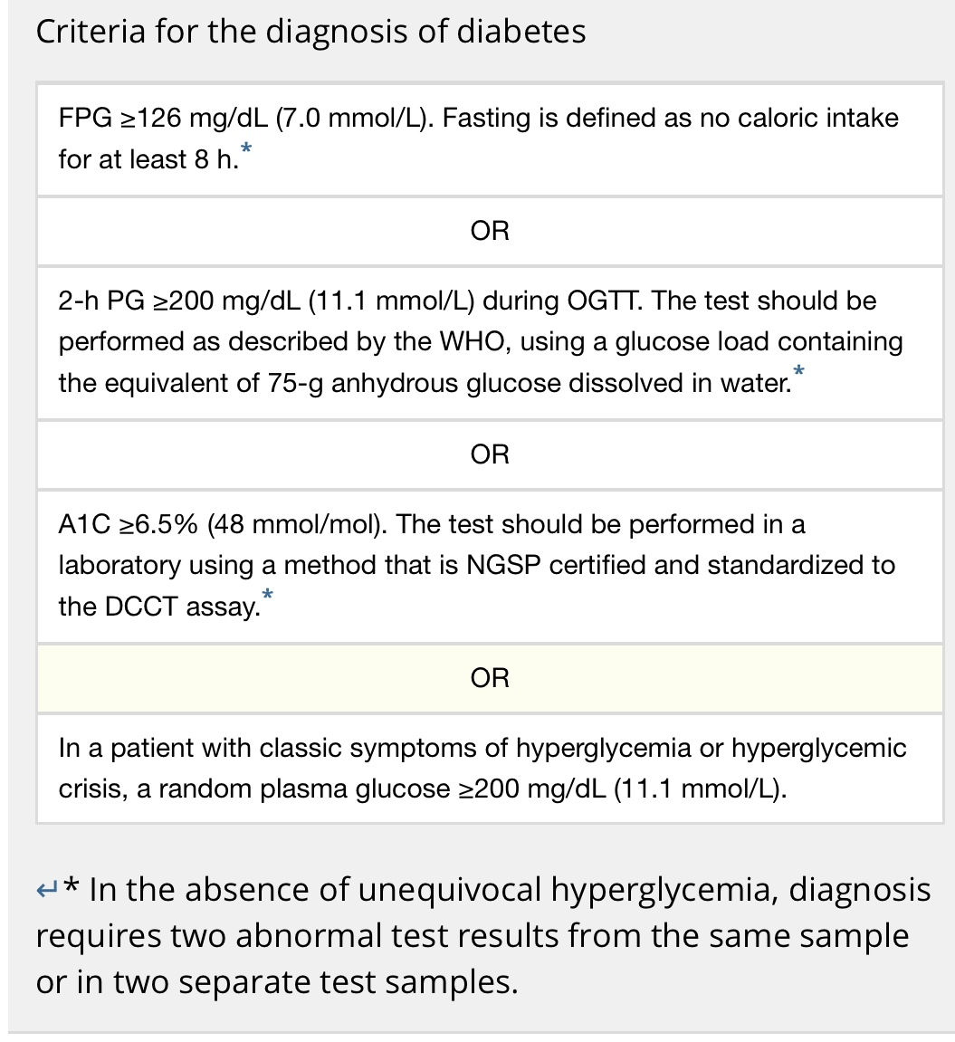
Diagnosis

Slide 5

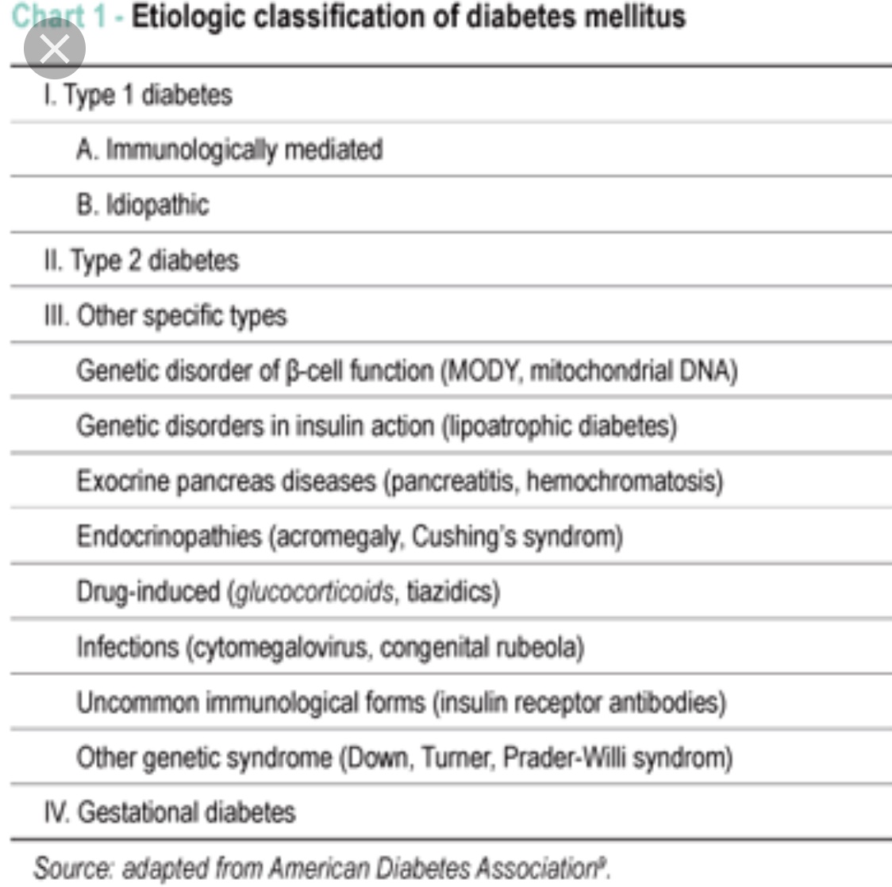
Classification

Slide 6
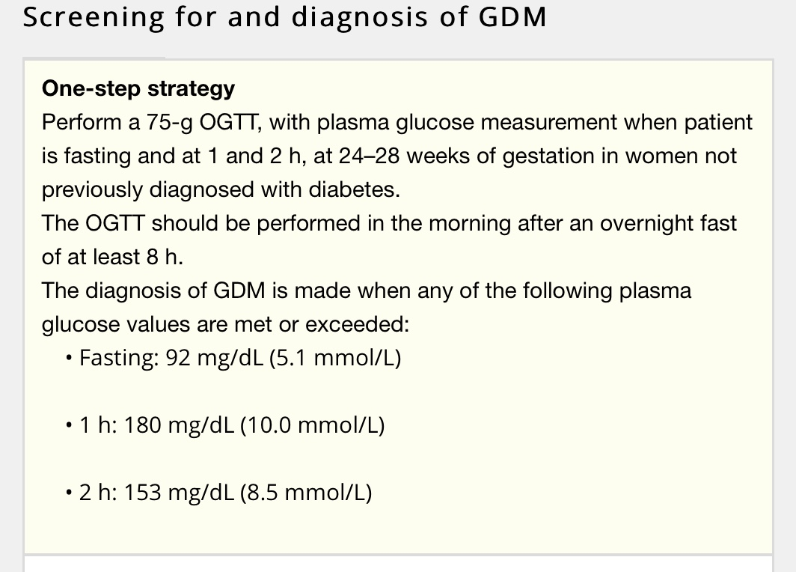


Slide 7
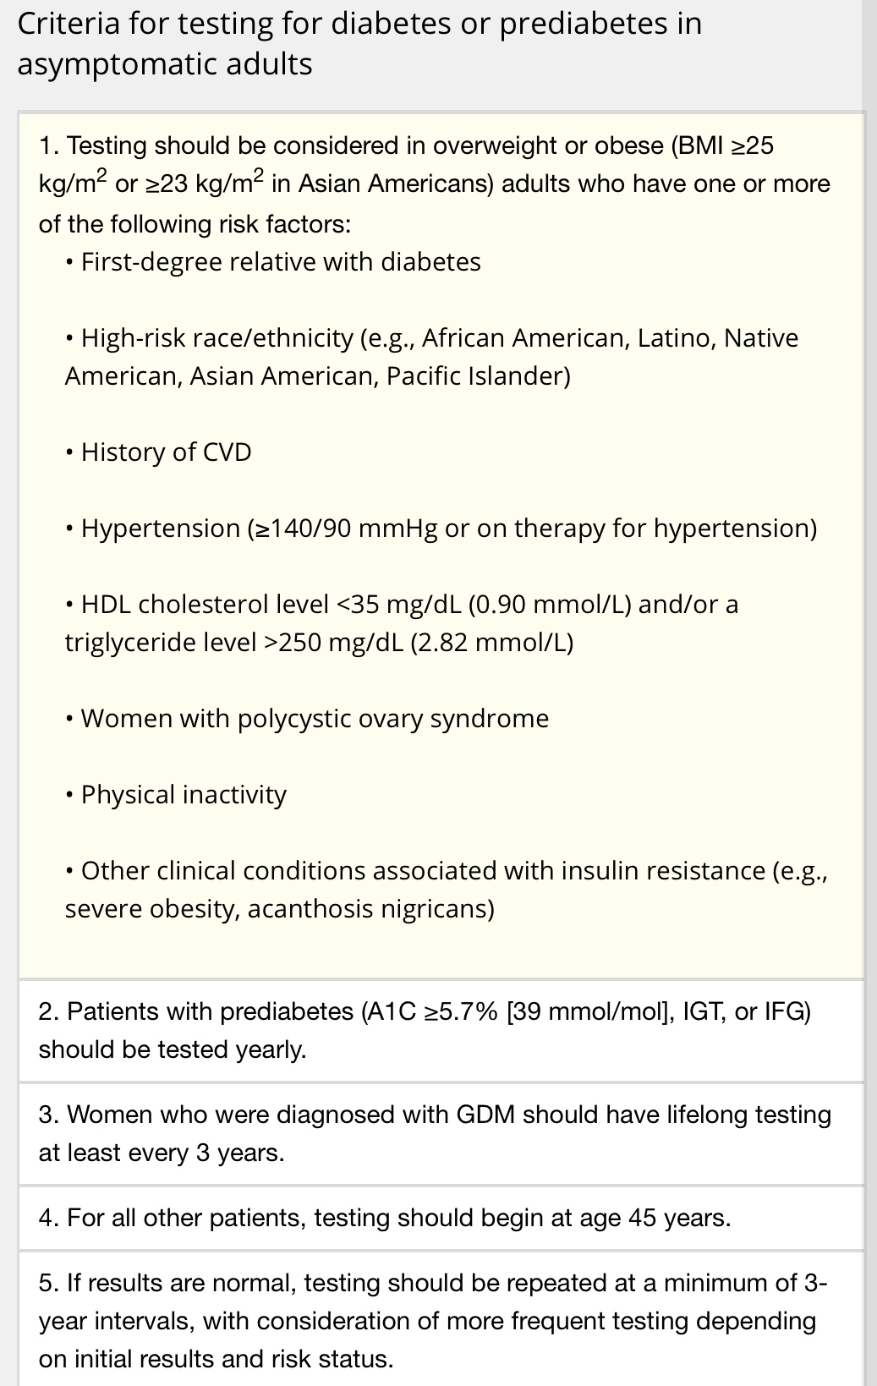
Prevention or Delay of DM2

Slide 8
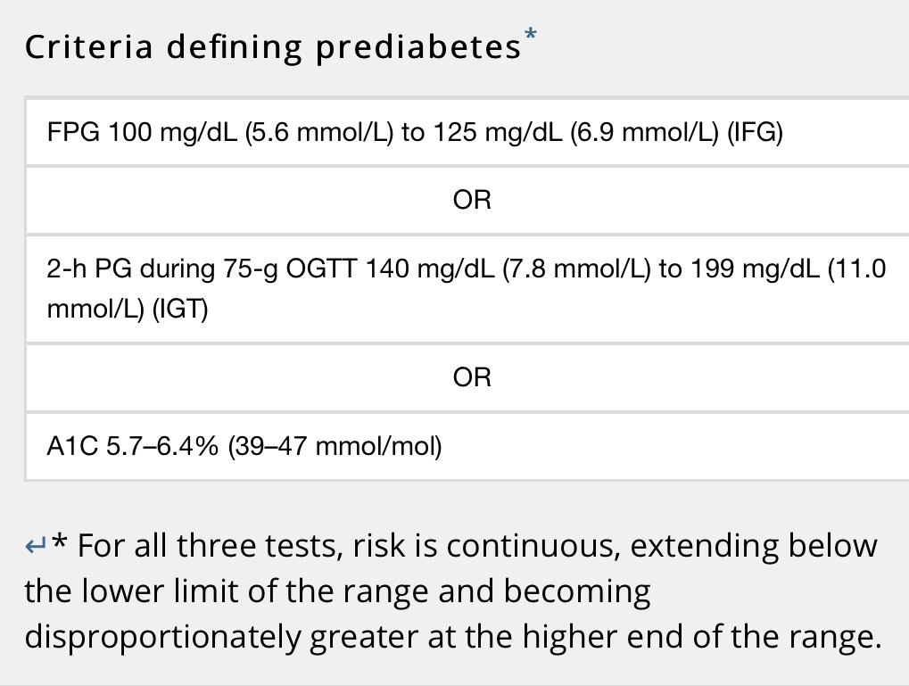
Prevention or Delay of type 2 diabetes

Slide 9

Prevention or Delay of type 2 diabetes
Annual monitoring.
7% loss of initial body weight.
Moderate-intensity physical activity (such as brisk walking) at least 150 min/week.
Mediterranean eating plan and a low-calorie, low-fat eating plan.
Metformin: BMI≥35 kg/m2, aged <60 years, and women with prior gestational diabetes mellitus.
Screening and treatment of modiﬁable risk factors for cardiovascular disease.

Slide 10
Medical evaluation and assessment
Initial visit
Confirm and classify diabetes.
Detect diabetes complications (micro-, macrovascular).
Review previous treatment. (from GP)
ASCVD risk factor and comorbidities.
Formulate a management plan.
Provide a basis for continuing care.

Slide 11
Medical evaluation and assessment
Each F.U visit
4 C’s approach:
Complain.
Compliance: diet, exercise and medications.
Control: Hypos and hyperglycemia, results of glucose monitoring and A1c.
Complications:
Hypoglycemia, Hyperglycemia.
Microvascular: retinopathy, nephropathy, neuropathy (sensory, including history of foot lesions; autonomic, including sexual dysfunction and gastroparesis).
Macrovascular: coronary heart disease, cerebrovascular disease, and peripheral arterial disease.

Slide 12

Medical evaluation and assessment
Psychosocial Hx: diabetes distress, depression, anxiety, disordered eating, and cognitive capacities and existing social support.
Vaccination history and needs.
The 10-year risk of a ﬁrst atherosclerotic cardiovascular disease event should be assessed.

Slide 13
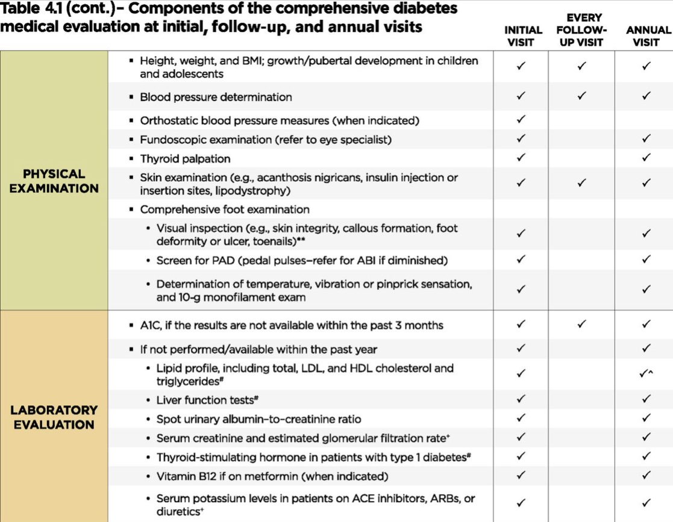
Medical evaluation and assessment

Slide 14
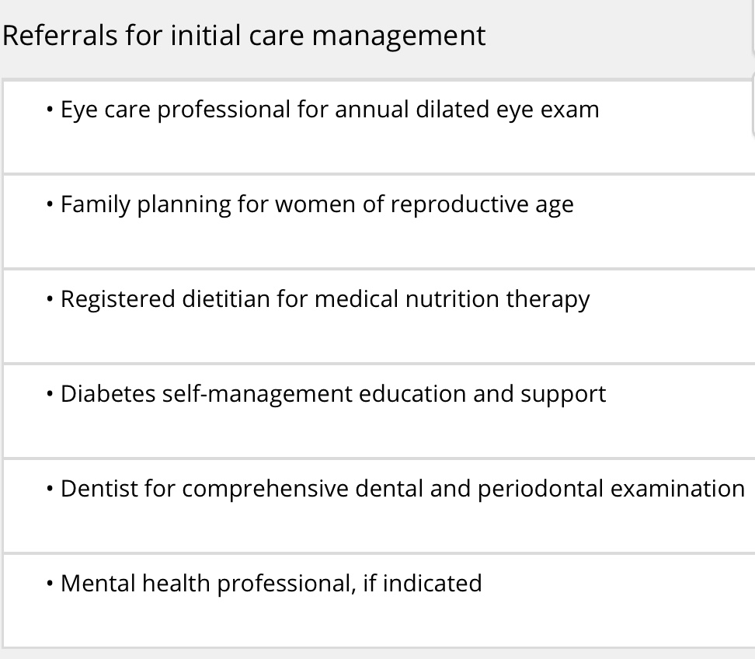
Medical evaluation and assessment

Slide 15
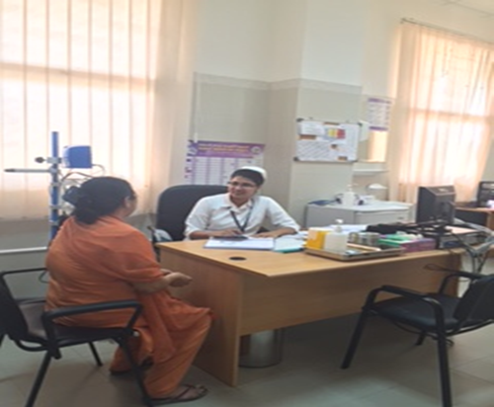
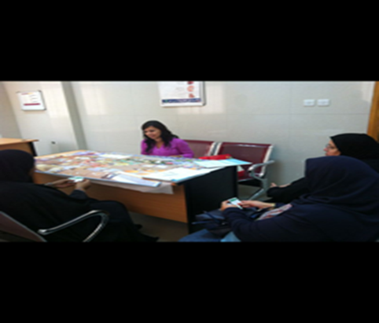
Diabetes education

Slide 16
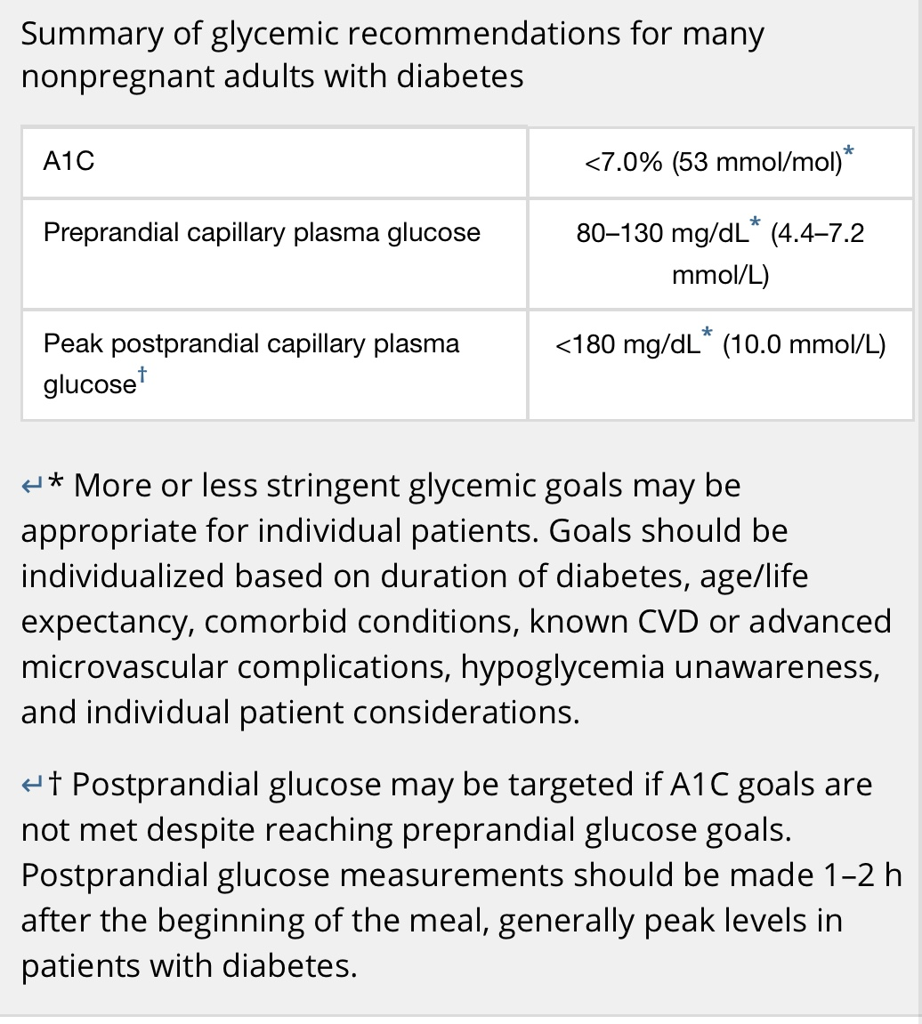
Glycemic targets

Slide 17
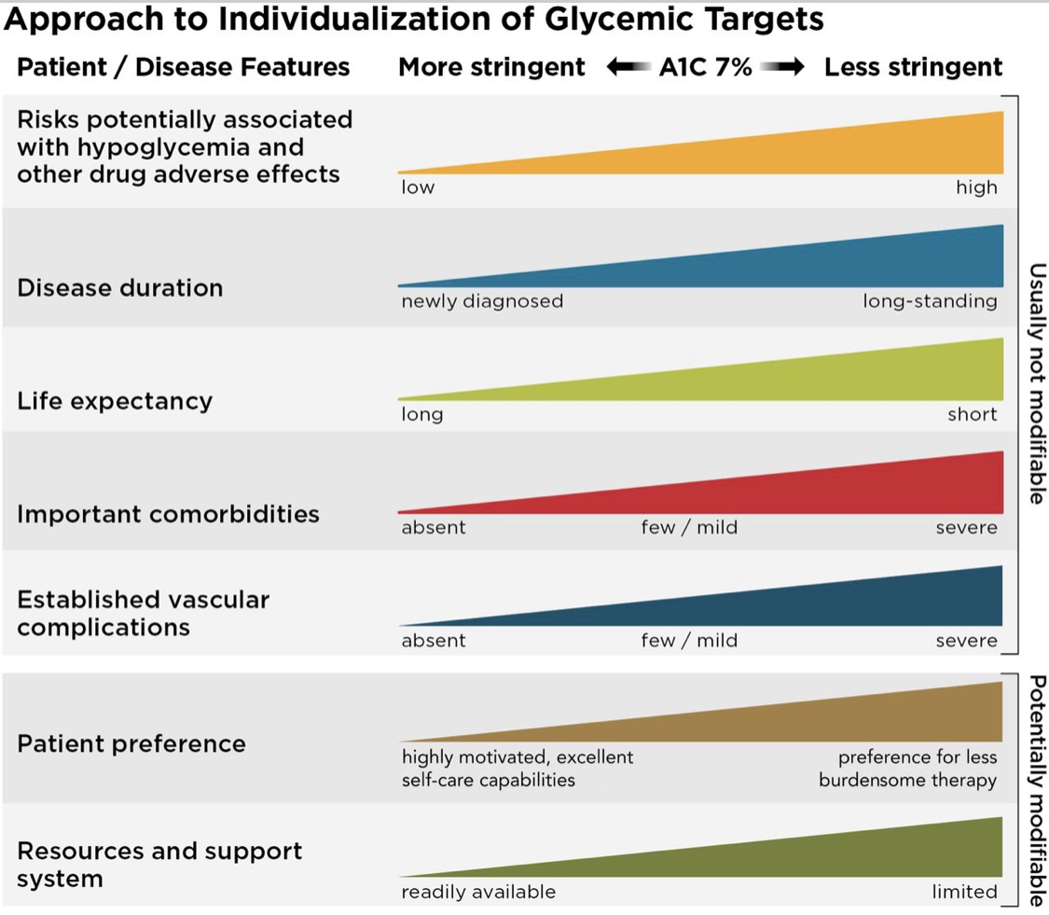
Glycemic targets

Slide 18
Pharmacologic approaches
Choice of pharmacologic agents:
Comorbidities (atherosclerotic cardiovascular disease, heart failure, chronic kidney disease).
Hypoglycemia risk.
Impact on weight.
Cost.
Risk for side effects.
Patient preferences.

Slide 19
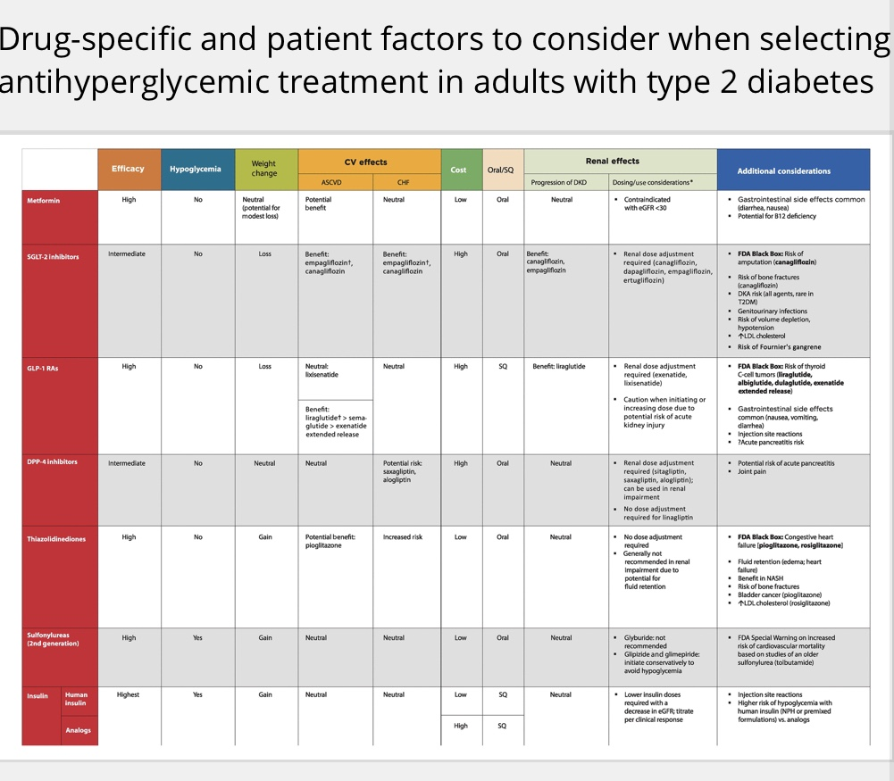

Slide 20
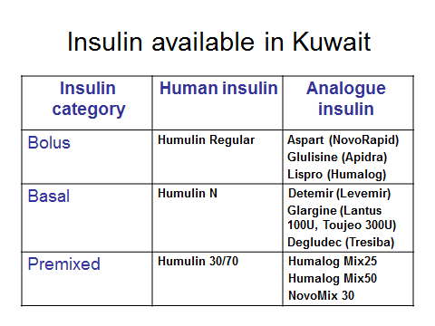

Slide 21
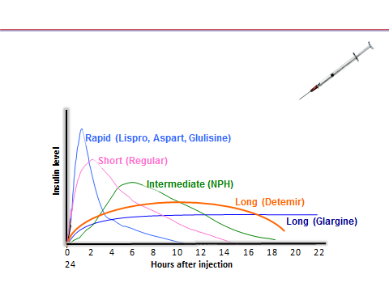

Slide 22
Pharmacologic approaches
Early insulin: catabolism (weight loss), symptoms of hyperglycemia, or A1C levels >10% or blood glucose levels >16.7 mmol/L.
Dual therapy: A1C >1.5% above their glycemic target.

Slide 23
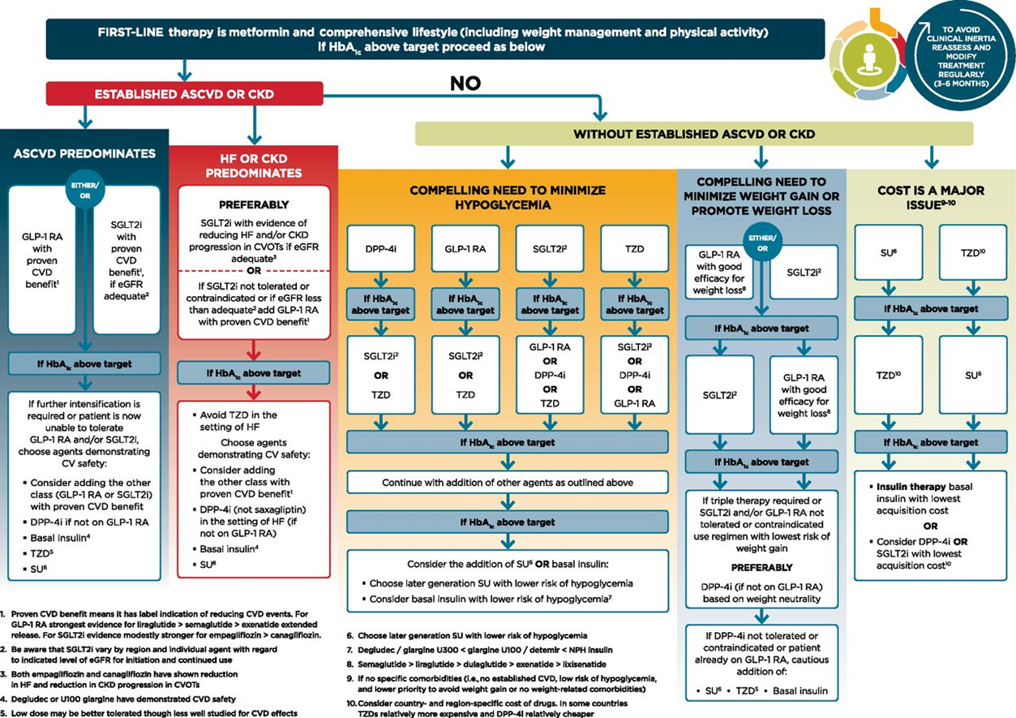

Slide 24
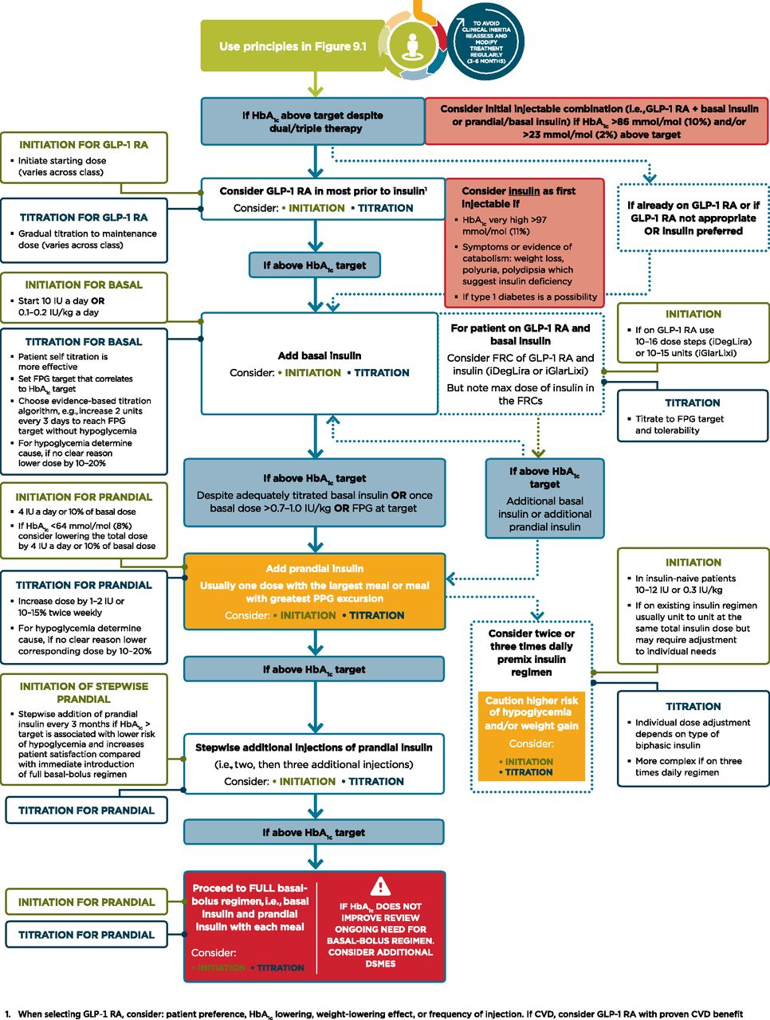

Intensifying to injectable therapies.
American Diabetes Association Dia Care 2019;42:S90-S102
©2019 by American Diabetes Association
Notes:
Intensifying to injectable therapies. For appropriate context, see Fig. 4.1. DSMES, diabetes self-management education and support; FPG, fasting plasma glucose; FRC, fixed-ratio combination; GLP-1 RA, glucagon-like peptide 1 receptor agonist; max, maximum; PPG, postprandial glucose. Adapted from Davies et al. (39).

Slide 25
Hypertension in DM
Targets
DM and HTN at higher cardiovascular risk (existing atherosclerotic cardiovascular disease or 10-year atherosclerotic cardiovascular disease risk >15%) ------ <130/80.
DM and HTN at lower risk for cardiovascular disease (10-year atherosclerotic cardiovascular disease risk<15%)----- <140/90 .

Slide 26
Hypertension in DM
Treatment Strategies
BP >120/80: wt loss, DASH diet, exercise, moderate alcohol.
BP ≥ 140/90: life style modification and pharmacotherapy.
BP ≥ 160/100: life style modification and two drugs or a single-pill combination of drugs.
Resistant HTN: mineralocorticoid receptor antagonist therapy.

Slide 27
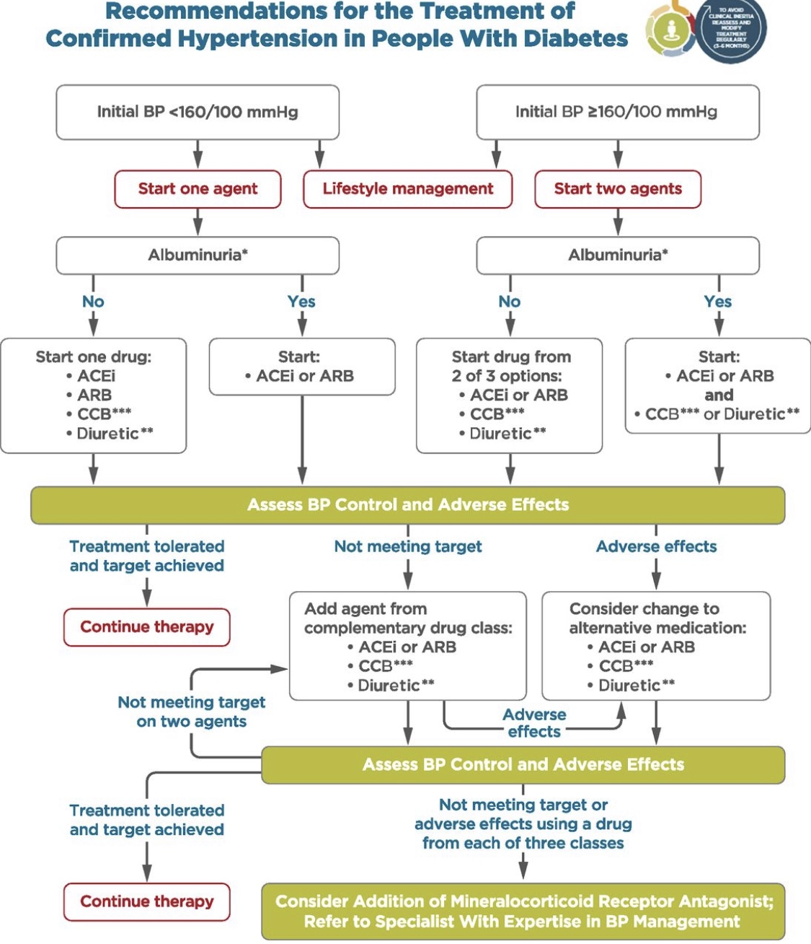

Slide 28
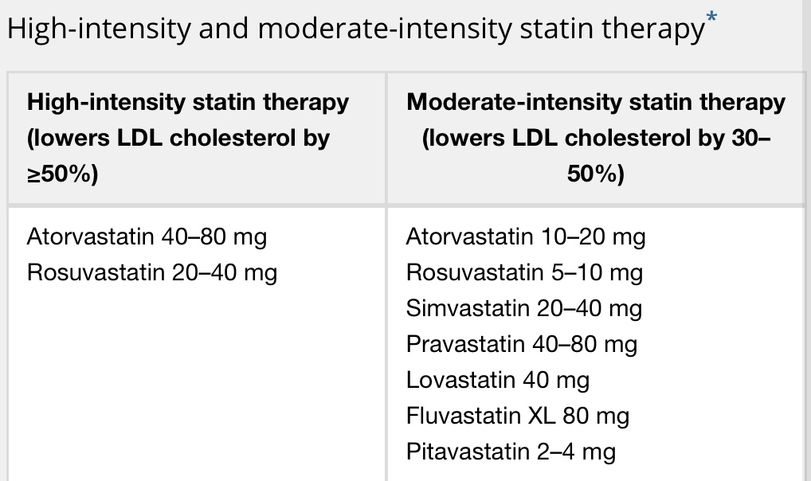
Lipid management

Slide 29
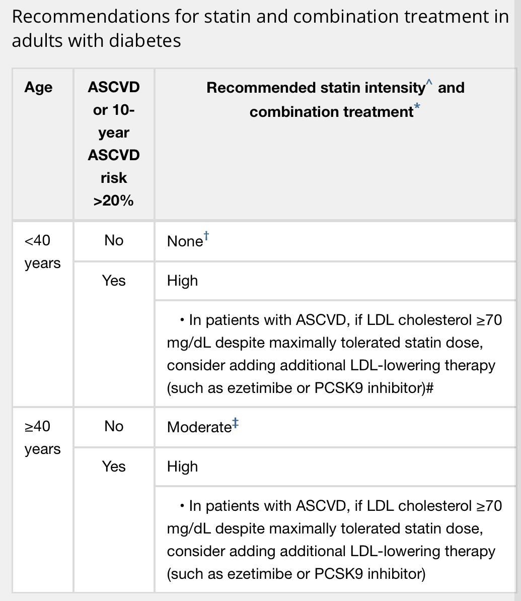

Slide 30
Antiplatelet
Secondary prevention:
Aspirin therapy (75–162 mg/day) for diabetes and a history of atherosclerotic cardiovascular disease. If aspirin allergy--- clopidogrel (75 mg/day).

Slide 31
Antiplatelet
Primary prevention:
Men and women aged≥ 50 years + diabetes + one additional major risk factor (family history of premature ASCVD, hypertension, dyslipidemia, smoking, chronic kidney disease/albuminuria) + no increased risk of bleeding (e.g., older age, anemia, renal disease).

Slide 32
Chronic kidney disease (CKD)
CKD is diagnosed by persistent albuminuria, low eGFR, or other manifestations of kidney damage.
Diabetic Kidney Disease: albuminuria +/- reduced eGFR with no primary causes of kidney damage.
Screening: At least once a year, assess urinary albumin (e.g., UACR) and eGFR.

Slide 33
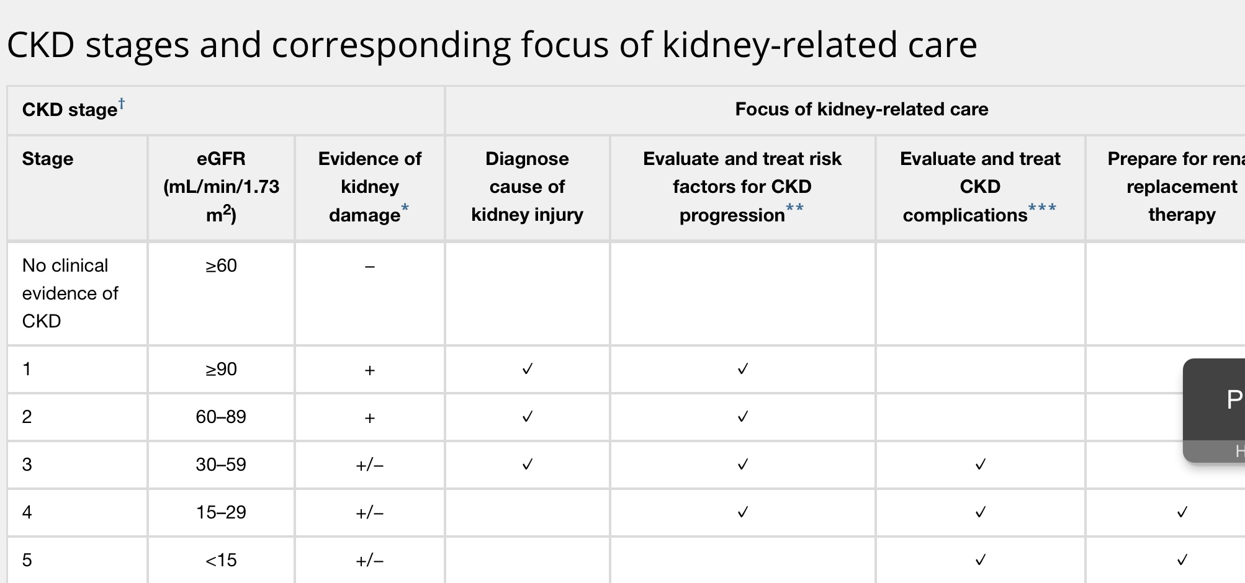
Chronic kidney disease (CKD)

Slide 34
Chronic kidney disease (CKD)
Treatment
Optimize glucose control.
Consider use of SGLT2 inhibitors and GLP1 receptor agonist.
Blood pressure control.
Dietary protein intake of 0.8 g/kg body weight per day.
In diabetes and hypertension, use either an ACE I or ARB if elevated UACR. (monitor s.creat and K).

Slide 35
Chronic kidney disease (CKD)
Treatment
Continued monitoring of UACR in patients with albuminuria treated with an ACEI or ARB to assess response to treatment and progression of CKD.
Refer:
For renal replacement treatment if eGFR < 30.
Refer to nephrologist if uncertain about the etiology of kidney disease, difﬁcult management issues,and rapidly progressing kidney disease.

Slide 36
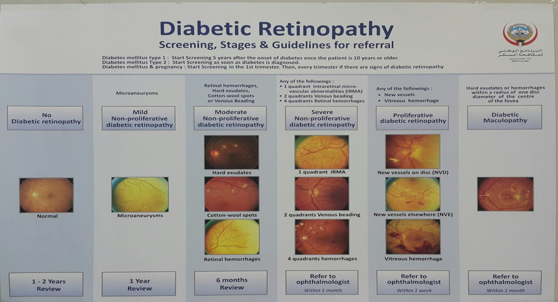

Slide 37
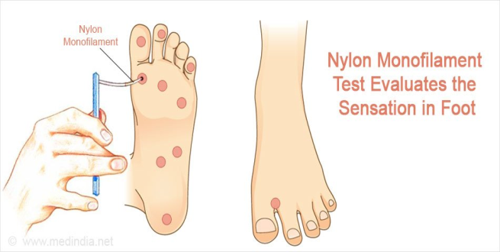

Neuropathy
Diabetic Peripheral Neuropathy
Screening:
DM annually for DPN by history and simple clinical tests.
Clinical tests:
1. Small-ﬁber: pinprick and temperature sensation.
2. Large-ﬁber: vibration perception and 10-g monoﬁlament .
3. Protective sensation: 10-g monoﬁlament

Slide 38


Neuropathy
Diabetic Autonomic Neuropathy
Hypoglycemia unawareness, resting tachycardia, orthostatic hypotension, gastroparesis, constipation, diarrhea, fecal incontinence, erectile dysfunction, neurogenic bladder, and sudomotor dysfunction with either increased or decreased sweating.

Slide 39
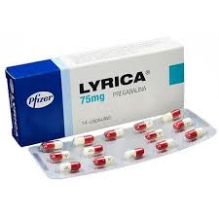
Neuropathy
Treatment
Glucose control: prevent or delay the development of neuropathy type 1 diabetes and to slow the progression of neuropathy in type2 diabetes.
Neuropathic pain: pregabalin, duloxetine, or gabapentin are recommended. Tricyclic antidepressants, venlafaxine, carbamazepine, and topical capsaicin may help.

Slide 40

Neuropathy
Treatment
Orthostatic Hypotension: adequate salt intake, avoiding medications that aggravate hypotension, using compressive garments over the legs and abdomen.
Gastroparesis: low-ﬁber, low-fat eating plan provided in small frequent meals. Metoclopramide, domperidone and erythromycin.
Erectile dysfunction: phosphodiesterase type 5 inhibitors, intracorporeal or intraurethral prostaglandins, vacuumdevices, or penile prostheses.

Slide 41

Foot care
Comprehensive foot evaluation: at least annually
and if sensory loss or prior ulceration or amputation then feet inspected at every visit.
History: past ulceration, amputation, Charcot foot, angioplasty or vascular surgery, cigarette smoking, retinopathy, and renal disease and assess current symptoms of neuropathy(pain,burning,numbness) and vascular disease (leg fatigue, claudication).

Slide 42
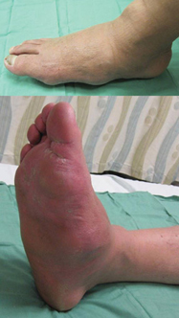
Foot care
Examination:
inspection of the skin, assessment of foot deformities, neurological assessment (10-g monoﬁlament testing with at least one other assessment: pinprick, temperature, vibration or ankle reflex), and vascular assessment including pulses in the legs and feet.

Slide 43
Take home messages
Screening for prediabetes and diabetes in high risk patient is important.
Always be sure about the diagnosis of DM before labeling your patient.
Don’t forget the 4 C’s during your consultation.
Individualized your targets and management.
Avoid clinical inertia.
Screen for DM complication to prevent and manage.
Management of DM is multidisciplinary.

Slide 44

Thanks..

