Slide 1
Examinations
Dr. Sara Al Abdulhadi

Slide 2
Just examine– don’t forget to talk to the patient (real person!)
As a case
Differential diagnosis
Management
Answer questions
Talk as you examine, what are you looking for?
Positive and negative findings
Full examination– general appearance, inspect, palpate, listen
Don’t forget to expose the correct area
Take permission!

Slide 3
What do you expect to come?

Slide 4
Chest ( resp and cardio)
Either will be cases so:
you have to know how to diagnose
how to mange it
or sounds listen:
and tell what it is
diagnosis
So watch the MacLeod video
practice practice

Slide 5
Cvs
Murmurs
Don’t forget pericardial rub
Respiratory
Wheeze
Crepitation
Absent sounds

Slide 6
Child
-Asthma
-Bronchiolitis
Adult
-Pneumonia
-Asthma
-Heart failure
-Pleural effusion

Slide 7
Before any examination you need to:
Wash Hands
Introduce yourself
Explain the examination
Gain consent
Expose the area of examination
Ask if the patient has any pain

Slide 8
Respiratory exam
Hands
Peripheral cyanosis
Clubbing
Respiratory rate – normal adult range = 12-20 breaths per minute
Pulse – rate & rhythm
Pulses paradoxus – pulse wave volume decreases with inspiration – asthma / COPD
Fine tremor
Flapping tremor

Slide 9
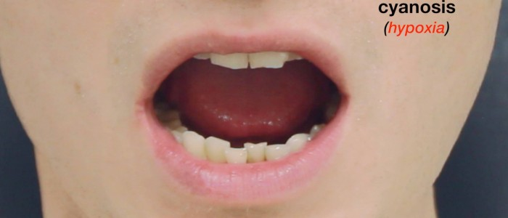
Respiratory examination
Head & Neck
Conjunctival pallor –Central cyanosis
Jugular Venous Pressure

Slide 10
Respiratory examination
General inspection
treatments or adjuncts around bed
Does patient look SOB? Able to speak in full sentences?
Scars
Chest wall
Cachexia – very thin patient with muscle wasting – malignancy

Slide 11
Respiratory examination
Inspection
Scars
Skin changes – Asymmetry – major surgery
Deformities – barrel chest (COPD)
Palpation:
Tracheal position
Cricosternal distance
Chest expansion:

Slide 12
Respiratory examination
Percussion
Resonant : this is a normal finding
Dullness : consolidation / fluid / tumor / collapse
Stony dullness : this suggests the presence of a pleural effusion
Hyper-resonance : e.g. pneumothorax
check tactile vocal fremitus
Say 99

Slide 13
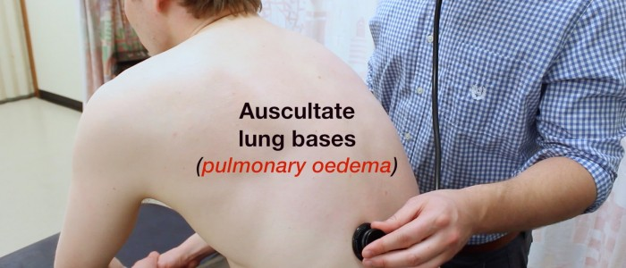
Auscultation
Assess quality
Assess volume
Added sound:
Wheeze – asthma\COPD
Coarse crackles – pneumonia / fluid
Fine crackles – pulmonary fibrosis

Slide 14
3. Vocal resonance:
Ask patient to say “99” repeatedly & auscultate the chest again
Increased volume over suggest consolidation/fluid
Note that same thing will be come at the back

Slide 15
CVS EXAMINATION
IN EXAM IT MAY COME AS CASE OR MURMER SOUND
general inspection:
Bedside – treatments or adjuncts? – GTN spray / O2 / medication / mobility aids
Comfortable at rest? –
Shortness of breath at rest?
Inspect chest – scars or visible pulsations?
Inspect legs

Slide 16
CVS EXAMINATION
hand:
Splinter hemorrhages
Finger clubbing:
Colour
Temperature Janeway lesions – non-tender maculopapular erythematous palm pulp lesions – bacterial endocarditis
Osler’s nodes – tender red nodules on finger pulps / thenar eminence – infective endocarditis
Exanthemata
Capillary refill

Slide 17
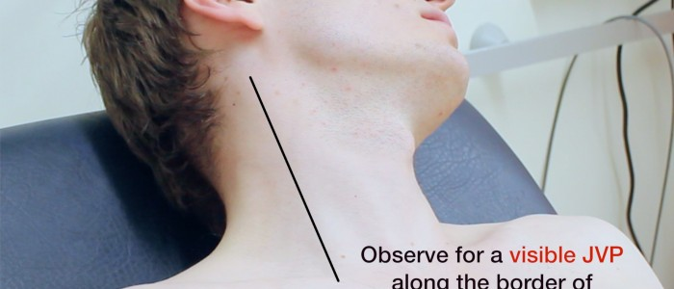
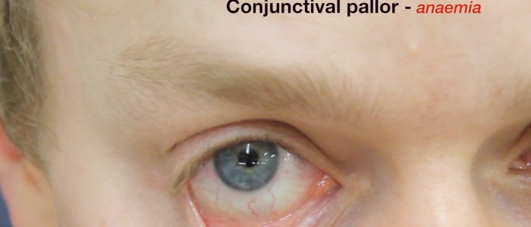
JVP
Face
eye
Conjuctival pallor
xanthelesma
2.Mouth
Dental hygiene
Angular stomatis
Central cyanosis

Slide 18
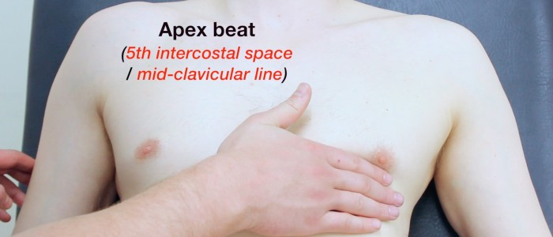
CVS EXAMINATION
Chest inspect:
Scars:
Chest wall deformities
Visible pulsations
palpation
thrill
apex beat

Slide 19
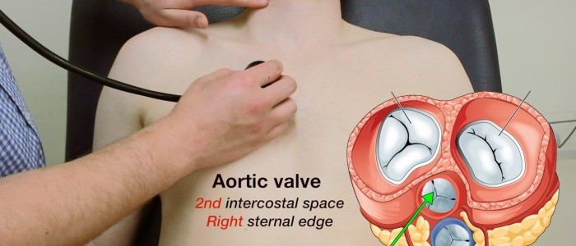
Auscultation
heart sound
aortic valve
Pulmonary valve
Mitral valve
Tricuspid valve
2. check for the murmer
3. to complete examination
4.auscultate lung bases
Sacral oedema / Pedal oedema

Slide 20
Thyroid exam

Slide 21
Thyroid examination
Inspection:
Inspect the patients hands for
Dry skin (hypothyroid)
Increased sweating (hyperthyroid)
Thyroid acropachy – phalangeal bone overgrowth – Graves’ disease
Palmar erythema
Prepieral tremor
radial pulse

Slide 22
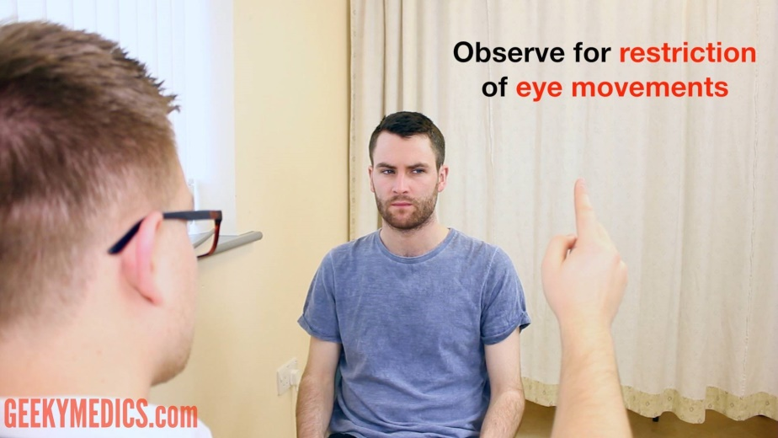
Inspect the face for…
Dry skin
Sweating
Eyes
Exophthalmos
Eye movement
Lid lag

Slide 24
Thyroid
Inspect the midline of the neck (in the region of the thyroid)
Any skin changes Any scars? –
Note any swellings / masses in the area
If a mass is noted on inspection
1. Ask the patient to swallow some water
2. Ask patient to protrude their tongue

Slide 25
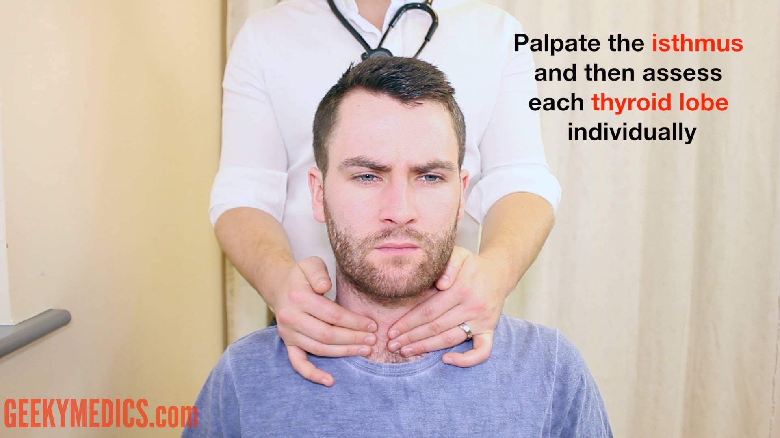
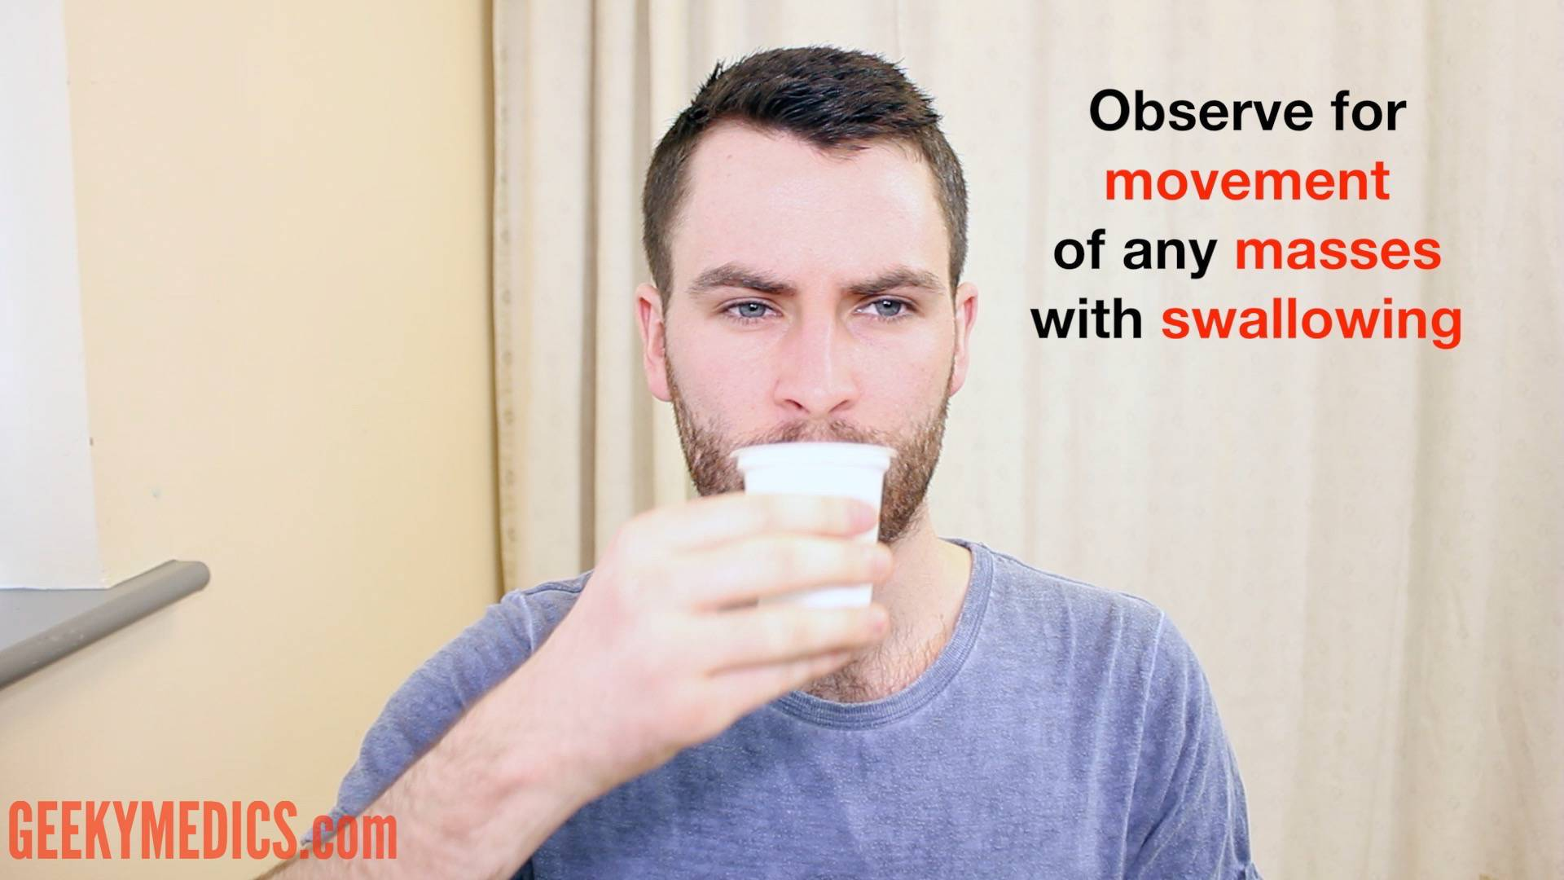
Palpation:
1. Palpate the thyroid isthmus using the pads of your fingers
2. Palpate each lobe of the thyroid
3. Ask the patient to swallow some water, whilst you feel for symmetrical elevation of the thyroid lobes
4. Ask the patient to protrude their tongue once more

Slide 26
When palpating the thyroid gland, assess the following:
-Size
-Symmetry – Consistency
-Masses
-Palpable thrill
If a mass is noted… Assess – position / shape / tenderness/ consistency / mobility

Slide 27
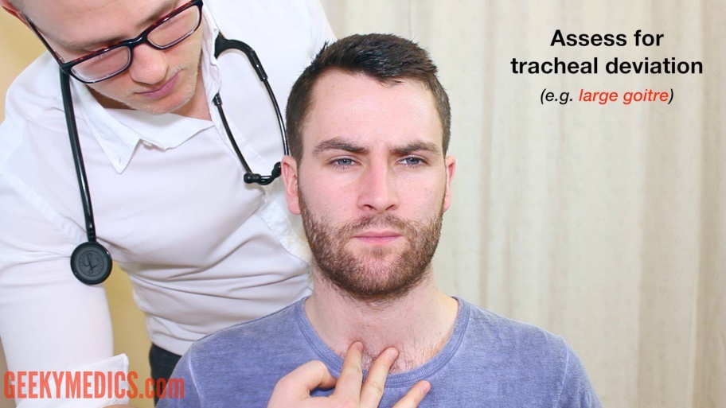
Lymph nodes Palpate for local lymphadenopathy: Trachea Note any deviation of the trachea – may be caused by a large thyroid mass

Slide 28
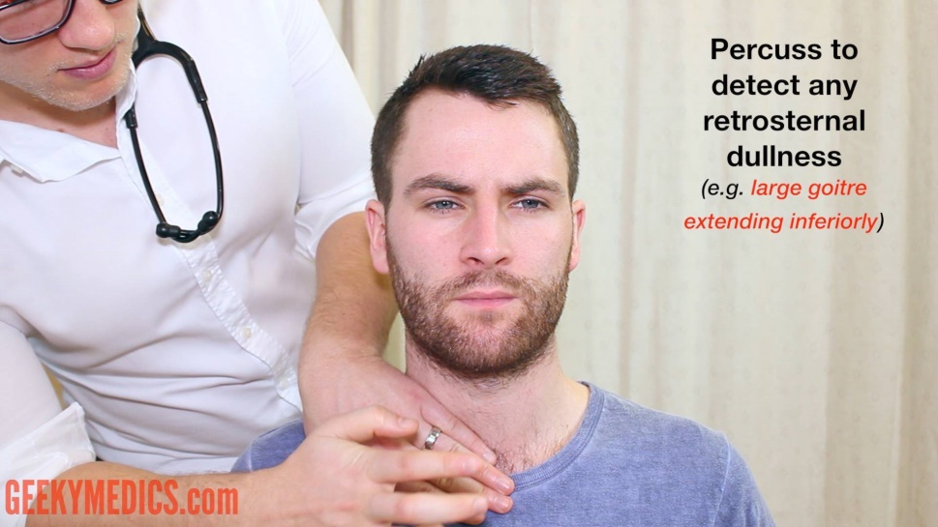
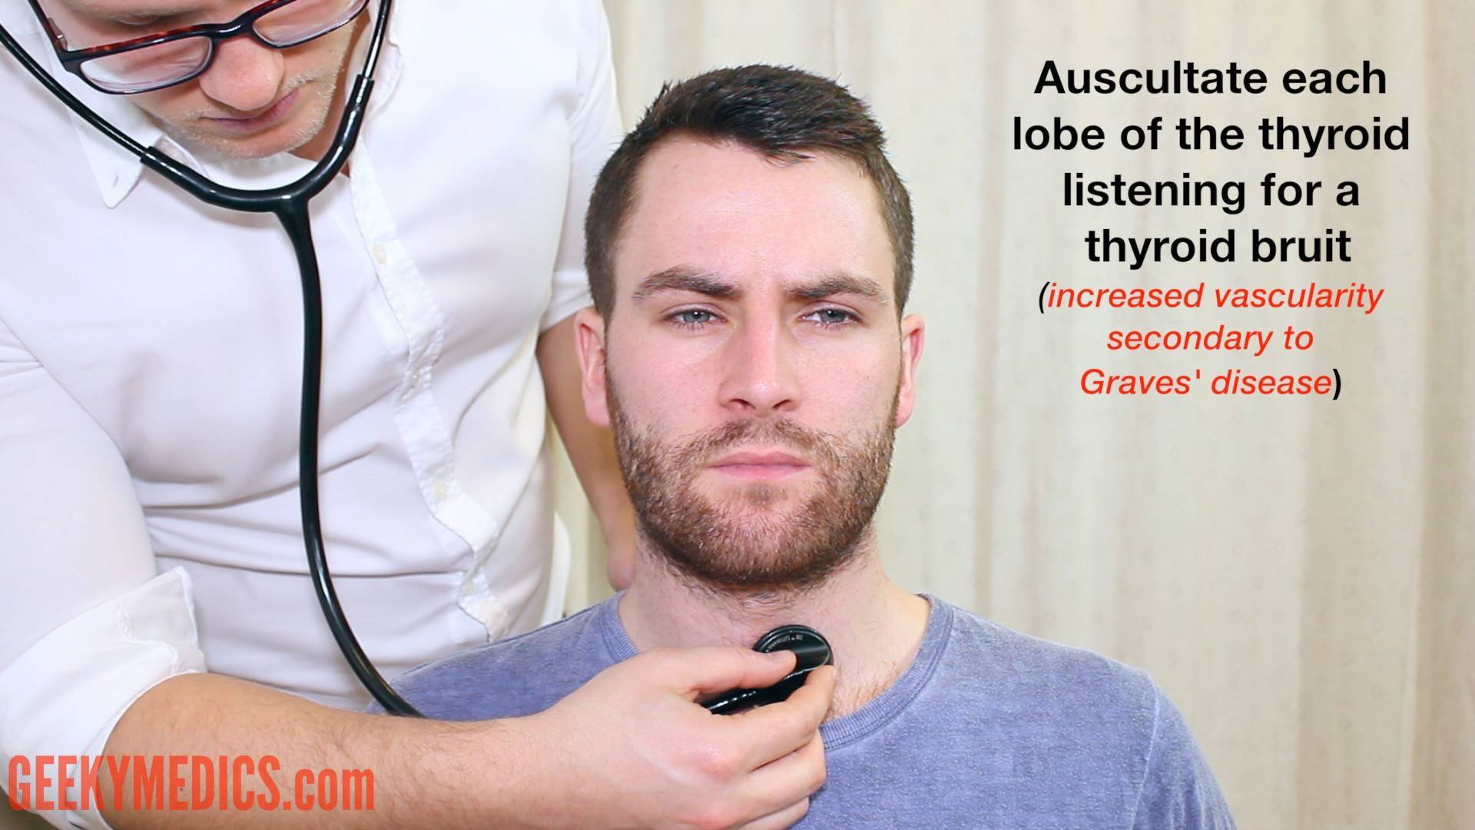
percussion
Percuss downwards from the sternal notch.
Auscultation
Auscultate each lobe of the thyroid for a bruit.

Slide 29
Special test
Reflexes
2. Inspect for pretibial myxedema – associated with Graves’ disease
3. Proximal myopathy:
Ask the patient to stand from a sitting position with arms crossed

Slide 30
Diabetic foot

Slide 31
read what they want exactly
ask for the instruments you need

Slide 32
DIABETIC FOOT EXAM
Inspect:
Color
Skin
Foot inspect between toe and behind legs
Shoes: incorrectly fitting shoes?
deformity: Charcot joints

Slide 33
DIABETIC FOOT EXAM
Palpation:
Temperature
pulse
Capillary refill: normal<2 sec
Soft touch sensation( assess lower limb compare dermattomes R and L)
Pain sensation (sharp) assess lower limb dermatomes compare R and L

Slide 34
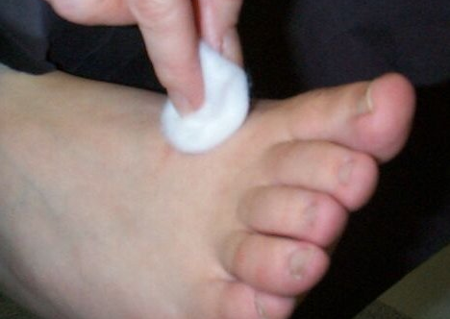
pain sensation -sharp
Soft touch sensation

Slide 35
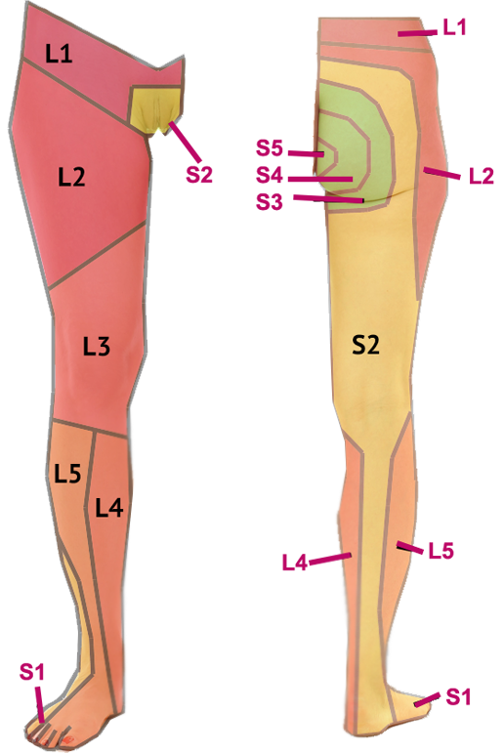
dermatomes

Slide 36
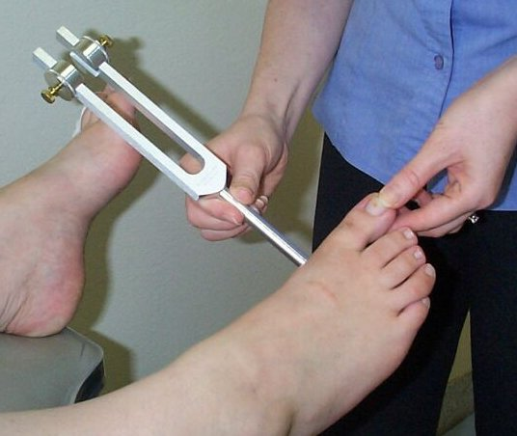
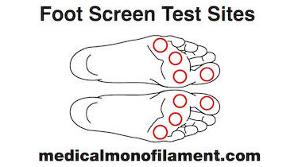
DIABETIC FOOT EXAM
Vibration
-ask patient to close eyes
b. monofilament:
- Ask patient to close eyes and inform you when they feel their foot being touched

Slide 37
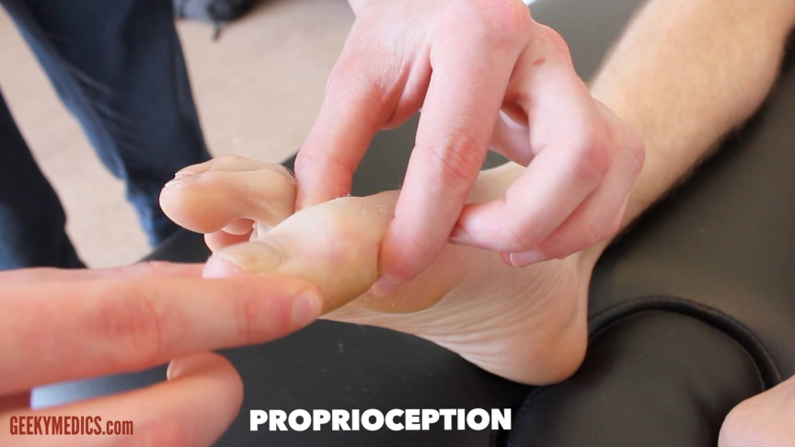
DIABETIC FOOT EXAM
c. Proprioception
d. ankle jerk
e. Gait
observe the patient walking ,assess the following:
Symmetry\ turning

Slide 38
examine shoe
pattern of wear on soles
ensure the shoes are correct size for the patient
note any holes \material inside shoe that cause rubbing \ foot injury

Slide 39
Neurology exam

Slide 40
As examination either:
- motor system
Sensory system
cerebellar sign
- cranial nerve
Ask for the instruments you may need
So watch the MacLeod video
practice practice

Slide 42
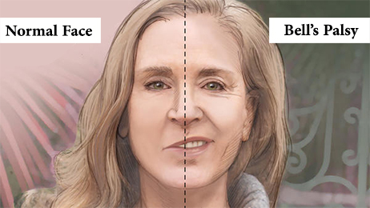
Facial palsy examination
Approach to the clinical examination for Bell palsy
Observe asymmetry :
-pay close attention to
-blinking
-Nasolabial fold
-Corner of mouth

Slide 44
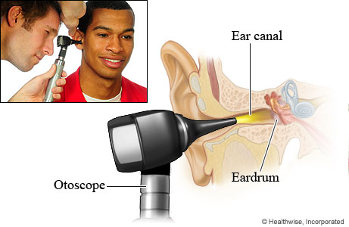
2. ear:
-inspect:
-tympanic membrane

Slide 45
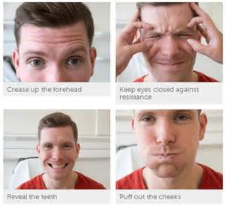
3.Assess motor function:
-raise eyebrows
-close both eye tightly
-puff the cheeks
- purse the lips
- Show the upper and lower teeth

Slide 46
4. Assess sensation
Anterior 2\3 of tongue taste and salivation

Slide 47
5.Assess reflexes
corneal reflex

Slide 48
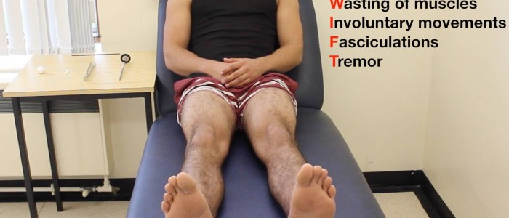
NEUEROLOGY EXAMINATION
Speech
Intellectual function- mental test
gait
Motor system
Inspect: wasting/fasciulation/involuntary movement
Tone
Power
5. reflex

Slide 49
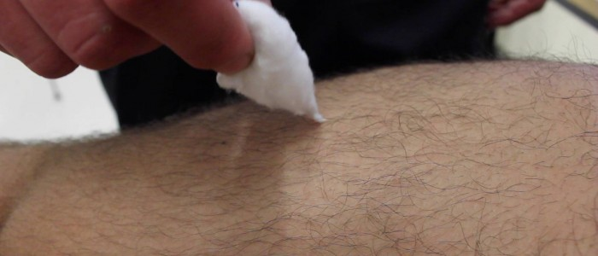
NEUROLOGY EXAMINATION
6.Sensory system:
Simple touch
pain
temperature
joint position sense
vibration
coordination: finger nose test, heel-shin test and Romberg sign

Slide 50
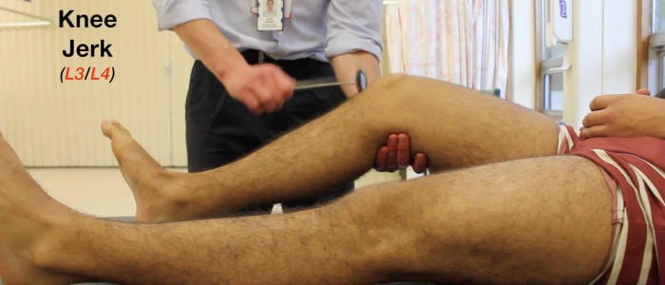

Slide 51
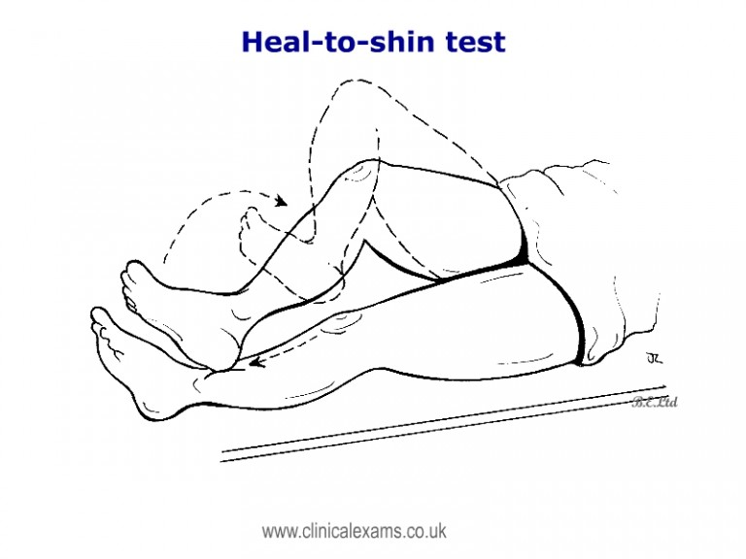
Finger nose test

Slide 52
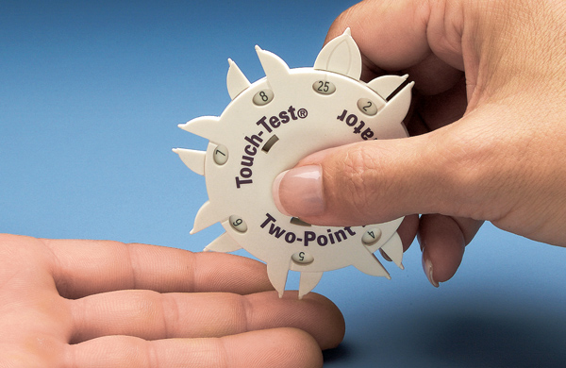
NEUROLOGY EXAMINATION
7. Cortical sensory function:
-Stereognosis
Two point discrimination
8. Cranial nerve

Slide 54
Ear examination
Hearing– whisper test
Otter pina
Otoscope
Rhinne & Weber test

Slide 55
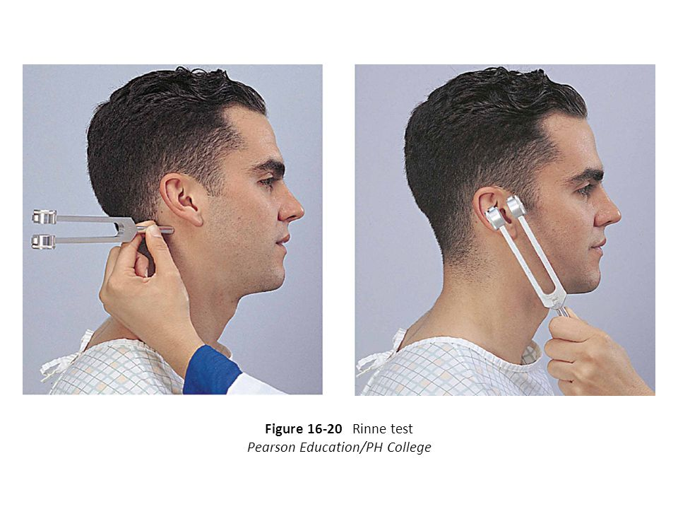

Slide 56
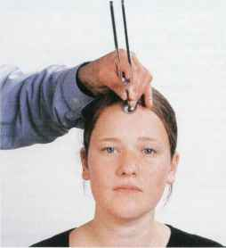

Slide 58
Mr X comes to the clinic with pain in his right knee after a soccer injury
Please examine his knee

Slide 59
Orthopedics

Slide 60
Procedure
Introduce yourself
Wash hands
Take permission
Expose the right area
Start away from pain
Compare both sides
Referred pain

Slide 61
Examination
Inspection
Deformity
Discoloration
Swelling
Scars
Palpation
Tender points
Joint lines
temperature
Range of motion
Active
Passive
Feel for crepitus
Special tests

Slide 62
Examination
Videos– Macleod– available on YouTube
Practice! Practice! Practice!

Slide 63
Shoulder Examination
Inspection – don’t forget the back
Palpation– palpate all joints
Asses flexion, extension, abduction, adduction, internal and external rotation
Asses rotator cuff muscles
Special tests
“could be referred pain from the neck so I would like to examine it”
Notes:
Against resistance– specific muscles
Resisted external rotation– infraspinatus/teres minor
Resisted internal rotation -- subscapularis

Slide 66
Fast assessment/scratch test
(Left) Testing abduction and external rotation. (Right) Testing adduction and internal rotation.

Slide 67
Rotator cuff special tests
Impingement test
Neer Test
Empty Can test
Hawkins-Kennedy Test
All test for impingement of supraspinatus

Slide 68
Empty can
Supraspinatus
90 degrees flexion
30 degrees abduction
Thumb downward
Apply pressure
+ve if weak or pain

Slide 69
Rotator cuff tests
Neer’s test
Hawkin’s test
https://www.youtube.com/watch?v=U8-yLHQ_JaM-
https://www.youtube.com/watch?v=OYK5qL2om-c
Notes:
https://www.youtube.com/watch?v=r8Rl0_KE3OA-- full exam

Slide 70
Instability tests
Load and Shift
Apprehension test
Apprehension relocation (anterior instability)
Sulcus Sign (inferior instability)

Slide 71
Load and shift
Sulcus sign

Slide 72
Apprehension/relocation tests
Apprehension test
Relocation test
https://www.youtube.com/watch?v=xEtzVcV9Z5Q

Slide 73
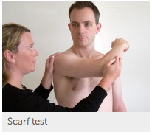
Scarf test
Acromio-clavicular dysfunction

Slide 74
Elbow Examination
Inspection
Palpation– over bursa and epicondyles
Range of movement– extension, flexion, supination, pronation
Special tests
Referred pain from the shoulder

Slide 75
Tennis elbow
Mills test (passive)
Cozen’s test (active)
Elbow extended
Pronation
Flexion of wrist
This stretches the muscle
Flex elbow
Press on lateral epicondyle
Pronation
Resistance against dorsiflexion
Pain over the lateral epicondyle
Notes:
Keep palpating the epicondyle
Extensor group

Slide 76
Golfer’s elbow
Pain over the medical epicondyle
https://www.youtube.com/watch?v=7rBCpk3jFaQ

Slide 77
Wrist/hand examination
Inspection– nodes, cysts, mallet finger, rheumatoid changes, psoriasis patches , wasting
Palpation
Asses range of motion
Trigger finger?
Special tests
Referred pain?

Slide 78
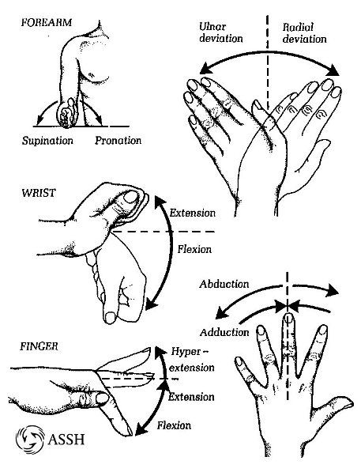

Slide 79
Special tests

Slide 80
Special tests
Finkelstein test
Pain over the abductor pollicis longus and extensor pollicis brevis tendon
De quarvain’s tendonitis

Slide 81
Back Examination
Deformities – kyphosis, loss of lumbar lordosis, scoliosis
Palpate for tenderness and muscle spasm
Asses flexion, extension, lateral flexion, and rotation
Ask to lie down
Lower limb neurological examination
Special tests

Slide 82
Straight leg raise
Ask patient to lie down and raise 1 leg
Passively dorsiflex the foot
Positive if there is pain
Dorsiflexion intensifies pain
Tests L4,L5,S1 nerve root

Slide 83
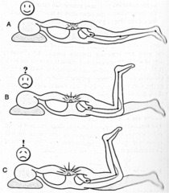
Femoral stretch test
Tests L3,L4 nerve root
Pain on extension of the hip

Slide 84
Schober’s test
5 cm below dimples of Venus and 10 cm above
Normal is more than 5 cm increase

Slide 85
Hip Examination
Gait
Deformities – stance, pelvic tilt, increased lordosis
Palpate for tenderness
Trochanter
Asses range of motion
Special tests
“could be referred pain from the back so ideally I’d like to examine the back as well”

Slide 86
Trendelenburg’s test
Used to asses weak or paralyzed abductor muscles of the hip, namely gluteus medius and gluteus minimus
Ask patient to stand on 1 leg
“Sound side sags”

Slide 87
Shortening
Asses length of legs to check that they are equal
Apparent length:
from umbilicus to medial malleolus
True length:
from ASIS to medical malleolus

Slide 88
Thomas test
Used to rule out hip flexion contracture and psoas syndrome
Enjoy the video ☺
https://www.youtube.com/watch?v=KAgRJTsXHrU

Slide 89
Knee Examination
Inspection– don’t forget the back ?backer’s cyst
Palpate– joint lines, effusion
Asses flexion and extension
Special test- knee stability
Referred pain

Slide 90
Knee stability cruciate ligaments
Anterior drawer test
Posterior drawer test
Sit on feet to stabilize the leg
Flexion
Fingers in popliteal fossa
Thumbs on tibial tuberosity

Slide 91
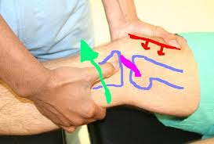
Lachman test

Slide 92
Knee stability
Collateral ligaments
Menisci (McMurray’s test)
Patellar stability (apprehension test)
https://www.youtube.com/watch?v=wOplC9qMfrU

Slide 93
Ankle/foot examination
Gait– heel strike, toe off
Inspection- hallux valgus, arches, Achilles tendon, varus/valgus deformity
Look at patients shoes
Palpate all joint
ROM– planter flexion, dorsiflexion, inversion, eversion, flexion of big toe
Passive– mid tarsal and subtalar movement https://www.youtube.com/watch?v=ImPQ2TxQm8I
Special tests
Notes:
mid tarsal/subtalar

Slide 95
Special tests
Lateral view

Slide 96
Special tests
Anterior drawer test
Anterior talo-fibular ligament
Talar tilt test
Posterior talo-fibular
Calcaneofibular
Anterior talo-fibular
Thomson’s test
Achilles tendon

Slide 97
Special test
Squeeze test
High injury
Syndesmosis injury
https://www.youtube.com/watch?v=Jpsg2LCS8us

