Slide 1
ECG
Dr. Sara Al Abdulhadi

Slide 2
Approach
Rate
Regular: 300/ #of large squares between QRS complex
Irregular: # of QRS multiplied by 10 (6 sec strip)
Rhythm
P wave followed by QRS
Uniform shape
Abnormalities
Regular Vs. irregular
Sinus?

Slide 4
P wave < 3 small squares
PR <= 1 large square
QRS 1-3 small squares
QT around 2 large squares

Slide 6
NORMAL

Slide 7
Exam rhythms

Slide 8
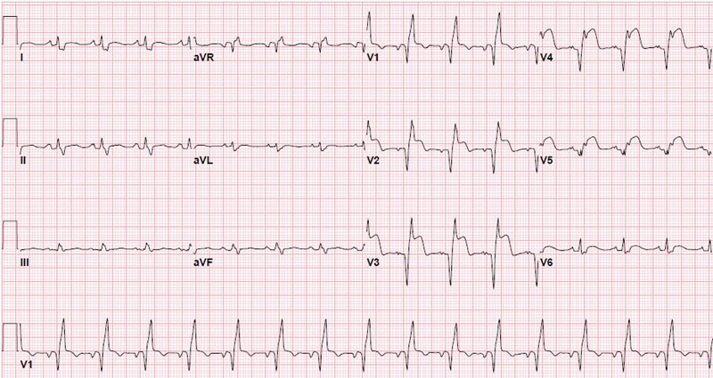
ST segment elevation
Depression in lead 1
Notes:
Anterio-lateral

Slide 10
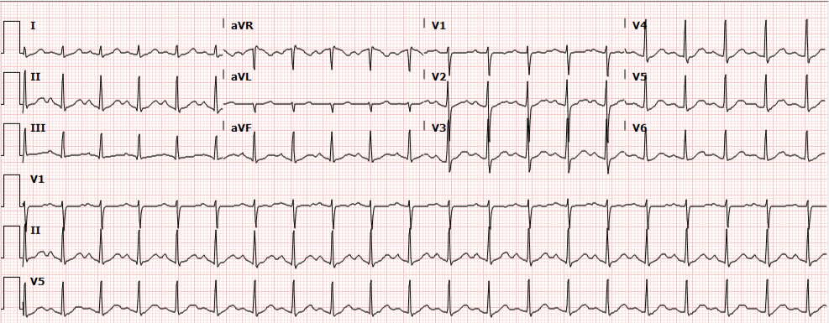
Sinus Tachycardia
Notes:
Every p wave followed by QRS, normal width QRS

Slide 11
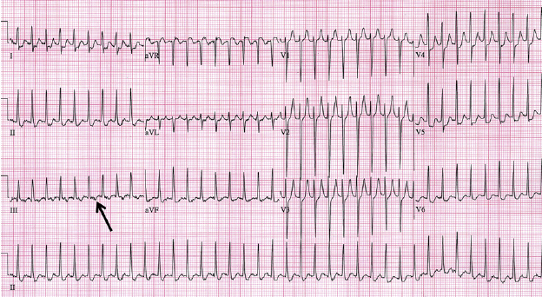
SVT
Notes:
Narrow QRS, no P wave

Slide 13
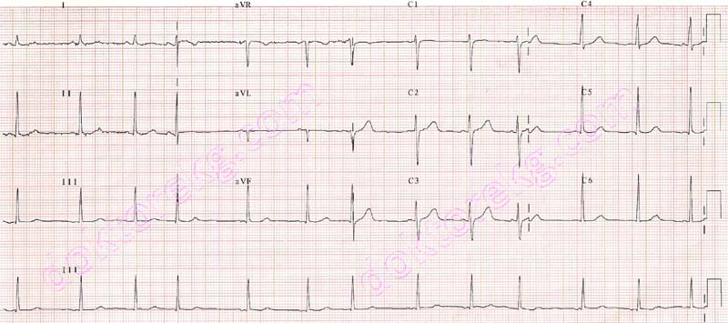
Atrial Fibrillation
Notes:
Irregularly irregular

Slide 14
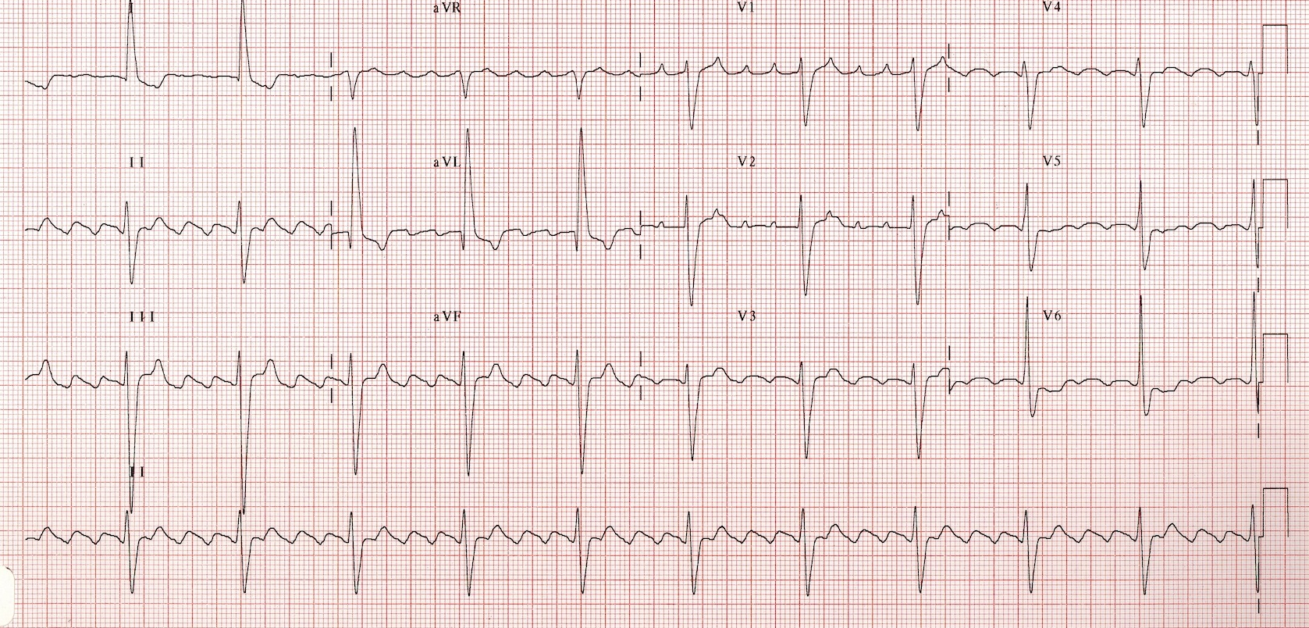
Atrial Flutter
Notes:
Saw tooth pattern

Slide 15
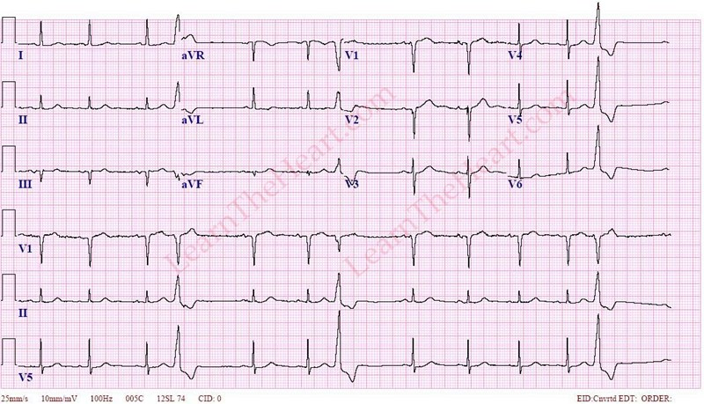
Premature Ventricular complex

Slide 16
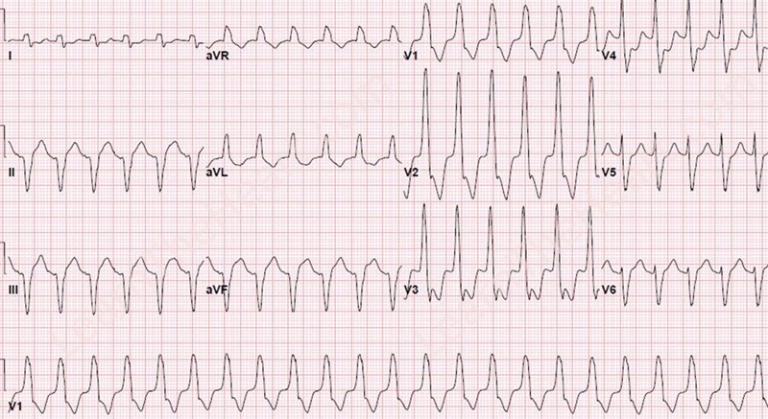
Ventricular tachycardia
Notes:
Regular, no p wave

Slide 17
Ventricular Fibrillation

Slide 18
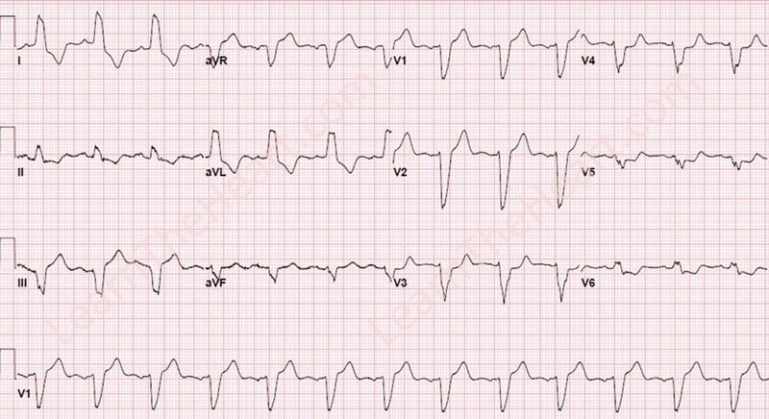
Left Bundle Branch Block

Slide 19
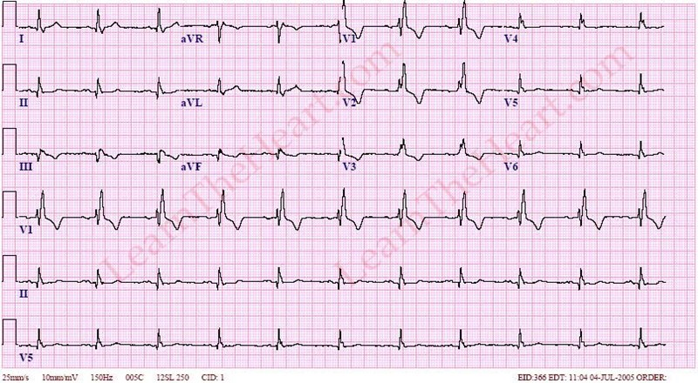
Right Bundle Branch Block

Slide 20
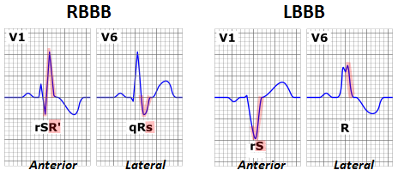

Slide 21
Sinus Bradycardia
Notes:
50 pbm

Slide 22
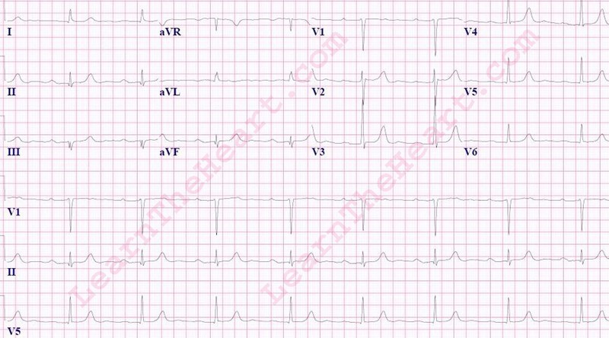
1st degree heart block
Notes:
Prolonged pr interval– hr around 50

Slide 23
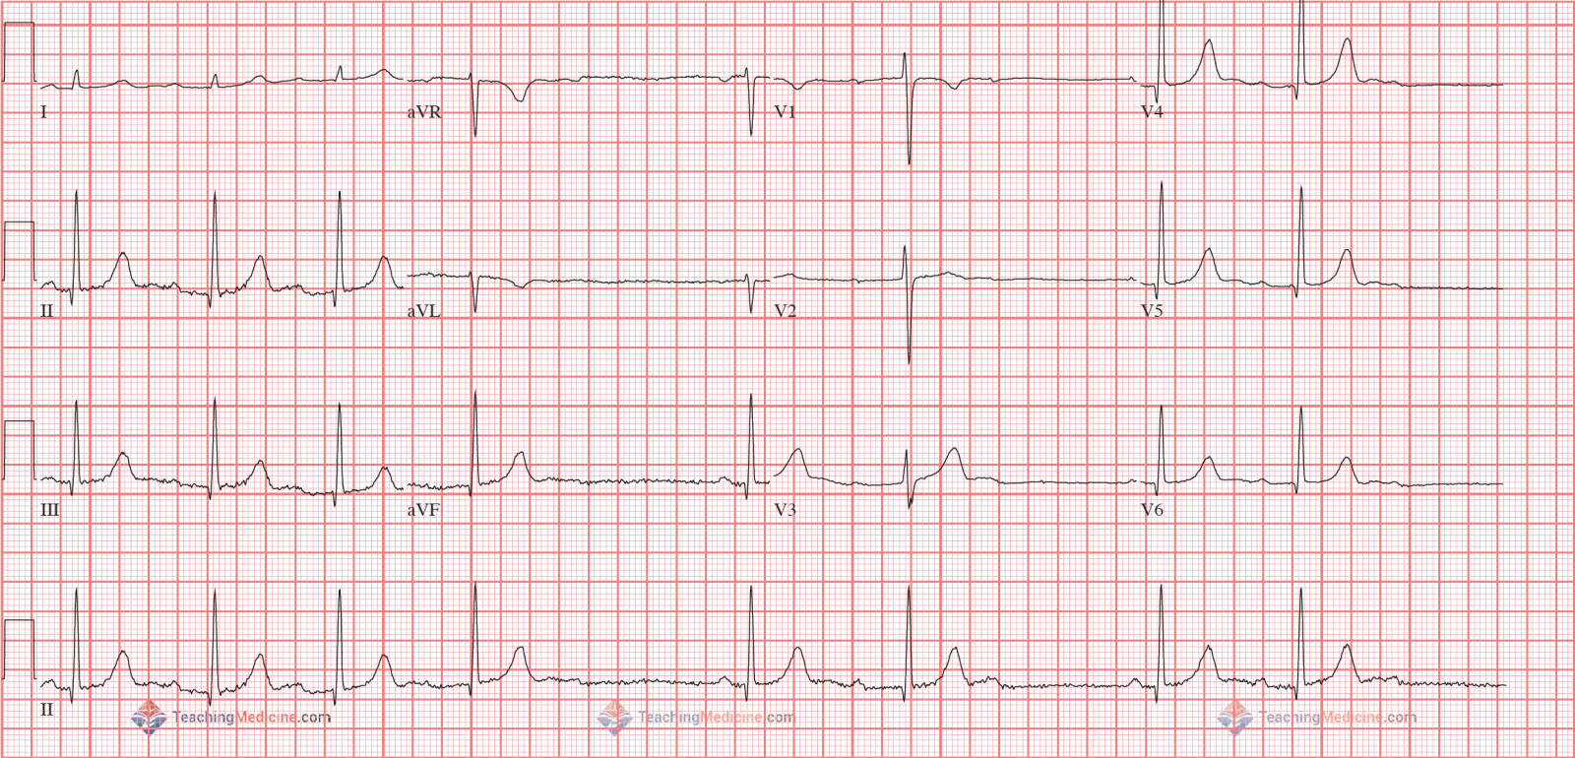
Mobitz type I
Notes:
Pr gets longer then makoo

Slide 24
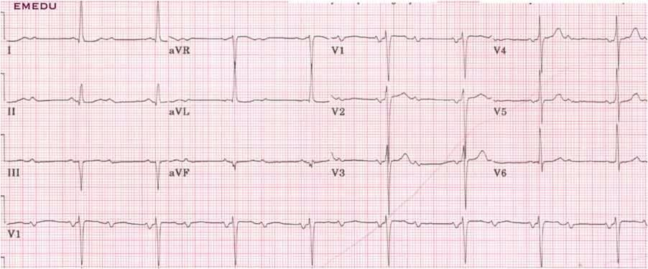
Mobitz type II
Notes:
Pr normal but sme p waves have no QRS

Slide 25
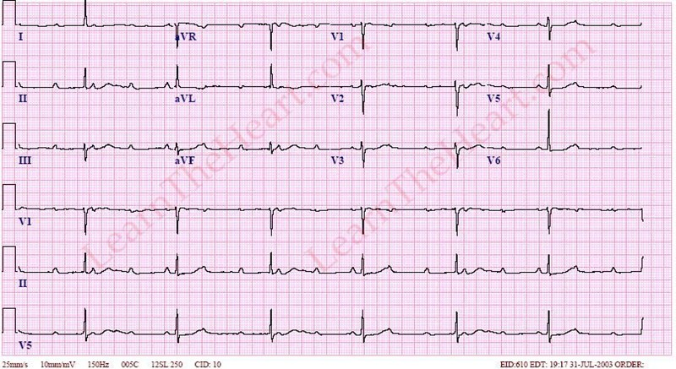
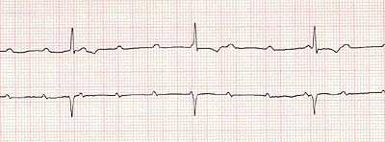
3rd Degree Heart Block

Slide 26
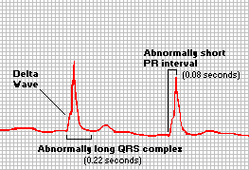
Wolff-Parkinson- White Syndrome

Slide 27
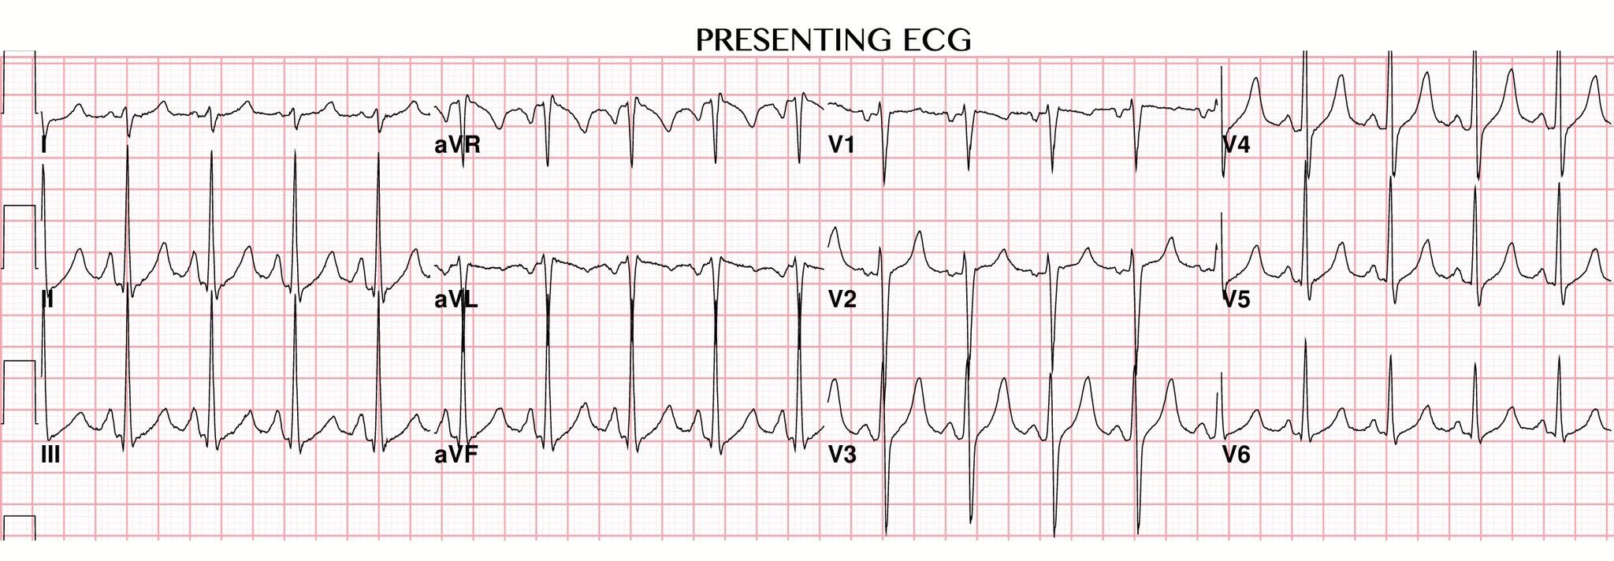

Slide 28
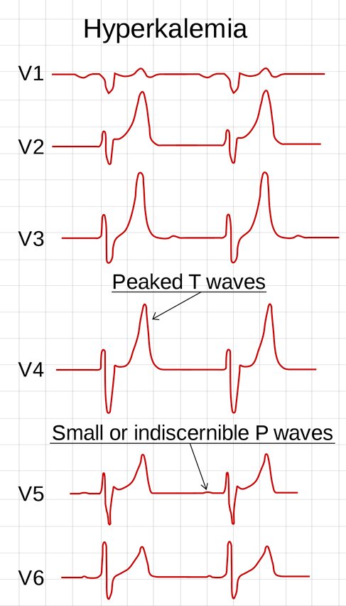

Slide 29
