Slide 1
Women’s Health
Dr.Jameela Al-Qahtani
Obstetrician and Gynecologist
Kuwaiti Board
Maternity Hospital

Slide 2
Abnormal uterine bleeding

Slide 3
Abnormal uterine bleeding
Abnormal uterine bleeding is a term which refers to menstrual bleeding of abnormal quantity, duration, or schedule)
A common gynecologic complaint, accounting for one-third of outpatient visits to gynecologists

Slide 4
Abnormal uterine bleeding
Can be caused by a wide variety of local and systemic diseases or related to medications
FIGO classification system for causes of abnormal uterine bleeding (PALM-COEIN)

Slide 5
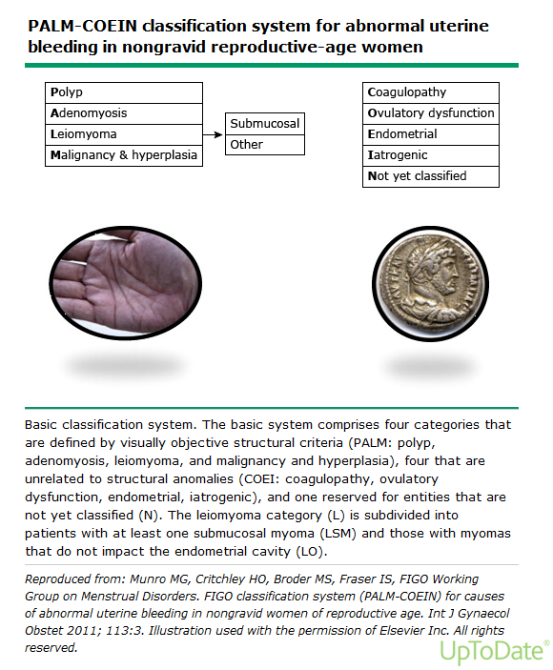
Abnormal uterine bleeding

Slide 6
Abnormal uterine bleeding PALM-COEIN
Polyp

Slide 7
Abnormal uterine bleeding Endometrial polyp
Endometrial polyps are one of the most common etiologies of abnormal genital bleeding in both premenopausal and postmenopausal women
They are hyperplastic overgrowths of endometrial glands and stroma that form a projection from the surface of the endometrium (lining of the uterus)
They may also be asymptomatic
The great majority of endometrial polyps are benign, but malignancy occurs in some women

Slide 8
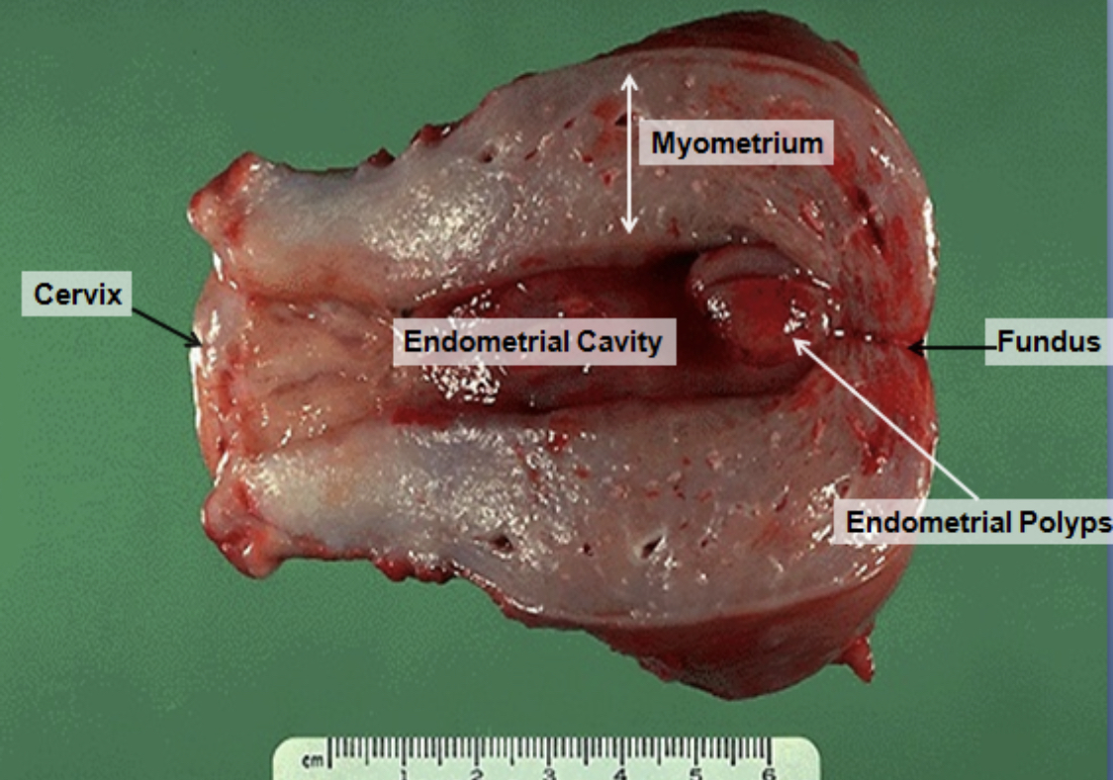
Abnormal uterine bleeding Endometrial polyp

Slide 9
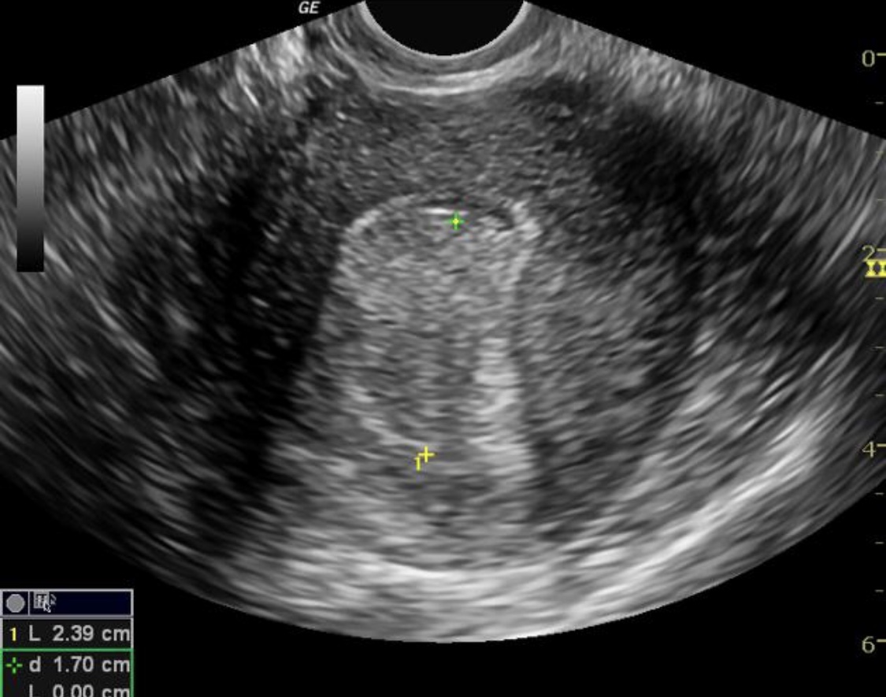
Abnormal uterine bleeding Endometrial polyp

Slide 10
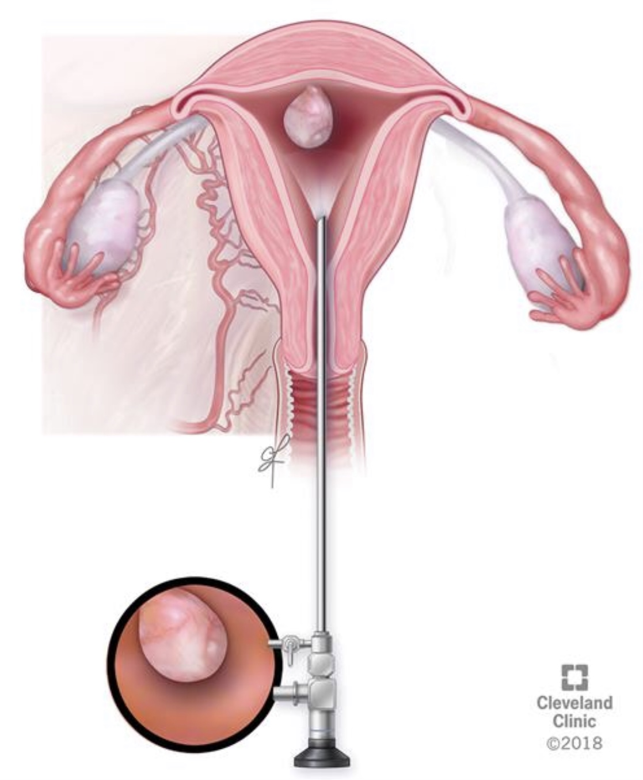
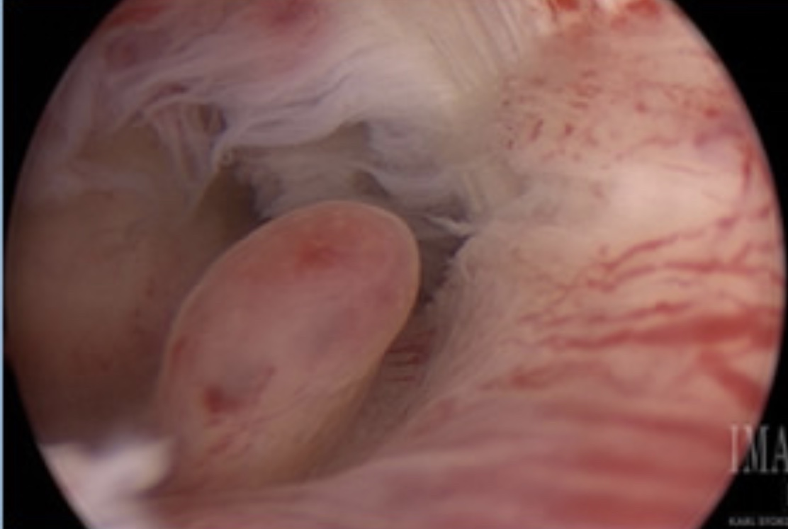
Abnormal uterine bleeding Endometrial polyp

Slide 11
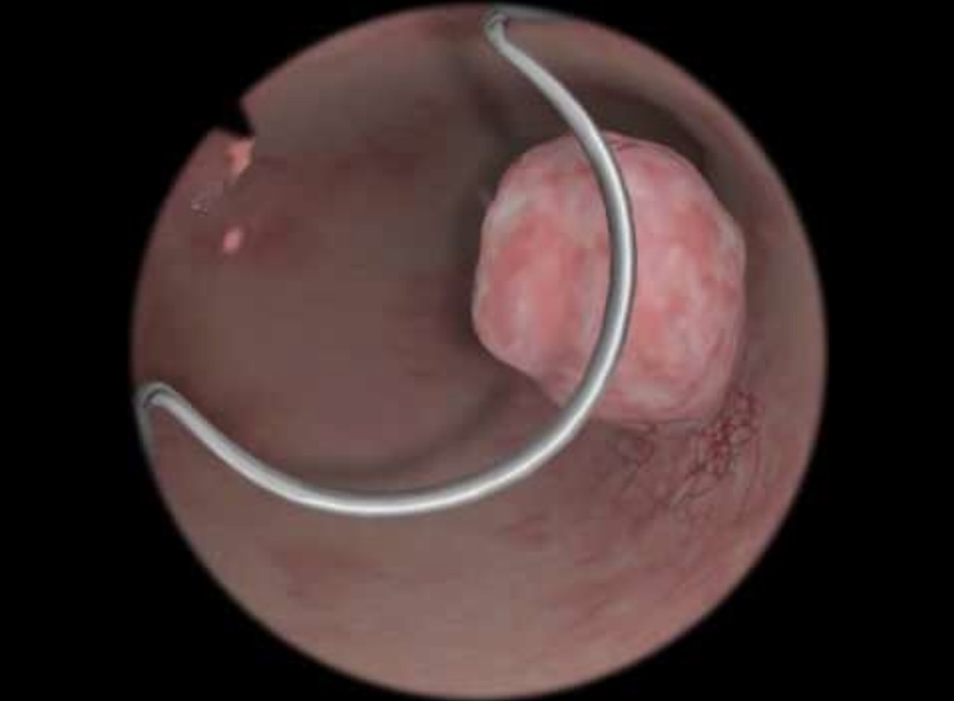
Abnormal uterine bleeding Endometrial polyp

Slide 12
Abnormal uterine bleeding PALM-COEIN
Adenomyosis

Slide 13
Abnormal uterine bleeding Adenomyosis
It is a disorder in which endometrial glands and stroma are present within the myometrium (uterine musculature)
Women with symptomatic adenomyosis present with uterine enlargement, abnormal uterine bleeding, and painful menses

Slide 14
Abnormal uterine bleeding Adenomyosis

Slide 15
Abnormal uterine bleeding Adenomyosis

Slide 16
Abnormal uterine bleeding Adenomyosis
Heavy menstrual bleeding and dysmenorrhea are the typical symptoms of adenomyosis, occurring in approximately 60 and 25 percent of women, respectively
Chronic pelvic pain may also occur
Heavy menstrual bleeding is possibly related to the increased endometrial surface of the enlarged uterus, while pain may be due to bleeding and swelling of endometrial islands confined by myometrium
Approximately one-third of women are asymptomatic

Slide 17
Abnormal uterine bleeding Adenomyosis
Symptoms are typically reported to develop between the ages of 40 and 50 years; however, this may reflect the fact that most adenomyosis has historically been diagnosed at hysterectomy, and younger women are less likely to undergo definitive reproductive surgery

Slide 18
Abnormal uterine bleeding Adenomyosis
History: Heavy menstrual bleeding or pelvic pain should be included.
Pelvic examination: The bimanual pelvic examination in women with adenomyosis typically shows a mobile, diffusely enlarged (often referred to as "globular" enlargement), soft (often referred to as "boggy"), and globular uterus

Slide 19
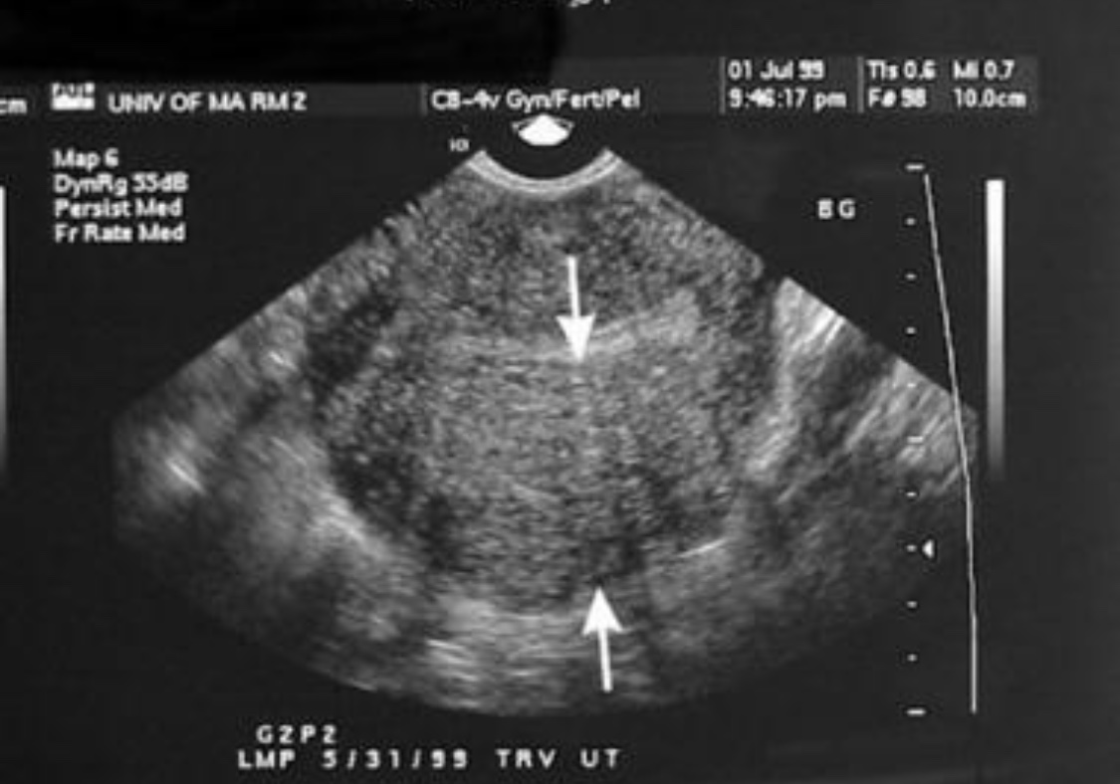
Abnormal uterine bleeding Adenomyosis
Transvaginal ultrasound

Slide 20
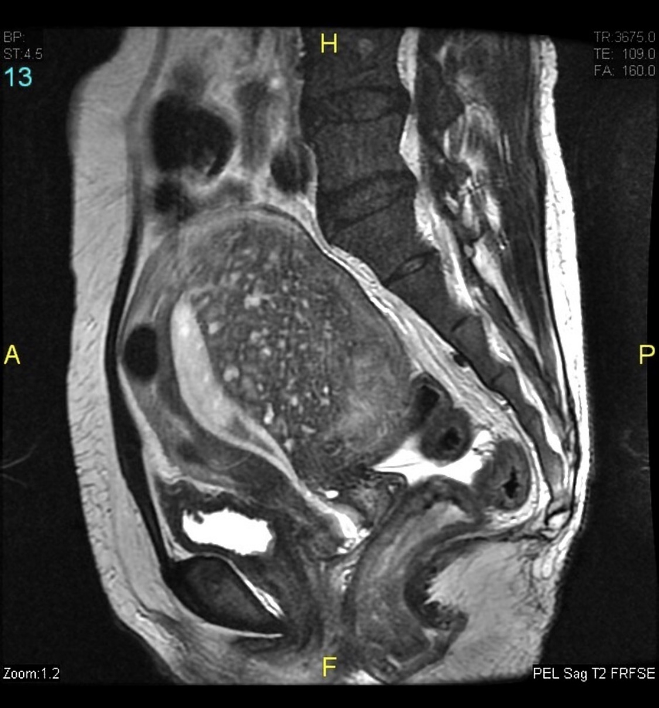
Abnormal uterine bleeding Adenomyosis
MRI

Slide 21
Abnormal uterine bleeding Adenomyosis- Management
Hysterectomy: Total hysterectomy is the definite treatment of adenomyosis
Hormonal medications: Hormonal treatment may be effective for reducing heavy menstrual bleeding and dysmenorrhea
Uterus-conserving procedures:
Uterine artery embolization
Uterus-sparing resection

Slide 22
Abnormal uterine bleeding PALM-COEIN
Leiomyoma

Slide 23
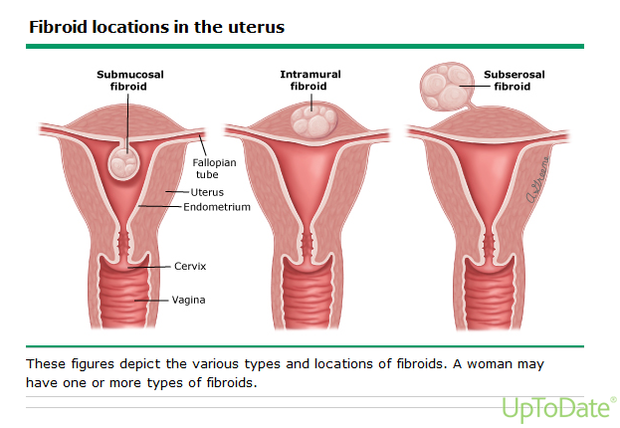
Abnormal uterine bleeding Leiomyoma
Leiomyomas of the uterus (also referred to as myomas or uterine fibroids) are benign neoplasms of smooth muscle of the myometrium

Slide 24
Abnormal uterine bleeding Leiomyoma
Risk Factors:
Race
Parity
Early menarche
Hormonal contraception
Obesity
Diet

Slide 25
Abnormal uterine bleeding Leiomyoma
Symptoms are classified into three categories:
Heavy or prolonged menstrual bleeding
Bulk-related symptoms, such as pelvic pressure and pain
Reproductive dysfunction ( infertility or obstetric complications)

Slide 26
Abnormal uterine bleeding Leiomyoma
Physical examination
Abdominal and Bimanual pelvic examination to check the size, contour, and mobility of the fibroid
An enlarged, mobile uterus with an irregular contour is consistent with a leiomyomatous uterus

Slide 27
Abnormal uterine bleeding Leiomyoma
Pelvic ultrasound is the imaging study of choice for uterine leiomyomas

Slide 28
Abnormal uterine bleeding Leiomyoma- management
Hormonal therapies
Hysterectomy
Myomectomy
Endometrial ablation
Uterine artery occlusion
Notes:
Hormonal therapies hormonal treatment have limited efficacy in the treatment of uterine leiomyomas.. They can reduce HMB.. but they do not appear to be effective in decreasing bulk symptoms

Slide 29
Abnormal uterine bleeding PALM-COEIN
Malignancy and hyperplasia

Slide 30
Abnormal uterine bleeding Malignancy and hyperplasia
Seventy-five to 90 percent of women with endometrial carcinoma present with abnormal uterine bleeding
Women with a clinical presentation suspicious for endometrial carcinoma or hyperplasia should undergo a pelvic examination to evaluate the size, mobility, and axis of the uterus and do endometrial sampling

Slide 31
Abnormal uterine bleeding Malignancy and hyperplasia
Risk factors:
- Age >45 - Unopposed estrogen therapy
- Tamoxifen therapy - Early menarche
- Late menopause (after age 55) - Nulliparity
- DM - Polycystic ovary syndrome
- Obesity -Estrogen-secreting tumor
- Lynch syndrome (hereditary nonpolyposis colorectal cancer)
- Family history of endometrial, ovarian, breast, or colon cancer

Slide 32
Abnormal uterine bleeding

Slide 33
Abnormal uterine bleeding PALM-COEIN
Coagulopathy

Slide 34
Abnormal uterine bleeding PALM-COEIN- coagulopathy
Bleeding disorders are common in reproductive-age women.
Up to 15 to 24 percent of women presenting with menorrhagia may have some type of bleeding diathesis (eg, von Willebrand disease, immune thrombocytopenia, or platelet function defect)

Slide 35
Abnormal uterine bleeding PALM-COEIN- coagulopathy
A bleeding disorder should be suspected if:
heavy or prolonged menses began at menarche
Associated with a family history of coagulopathy
The patient has signs of a bleeding diathesis (eg, easy bruising or prolonged bleeding from mucosal surfaces)
Patient is taking medications associated with an increased bleeding tendency

Slide 36
Abnormal uterine bleeding PALM-COEIN
Ovulatory
Dysfunction

Slide 37
Abnormal uterine bleeding PALM-COEIN- Ovulatory dysfunction
Ovulatory dysfunction occurs when a woman is not ovulating, or having infrequent ovulation
Women typically experience some combination of irregularity of bleeding and a variable volume

Slide 38
Abnormal uterine bleeding PALM-COEIN- Ovulatory dysfunction
It can be related to:
Psychological stress
Weight loss or gain
Excessive exercise
Medications that affect dopamine metabolism
An endocrine abnormality that impacts the hypothalamic-pituitary-ovarian axis, such as hyperprolactinemia, thyroid disease, and polycystic ovary syndrome

Slide 39
Abnormal uterine bleeding PALM-COEIN
Endometrial

Slide 40
Abnormal uterine bleeding PALM-COEIN- Endometrial
In women with predictable and cyclic menses suggestive of normal ovulation who have AUB, particularly the symptom of HMB but can also include intermenstrual bleeding, and absent other definable causes, the patient is classified as having AUB-E
Most often, the cause of such bleeding is a primary disorder of the endometrium.

Slide 41
Abnormal uterine bleeding PALM-COEIN- Endometrial
If the symptom is HMB, the patient may have a primary disorder of mechanisms regulating local endometrial hemostasis.
There are no available tests for these disorders.
AUB-E is assigned after excluding other etiologies of AUB in women of reproductive years.
There may exist other causes of AUB-E, such as endometritis secondary to, for example, Chlamydia trachomatis

Slide 42
Abnormal uterine bleeding PALM-COEIN
Iatrogenic

Slide 43
Abnormal uterine bleeding PALM-COEIN- Iatrogenic
Medications that may cause AUB-I include:
Gonadal steroids (eg, estrogens, progestins, androgens)
Gonadal steroid-related therapy
Anticoagulants
Systemic agents that contribute to disorders of ovulation
Intrauterine devices

Slide 44
Abnormal uterine bleeding PALM-COEIN
Not yet classified

Slide 45
Abnormal uterine bleeding PALM-COEIN- Not yet classified
These have either been poorly defined, inadequately examined, and/or are extremely rare

Slide 46
Heavy menstrual bleeding (HMB)

Slide 47
Heavy menstrual bleeding (HMB)
Take a history from the woman that covers:
The nature of the bleeding
Related symptoms, such as persistent intermenstrual bleeding, pelvic pain and/or pressure symptoms Impact on her quality of life
Other factors that may affect treatment options (such as comorbidities or previous treatment for HMB)

Slide 48
HMB
Carry out a physical examination
Carry out a full blood count test for all women with HMB
Testing for coagulation disorders (for example, von Willebrand's disease) should be considered for women who: have had HMB since their periods started and have a personal or family history suggesting a coagulation disorder
Offer ultrasound
Consider hysteroscopy and endometrial biopsy

Slide 49
HMB
Treatments for women with no identified pathology
LNG-IUS should be the first line treatment for HMB
If a woman with HMB declines an LNG-IUS or it is not suitable, consider the following pharmacological treatments:
- Non-hormonal: Tranexamic acid and/or NSAIDs
- Hormonal: Combined hormonal contraception or
Cyclical oral progestogens

Slide 50
VAGINAL DISCHARGE
Notes:
-

Slide 51
VAGINAL DISCHARGE
Vaginal discharge is a prominent symptom of vaginitis but may be difficult to distinguish from normal vaginal discharge.
In reproductive-aged women, normal vaginal discharge consists of 1 to 4 mL fluid (per 24 hours), which is white or transparent, thick or thin, and mostly odorless.
The discharge may become more noticeable at times ("physiological leukorrhea"), such as at midmenstrual cycle close to the time of ovulation or during pregnancy or use of estrogen-progestin contraceptives

Slide 52
VAGINAL DISCHARGE
Diet, sexual activity, medication, and stress can also affect the volume and character of normal vaginal discharge
Although normal discharge may be yellowish, slightly malodorous, and accompanied by mild irritative symptoms, it is not accompanied by pruritus, pain, burning or significant irritation, erythema, local erosions, or cervical or vaginal friability

Slide 53
VAGINAL DISCHARGE
The initial evaluation typically consists of a history, physical examination, microscopy, and cervical tests for sexually transmitted infections

Slide 54
VAGINAL DISCHARGE DIAGNOSTIC EVALUATION- HISTORY
1. Quantity, color, consistency, and odor:
Bacterial vaginosis (BV) – The discharge of BV is typically malodorous, thin, grey (never yellow).
Vaginal candidiasis – Vaginal candidiasis typically presents with scant discharge that is thick, white, odorless, and often curd-like.
Trichomoniasis – Trichomoniasis is characterized by purulent, malodorous discharge, which may be accompanied by burning, pruritus, dysuria, frequency, and/or dyspareunia.

Slide 55
VAGINAL DISCHARGE DIAGNOSTIC EVALUATION- HISTORY
Burning, irritation, or other discomfort
Candida vulvovaginitis often presents with marked inflammatory symptoms (pruritus and soreness). In contrast, BV is associated with only minimal inflammation and minimal irritative symptoms.

Slide 56
VAGINAL DISCHARGE DIAGNOSTIC EVALUATION- HISTORY
3. Pruritus
General pruritus is suggestive of a diffuse process such as infection, allergy, or dermatosis. Focal pruritus is suggestive of a localized process such as neoplasia or malignancy

Slide 57
VAGINAL DISCHARGE DIAGNOSTIC EVALUATION- HISTORY
4. Vaginal bleeding
Vaginal bleeding is not consistent with infectious vaginitis

Slide 58
VAGINAL DISCHARGE DIAGNOSTIC EVALUATION- Physical examination
Vulva
Speculum examination
Bimanual examination

Slide 59
VAGINAL DISCHARGE DIAGNOSTIC EVALUATION- Physical examination
Vulva
Normal vulva are consistent with BV
Erythema, edema, or fissures suggest candidiasis, trichomoniasis, or dermatitis.
Atrophic changes are caused by hypoestrogenemia and suggest the possibility of atrophic vaginitis.
Changes in vulvovaginal architecture (eg, scarring) may be caused by a chronic inflammatory process, such as erosive lichen planus, as well as lichen sclerosis or mucous membrane pemphigoid rather than vaginitis.
•Pain with application of pressure from a cotton swab ("Q-tip test") on the labia or at the vaginal introitus may indicate an inflammatory process (candidiasis, dermatosis) or vulvodynia (ie, vulvar pain of unclear etiology).

Slide 60
Q-tip test

Slide 61
VAGINAL DISCHARGE DIAGNOSTIC EVALUATION- Physical examination
2. Speculum examination
a) Vagina
b) Vaginal discharge
c) Cervix

Slide 62
VAGINAL DISCHARGE DIAGNOSTIC EVALUATION- Physical examination
a) Vagina
A foreign body

Slide 63
VAGINAL DISCHARGE- Physical examination
a) Vagina
Vaginal warts

Slide 64
VAGINAL DISCHARGE- Physical examination
a) Vagina
Granulation tissue or surgical site infection

Slide 65
VAGINAL DISCHARGE- Physical examination
2. Speculum examination
a) Vagina
b) Vaginal discharge
c) Cervix

Slide 66
VAGINAL DISCHARGE- Physical examination
b) Vaginal discharge
Vaginal candidiasis: discharge may be white and clumpy and may or may not adhere to vagina
Bacterial vaginosis: off-white/gray thin discharge that coats the vagina
Trichomoniasis: thin green-yellow discharge

Slide 67
VAGINAL DISCHARGE- Physical examination
2. Speculum examination
a) Vagina
b) Vaginal discharge
c) Cervix

Slide 68
VAGINAL DISCHARGE- Physical examination
c) Cervix
Cervical inflammation with a normal vagina is suggestive of cervicitis rather than vaginitis
The cervix in women with cervicitis is usually erythematous and friable, with a mucopurulent discharge

Slide 69
VAGINAL DISCHARGE DIAGNOSTIC EVALUATION- Physical examination
Vulva
Speculum examination
Bimanual examination

Slide 70
VAGINAL DISCHARGE- Physical examination
Bimanual examination
Should be performed to assess for tenderness and/or abnormal anatomy

Slide 71
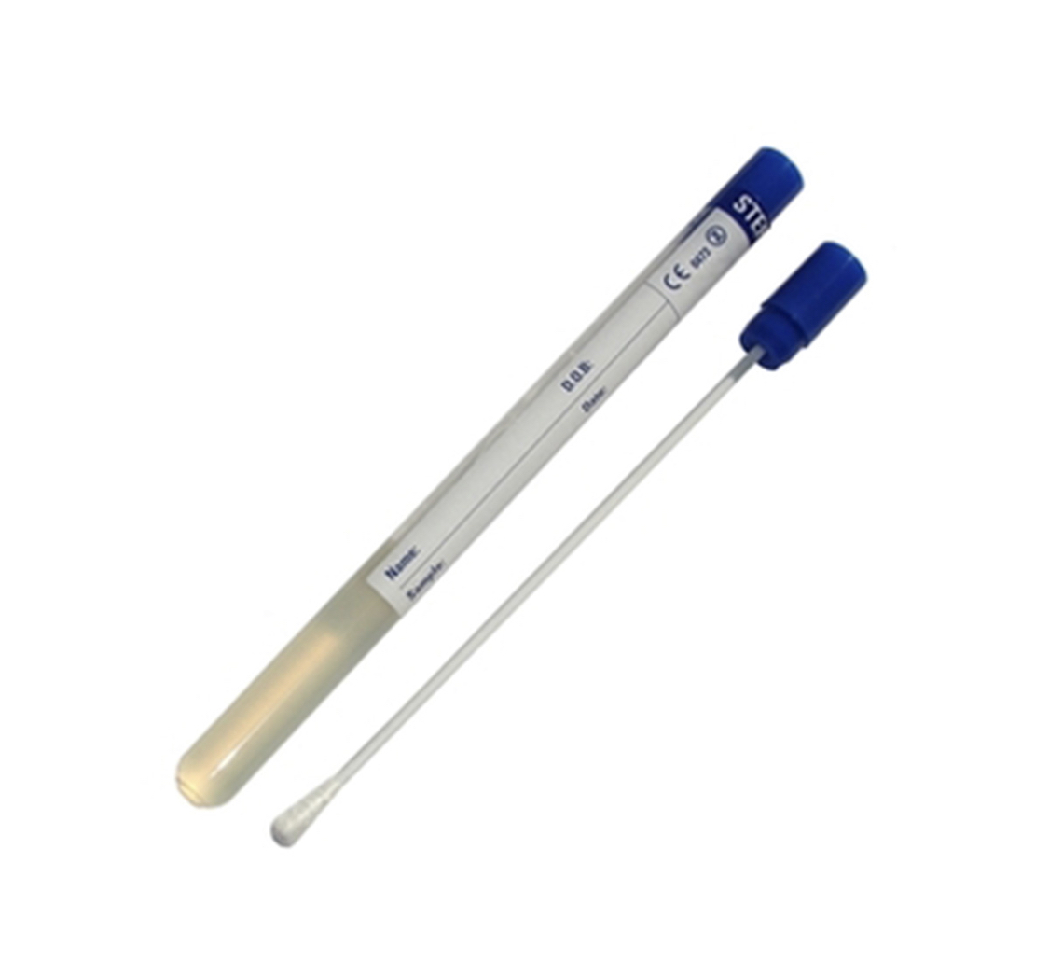
VAGINAL DISCHARGE
Diagnosis:
Microscopy

Slide 72
VAGINAL DISCHARGE
Cervical tests for Sexually transmitted infections
Neisseria gonorrhoeae and Chlamydia trachomatis must always be considered in sexually active women with vaginitis since women with STIs may go on to develop pelvic inflammatory disease and its potential complications

Slide 73
VAGINAL DISCHARGE- STI
Any woman with new or multiple sexual partners, a symptomatic sexual partner, or an otherwise unexplained cervical or vaginal discharge should be tested for Neisseria gonorrhoeae and Chlamydia trachomatis
Symptoms of PID include pelvic/abdominal pain, abnormal vaginal bleeding, and dyspareunia
On examination: abdominal tenderness, uterine tenderness, adnexal or cervical motion tenderness

Slide 74
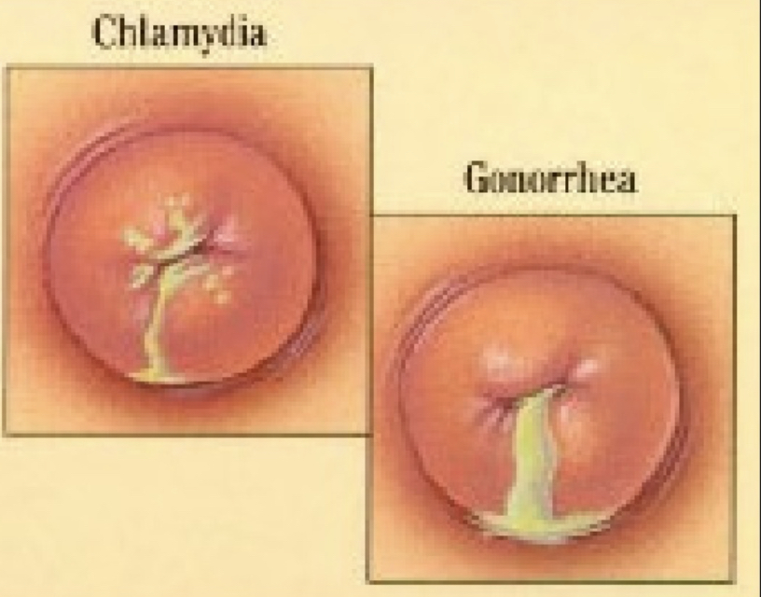
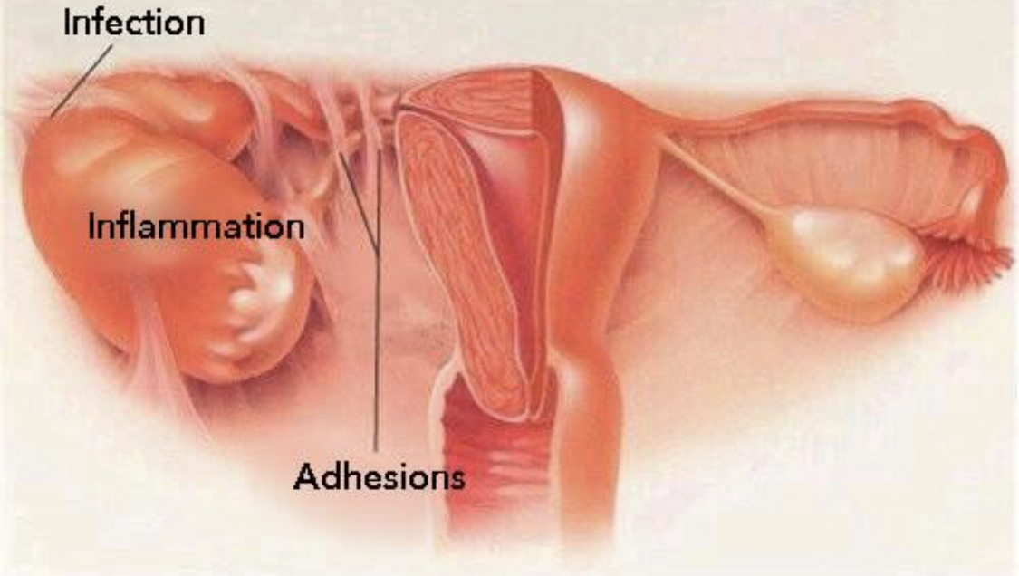
VAGINAL DISCHARGE- STI
Diagnosis

Slide 75
Pelvic Inflammatory Disease outpatient management
Recommended Regimens:
Ceftriaxone 500mg IM single dose followed by oral doxycycline 100mg twice daily plus metronidazole 400mg twice daily for 14 days
Oral ofloxacin 400mg twice daily plus oral metronidazole 400mg twice daily for 14 days
Alternative Regimens:
Ceftriaxone 500 mg IM followed by azithromycin 1 g/week for 2 weeks
Oral moxifloxacin 400mg once daily for 14 days

Slide 76
This was yesterday’s lecture by Abeer Al-Obaidan.. The best neurologist in Q8 راح ادفع ثمن غيابي عن محاضرتها.. دعواتكم.. وعسى هالسلايد يشفعلي

Slide 77
Chronic Pelvic pain (CPP)

Slide 78
Chronic Pelvic pain
CPP can be defined as intermittent or constant pain in the lower abdomen or pelvis of a woman of at least 6 months in duration, not occurring exclusively with menstruation or intercourse and not associated with pregnancy

Slide 79
Chronic Pelvic pain
Common gynecologic causes of CPP include endometriosis, prior pelvic inflammatory disease, ovarian cysts, adhesions, adenomyosis, and leiomyoma

Slide 80
CPP-EVALUATION
Women with acute pelvic pain, unstable vital signs, peritoneal signs, or suspected life-threatening pathology (e.g, ectopic pregnancy, bowel perforation) should be referred for emergent evaluation and management.

Slide 81
CPP- History
History should include urinary, gastrointestinal, gynecologic, musculoskeletal, sexual, and psychosocial symptoms

Slide 82
CPP- History
Provocative and palliative factors:
Pain that worsens with eating and/or improves with bowel movement is suggestive of a gastrointestinal process
Pain with urination or defecation can result from deep infiltrating endometriosis as well as functional and pathological disorders of the bladder or intestine (eg, painful bladder syndrome, irritable bowel syndrome, or inflammatory bowel disease).

Slide 83
CPP- History
Pain that is altered (increased or decreased) with specific activities or position changes suggests a musculoskeletal or vascular etiology (e.g, pelvic congestion syndrome)
Irritable bowel pain and painful bladder syndrome are typically associated with some degree of impaired visceral function

Slide 84
CPP- History
Radiation
Pelvic pain that isolates to a single area may be more commonly associated with an identifiable anatomic abnormality, such as ovarian cyst
Pain that starts in the back and then wraps around the torso and/or radiates to the upper thighs may be suggestive of pelvic girdle dysfunction.
Chronic nephrolithiasis, although will have classic renal colic with radiation of the pain to the flanks.
Chronic upper abdominal pain with radiation to the shoulders and back may be suggestive of chronic pancreatitis.

Slide 85
CPP- History
Sexual symptoms
dyspareunia
Pain that is isolated to the vaginal opening or vulva, and begins and is worsened with touch, is suggestive of vulvodynia or pelvic floor pain.
Deep pain, particularly with thrusting, is more suggestive of endometriosis or other deep pelvic pathology

Slide 86
CPP- History
Urinary symptoms
Women with interstitial cystitis/bladder pain syndrome often note pain with urination or a full bladder, urinary urgency, and/or urinary frequency

Slide 87
CPP- History
Bowel symptoms
Deep infiltrating endometriosis and acute colitis can present with associated symptoms such as diarrhea, constipation, blood or mucus in the stool, and/or abdominal bloating, although these nonspecific findings can also be seen in women with functional gastrointestinal disorders such as irritable bowel syndrome.
Women whose primary symptoms are more related to intestinal dysfunction than pain are referred for a gastroenterology consultation.

Slide 88
CPP- Psychosocial assessment
Psychiatric disorders
Women with CPP have been reported to have increased pain-catastrophizing thinking and greater anxiety, somatization, and depression compared with women without chronic pain
It is not clear if depression and CPP are causally related
Both depression and anxiety can generally worsen health outcomes and intensify pain independently of the actual biological process

Slide 89
CPP- Psychosocial assessment
Sleep disorder
Sleep disturbance is very common in chronic pain states and thus is crucial to identify.
Women with CPP can have sleep disorders that both result from and contribute to their pain and/or depression.

Slide 90
CPP- Psychosocial assessment
Abuse
A history of abuse (physical, emotional, sexual, or related to childhood neglect) appears to be more common in patients with CPP.
Studies of CPP have reported up to 47 percent of women with CPP disclose a history of physical and/or sexual abuse.

Slide 91
CPP- Psychosocial assessment
Opiate or substance dependency
Cross-sectional studies have reported that the prevalence of opioid dependence and/or abuse among patients treated with long-term opioids for chronic pain ranges from 3 to 26 percent.
Thus, women with CPP should be asked about their use of medications and other substances to treat pain
Patients with chronic pain often have a decreased responsiveness to opioid analgesics, such that higher than normal doses are required for adequate analgesia

Slide 93
CPP- P/E

Slide 94
CPP- P/E

Slide 95
CPP- P/E

Slide 96
CPP- TARGETED TESTING
Laboratory evaluation is done to exclude other causes for the patient's symptoms.
Women with pelvic pain should have a pregnancy test (if applicable)
Urinalysis, and tests for gonorrhea, chlamydia, and trichomonas .
Women with a urinalysis suggestive of infection then undergo urine culture.
Women with a recent travel history and gastrointestinal symptoms undergo testing for intestinal infection.

Slide 97
CPP- TARGETED TESTING
A pelvic ultrasound is typically performed for women with an enlarged uterus, an adnexal mass, other structural abnormality on physical examination, or symptoms of heavy or irregular bleeding.

Slide 98
CPP- TARGETED TESTING
MRI is helpful in women with suspected deep infiltrating endometriosis either by history (e.g, dyschezia or dyspareunia) or physical examination (e.g, rectovaginal nodules)
Computed tomography (CT) scans are infrequently utilized unless there is evidence of acute enteritis or colitis

Slide 99
Gynecologic causes of CPP
- Endometriosis - Pelvic congestion syndrome
- pelvic inflammatory disease (PID) - Ovarian remnant and residual ovary syndrome
- Adhesions - Malignancy
- Adenomyosis
- Leiomyoma

Slide 100
CPP- Endometriosis
Endometriosis, which is characterized by endometrial implants outside of the endometrial cavity, is a chronic disease that requires a lifelong management plan.
Women with endometriosis classically present during their reproductive years with pelvic pain (dysmenorrhea and dyspareunia, dysuria, dyschezia and nonmenstrual pelvic pain), infertility, or an ovarian mass

Slide 101
CPP- Endometriosis
Medical treatment options
Nonsteroidal anti-inflammatory drugs (NSAIDs)
Combined (estrogen and progestin) contraceptives
Progestins
Gonadotropin-releasing hormone (GnRH) agonists
Aromatase inhibitors

Slide 102
CPP- Endometriosis
Surgical treatment options
Surgical resection of endometriosis which can be:
Conservative (ablation or resection of endometriotic lesions)
Definitive (hysterectomy, with or without oophorectomy, in addition to resection of endometriosis)
Radical (removal of all visible implants at time of surgery)

Slide 103
CPP- Endometriosis
Surgical treatment options
Nerve transection procedures, including laparoscopic uterosacral nerve ablation (LUNA) and presacral neurectomy (PSN)

Slide 104
CPP- pelvic inflammatory disease (PID)
Pelvic inflammatory disease (PID) refers to infection of the upper genital tract in women, involving any or all of the uterus, fallopian tubes, and ovaries
It is often accompanied by involvement of the neighboring pelvic organs.
It results in endometritis, salpingitis, oophoritis, peritonitis, perihepatitis, and/or tubo-ovarian abscess.
The majority of PID cases (85 %) are caused by sexually transmitted pathogens

Slide 105
CPP- Adhesions
Most patients with symptomatic adhesions have a history of endometriosis, previous surgery or previous infection.
There is no evidence to support the division of fine adhesions in women with chronic pelvic pain
Division of dense vascular adhesion should be considered as this is associated with pain relief

Slide 106
CPP- Pelvic congestion syndrome
Refers to a condition in which characteristic symptoms of shifting location of pain, deep dyspareunia, postcoital pain, and exacerbation of pain after prolonged standing are associated with radiological findings of pelvic varicosities (dilated uterine and ovarian veins) that display reduced blood flow
One theory is that damage to the valves in the ovarian veins results in valvular incompetence leading to reflux and chronic dilation
However, incompetent and dilated pelvic veins are a common finding in asymptomatic women

Slide 107
CPP- Pelvic congestion syndrome
Hormonal treatment like Goserelin, Medroxyprogesterone acetate, or Etonogestrel implant
Embolization of ovarian veins
Sclerotherapy of the ovarian veins

Slide 108
CPP- Ovarian remnant and residual ovary syndrome
Ovarian remnant syndrome occurs in patients who have undergone bilateral oophorectomy and subsequently present with symptoms related to ovulatory function from ovarian tissue inadvertently left behind
Ovarian remnant syndrome is distinguished from the residual ovary syndrome, in which the ovary was intentionally preserved and subsequently develops pathology
The typical patient presents with cyclic pelvic pain and a mass, although the pain may be persistent with acute flare-ups.

Slide 109
CPP- Ovarian remnant and residual ovary syndrome
Surgical excision is recommended
Pharmacologic therapy is a reasonable option only for women with suspected ORS who have pelvic pain and have no pelvic mass

Slide 110
CPP- Malignancy
Ovarian cancer is the one that is most likely to cause diffuse pelvic symptoms, such as lower abdominal pain, discomfort, pressure, bloating, increased abdominal girth, constipation, lack of appetite, nausea or indigestion, irregular menstrual cycles or abnormal vaginal bleeding, low back pain, fatigue, urinary frequency, and/or dyspareunia

Slide 111
Urinary tract infection (UTI)

Slide 112
Urinary tract infection (UTI)
Urinary tract infections (UTIs) include cystitis (infection of the bladder/lower urinary tract) and pyelonephritis (infection of the kidney/upper urinary tract)
In women, the pathogenesis of UTIs begins with colonization of the vaginal introitus by uropathogens from the fecal flora, followed by ascension via the urethra into the bladder and, in the case of pyelonephritis, to the kidneys via the ureters.

Slide 113
UTI
Acute simple cystitis should be suspected in women who have acute symptoms of dysuria, urinary frequency or urgency, and/or suprapubic pain, particularly in the absence of vaginal symptoms (eg, vaginal pruritus or discharge).
The probability of cystitis is greater than 50 percent in women with any of these symptoms and greater than 90 percent in women who have dysuria and frequency without vaginal discharge or irritation

Slide 114
UTI- Management
If women have symptoms of UTI and their urine tests positive for both leucocytes and nitrites, send a midstream urine specimen for culture and analysis of antibiotic sensitivities. Prescribe an appropriate course of antibiotic treatment pending culture results

Slide 115
UTI- Management
If women have symptoms of UTI and their urine tests negative for either leucocytes or nitrites, send a midstream urine specimen for culture and analysis of antibiotic sensitivities. Consider the prescription of antibiotics pending culture results

Slide 116
UTI- Management
If women do not have symptoms of UTI, but their urine tests positive for both leucocytes and nitrites, do not offer antibiotics without the results of midstream urine culture

Slide 117
UTI- Management
First-line antimicrobial options:
Nitrofurantoin
Trimethoprim-sulfamethoxazole
Fosfomycin
Pivmecillinam (penicillin)
Alternative antimicrobial options:
Amoxicillin-clavulanate
Third generation cephalosporins (e.g Cefpodoxime, Cefdinir)
First generation cephalosporins (e.g Cefadroxil)

Slide 118
Recurrent UTI
Recurrent urinary tract infection is the term used to describe a UTI that follows the resolution of a previous UTI (both symptoms and bacteriuria).
A woman is described as having recurrent UTIs if she has two or more episodes of UTIs over a 6-month period, or three or more episodes of UTIs over a 12-month period.

Slide 119
Recurrent UTI
Recurrent infections may be due to relapse with the original organism or reinfection with the same or a different organism.
Generally, a 2-week period is used to differentiate between reinfection and relapse when the same microorganism is involved.
Reinfection is the most common cause for recurrent UTIs.

Slide 120
UTI- General treatment measures
Increased fluid intake (up to two litres of plain water)
Double urination – deliberately trying to empty the bladder after urination seems complete
Postcoital voiding
Avoiding nylon underwear and vaginal deodorants
Cranberry products

Slide 121
UTI in pregnancy
Pregnant women are thought to be at an increased risk of asymptomatic bacteriuria and symptomatic urinary sepsis as a result of increased urinary stasis and vesicoureteric reflux during pregnancy.
The incidence of asymptomatic bacteriuria varies between 2% and 10% in pregnant women.

Slide 122
UTI in pregnancy
The prevalence appears to be greatest between the 9th and 17th weeks of pregnancy, with the 16th week being the optimal time for a single screening test (microscopy and culture of a midstream sample of urine).
Symptomatic urinary sepsis occurs in up to 40% of untreated women with covert bacteriuria

Slide 123
UTI in pregnancy
Treatment of asymptomatic bacteriuria in pregnancy reduces the risk of developing pyelonephritis and its associated complications.
A 7-day course of treatment with a broad spectrum antibiotic, such as a cephalosporin, is recommended.

Slide 124
UTI in pregnancy
Symptomatic cystitis occurs in approximately 30% of women with untreated asymptomatic bacteriuria.
Symptoms include urinary frequency and urgency, dysuria, and suprapubic pain in the absence of a systemic illness.
No single antibiotic has been shown to be more successful than another.
Most women will receive empirical treatment with broad-spectrum antibiotics prior to culture results and their treatment regimen should be reviewed with the results and adjusted accordingly.

Slide 125
UTI in pregnancy
Pyelonephritis complicates approximately 2% of pregnancies, mostly during the second and third trimesters.
Symptoms include backache, fever, rigors, costovertebral angle tenderness, symptoms of acute cystitis, nausea and vomiting.
Women may also present with threatened preterm labour.
Treatment includes hydration and intravenous broad spectrum antibiotics.

Slide 127
Recurrent UTI in pregnancy
In women who have three or more episodes of recurrent cystitis during pregnancy, antimicrobial prophylaxis for the duration of pregnancy is a reasonable strategy to prevent additional episodes.
Ideally, low-dose nitrofurantoin (50 to 100 mg orally) or cephalexin (250 to 500 mg orally) can be used

Slide 128
Antibiotics in pregnancy

Slide 129
Antibiotics in pregnancy
Antibiotics that you may prescribe safely during pregnancy include:
Penicillins
Cephalosporins
Some macrolides (erythromycin and azithromycin)
Clindamycin
Metronidazole

Slide 130
Antibiotics in pregnancy
Antibiotics with known or potential teratogenic effects include:
Aminoglycosides: carry a risk of fetal ototoxicity and nephrotoxicity
Tetracyclines are generally contraindicated in pregnancy because of their adverse effects on fetal bone and teeth
Fluoroquinolones (Ciprofloxacin) should be avoided during pregnancy because they are toxic to developing cartilages

Slide 131
Antibiotics in pregnancy
Antibiotics with known or potential teratogenic effects include:
Use of “trimethoprim-sulfamethoxazole” is typically limited to mid-pregnancy, avoiding the first trimester and near term.. Trimethoprim is generally avoided in the first trimester because it is a folic acid antagonist, and sulfamethoxazole should be avoided in the last days before delivery because it increases the risk of kernicterus

Slide 132
Antibiotics in pregnancy
Antibiotics with known or potential teratogenic effects include:
Nitrofurantoin should be avoided in the first trimester IF another antibiotic that is safe and effective is available, and also near term because it has also been reported to cause hemolytic anemia in the mother and fetus with G-6PD deficiency

Slide 133
Pain management in pregnancy

Slide 134
Pain management in pregnancy
Acetaminophen (paracetamol):
Safe at all stages of pregnancy, with no increasing risks of pregnancy loss, congenital anomalies or neurodevelopmental delay.

Slide 135
Pain management in pregnancy
Nonsteroidal anti-inflammatory drugs
The risks and benefits of using nonsteroidal antiinflammatory drugs (NSAIDs) for treatment of pain or fever depend on the dose, gestational age, and duration of therapy
NSAIDs may be used from the beginning of the second trimester to week 30 of gestation.
From week 30 of gestation onward, NSAIDs should be avoided because of increased risk of premature closure of the ductus arteriosus, with the exception of low-dose aspirin being given for obstetric-related indications.

Slide 136
Pain management in pregnancy
Opioids:
There is limited information on the effects of long-term (≥1 month) prescription opioid use during pregnancy.
Neonatal withdrawal syndrome is a major concern when the mother has used opioids long-term and in the week prior to delivery
The safety of short-term opioid use is also unclear
Until better data are available, during the first month of embryonic development when neural tube development occurs, shared decision-making involves balancing the small potential increase in incidence of neural tube defects with the need for relief of moderate to severe pain, given the frequent lack of effective alternative analgesics.

Slide 137
Management of Sexual Assualt

Slide 138
Management of Sexual Assualt
Assess and treat injuries.. Check for genital trauma especially if patient gave history of sharp object penetration of the vagina or anus. Check for other injuries like head trauma
Pregnancy: If the patient is not on any contraceptive method.. offer emergency contraception. Some will work within 3 days of unprotected sexual intercourse. Others will work within 5 days.

Slide 139
Management of Sexual Assualt
STD: Give antibiotic prophylaxis (for gonorrhoea and chlamydia). The recommended regimen is 500 mg ceftriaxone IM, metronidazole 2g PO, and azithromycin 1g PO as a single dose.
HIV (Post-exposure prophylaxis): should be started as soon as possible, ideally within the first 24 hrs.

Slide 140
Management of Sexual assualt
Give hepatitis B vaccination
HPV vaccination
Psychosocial support!

Slide 141
Thank you

